Slide 1


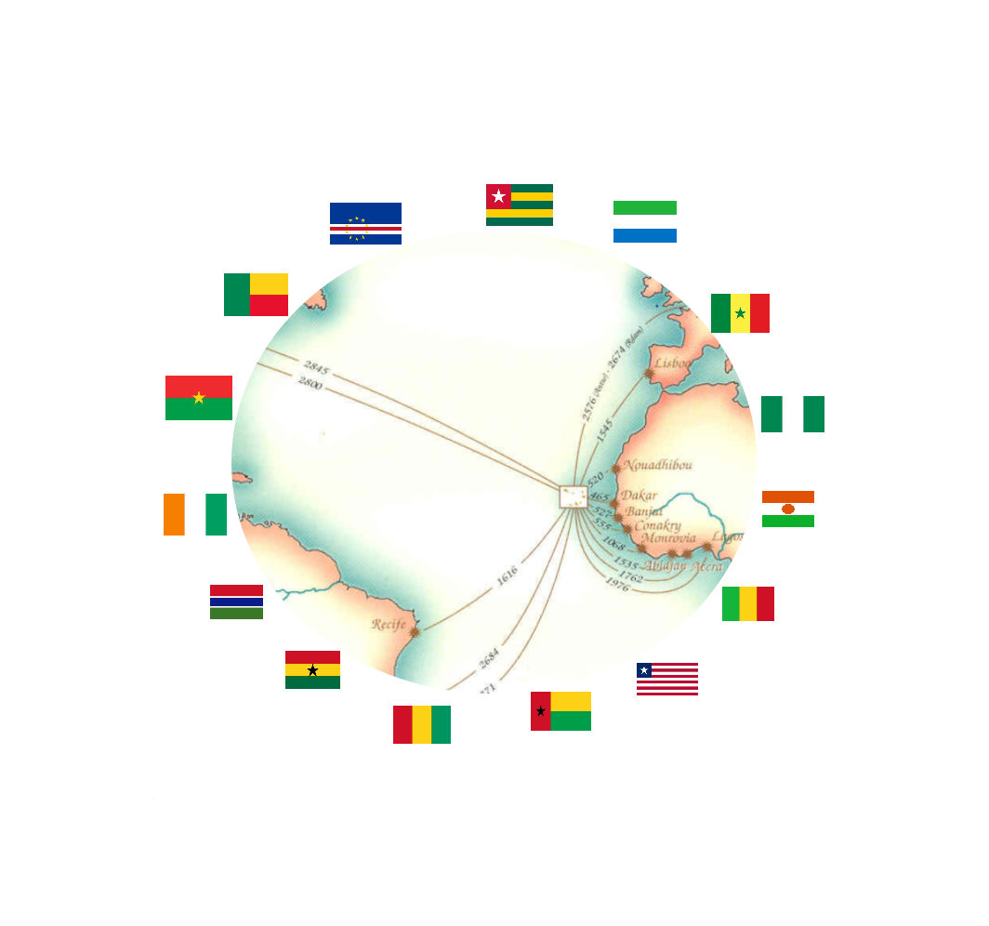
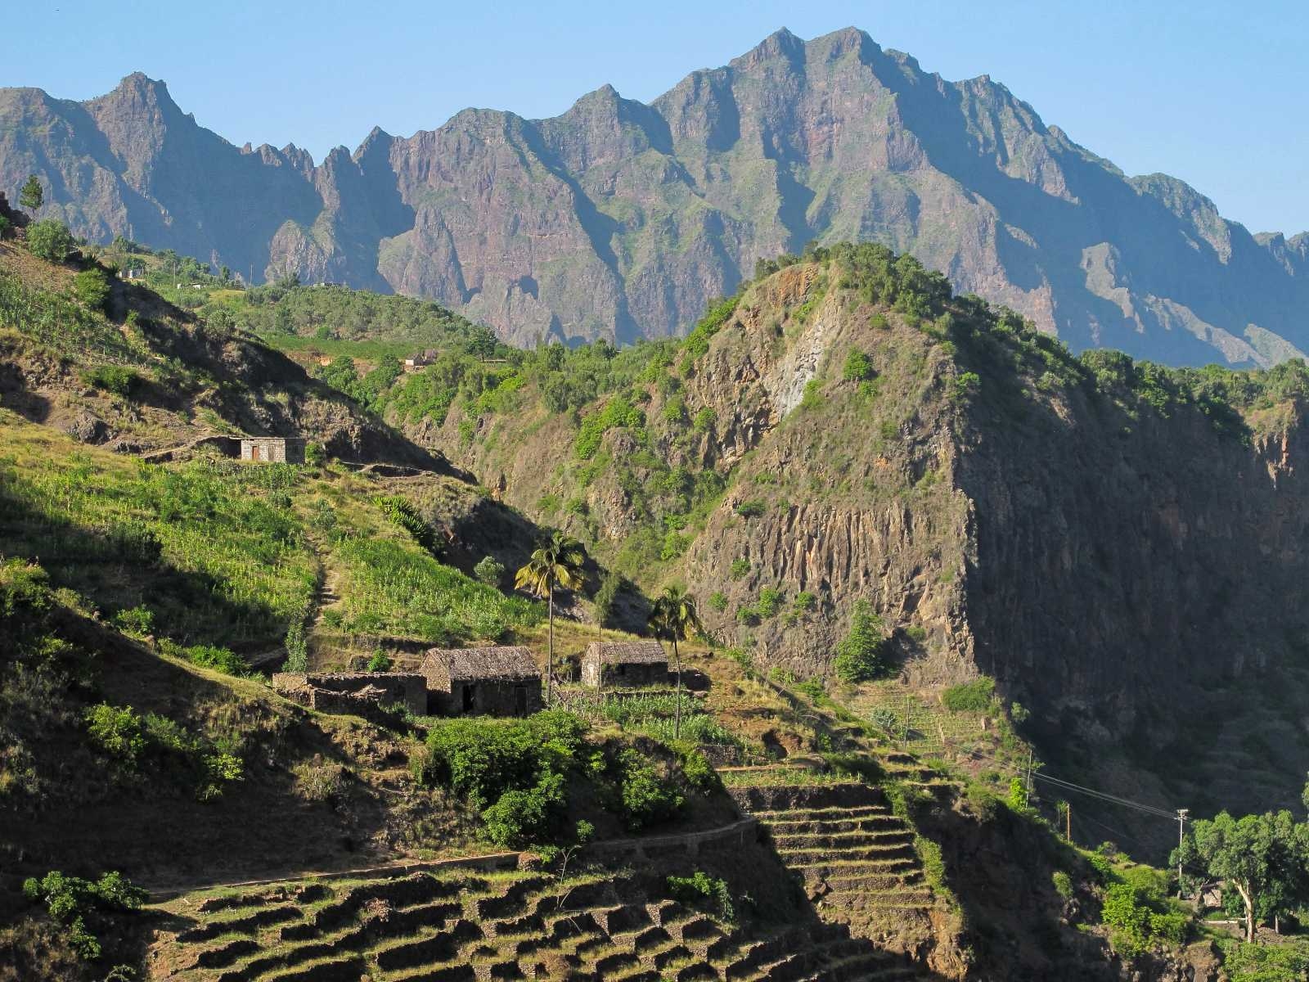
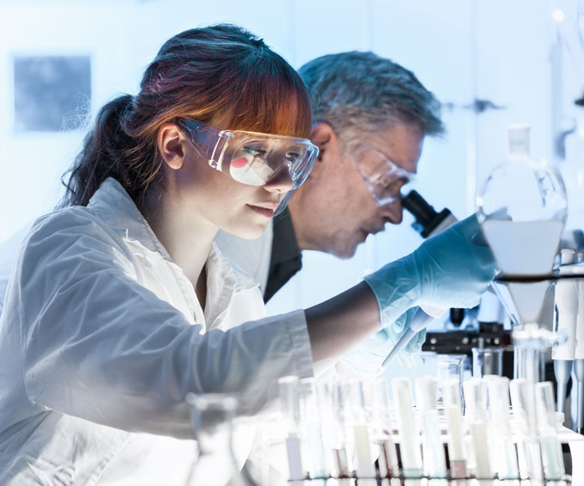
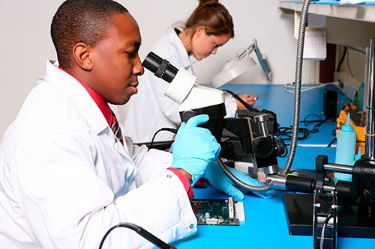
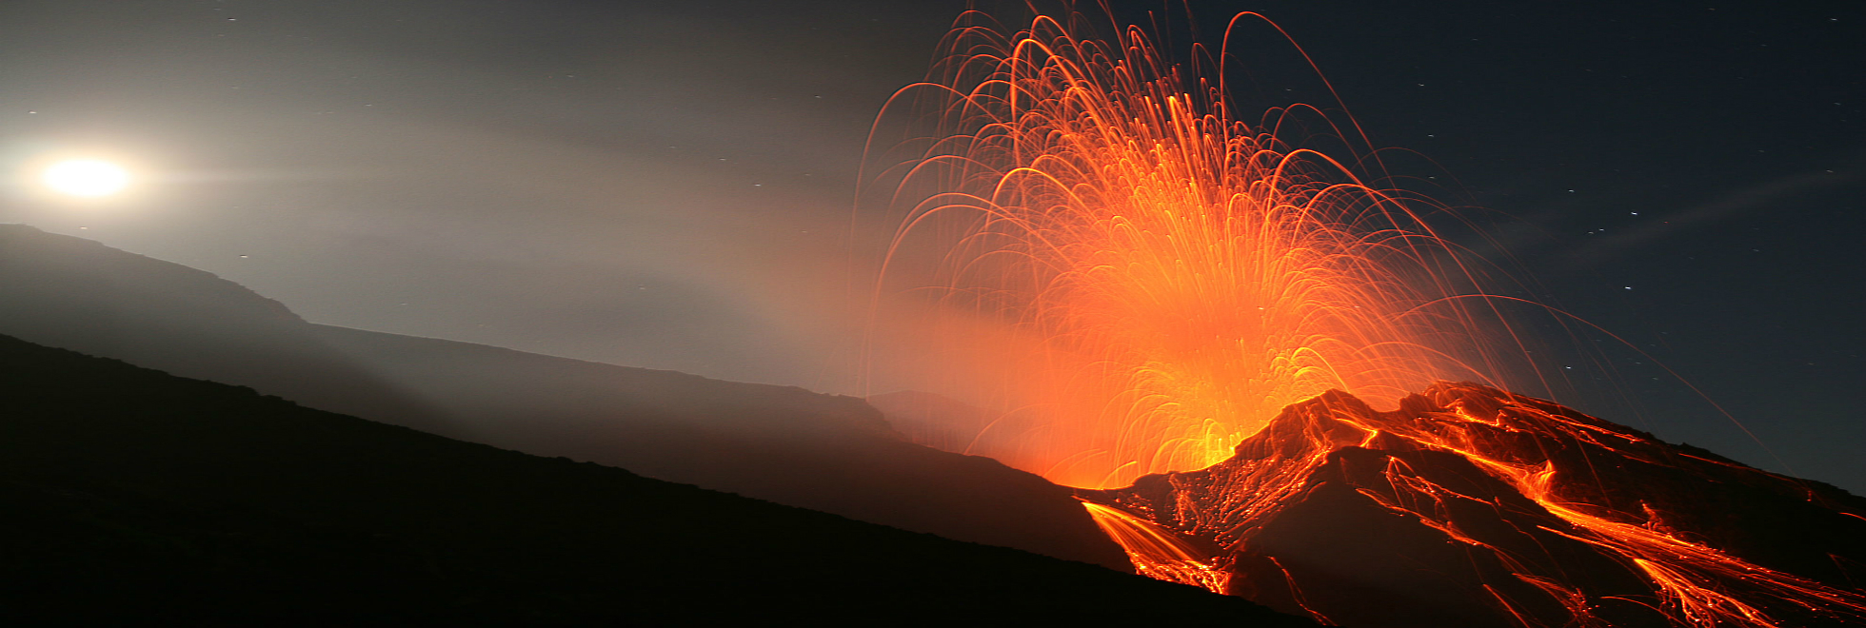

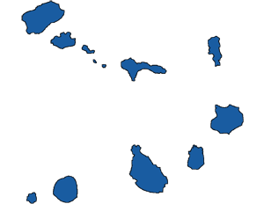
BASALT CONFERENCE
ROUND TABLE OF INTEGRATION AND DEBATEs
discussION GUIDE
CAPE VERDE
MARCH 16
2022
Pag 1
www.basaltconference.com
Ref.E-EICV.01/2022/VD-E.01

Slide 2
Item | Pag | Item | Pag
Frame | 3 | Round Table Discussion Guide | 9
Fertilizer consumption in ECOWAS | 4 | How debates work | 10
International fertilizer consumption | 5 | Planned text | 11
Purpose of the Round Table | 6 | Date and place of realization | 11
Round Table Programme | 7 | Contacts | 12
The participants | 8
ROUND TABLE
DISCUSSION GUIDE
MARCH 16
______■______
2022
PRAIA
CABO VERDE
www.basaltconference.com
Focused on environmental protection
PLAN
Focused on innovation
Actions
Résultats
Realistic
Strategic
Revaluation
Pag 2
www.basaltconference.com
Ref.E-EICV.01/2022/VD-E.01

Slide 3
ROUND TABLE ON INTEGRATION AND DEBATEs
BASALT POWDER IN AGRICULTURE
FOOD QUALITY AND ENVIRONMENTAL PROTECTION
FRAME
Agricultural land can be degraded for many reasons, including: shifting cultivation (or agricultural nomadism), overgrazing, over-exploitation of soils, excessive deforestation, soil salinization after years of intensive irrigation, repeated soil flooding, as well as by natural wear process of rocks (weathering), among others. In this sense, it is necessary to redouble our efforts, to take measures and adopt practices to restore degraded soils and, consequently, restore their fertility.
In June 2006, African leaders gathered in Abuja, Nigeria, to take action to highlight the importance of fertilizers for an African green revolution. The main outcome of this summit confirmed the commitment of African Heads of State to achieve a rapid increase in the use of fertilizers on the continent, increasing the average from 9 kilograms per hectare in 2006 to at least 50 kilograms per hectare in 2015, a target that even to this day, 2021, has not yet been met, as shown by the data presented in the following two pages of this document.
The average fertilizer consumption in Africa is 10 kg / ha, about 10% of the world average, and almost 20 times less than the Asian average (191 kg / ha) and 9 times less than the Latin American average (94 kg / ha). The low use of fertilizers in Africa is due to the high price of fertilizers, given the purchasing power of farmers and the lack of alternatives available to producers and farmers.
Over the past decades, relevant applied research centers, universities and governments have devoted themselves to finding alternatives to traditional chemical fertilizers, both with a view to increasing agricultural profitability and the quality of the food produced and Environmental protection. The application of rock powder in agriculture has proven to be an appropriate solution for agriculture to meet the challenges facing contemporary society, both in the present and in the future.
Basaltic rocks have a composition rich in chemical elements which are nutrients for plants, making them suitable for use in agriculture, improving soil fertility, protecting the environment, increasing agricultural profitability and greatly improving quality of food produced.
The use of rock powders to fertilize the soil is an age-old technique (the Inca and Egyptian civilizations already relied on the use of rock by-products for soil fertilization), which has been left out, by expanding the use and supply of soluble fertilizers. However, the rise in the prices of these products has left a growing number of farmers without the possibility of fertilizing the soil and thus guaranteeing a production compatible with their efforts and the investments made. Technological developments in recent decades have allowed the production of rock powders for agriculture at a cost compatible with the purchasing power of the entire population.
It is in this context that a «Round Table of Integration and Debates» will take place, bringing together some of the most eminent international researchers in the field of the use of rock powder for the fertilization of agricultural soils. Professionals from the agricultural sector will also participate in this round table: professionals in environmental protection; nutrition professionals; academics; researchers; Municipal managers and national and international development decision-makers.
In this document, it is presented, in addition to the program of the aforementioned «Round Table», the Guide for Discussion and Debates which will take place on March 16, 2022.
.
ROUND TABLE
DISCUSSION GUIDE
MARCH 16
______■______
2022
PRAIA
CABO VERDE
Pag 3
www.basaltconference.com
Ref.E-EICV.01/2022/VD-E.01

Slide 4
Pag 4
www.basaltconference.com
Ref.E-EICV.01/2022/VD-E.01

Slide 5
Pag 5
www.basaltconference.com
Ref.E-EICV.01/2022/VD-E.01

Slide 6
Purpose of the round table
The objective of the «Roundtable on Integration and Debates» is to allow scientific and technological knowledge and the sharing of national, regional and international experiences in the context of the use of basalt powder in the Fertilization of agricultural soils and its advantages with the aim of increasing agricultural profitability, the quality of food produced and environmental protection.
The Round Table reinforces the emphasis placed on the scientific and technological foundations of «Rochagem» as an adequate instrument to respond to food security, healthy eating and environmental protection.
The Round Table also aims to provide public and private decision-makers with a set of tools and knowledge that can support policies oriented towards good practices in profitable and sustainable agriculture based on “Rochagem” technology, particularly in the fields of research scientist; legislative processes; the regulatory and quality control processes of foods produced on the basis of the use of rock powders in the fertilization of agricultural soils.
ROUND TABLE
DISCUSSION GUIDE
MARCH 16
______■______
2022
PRAIA
CABO VERDE
Pag 6
www.basaltconference.com
Ref.E-EICV.01/2022/VD-E.01

Slide 7
PROGRAMME
THE ROUND TABLE PROGRAM
BASALT POWDER IN AGRICULTURE
FOOD QUALITY AND ENVIRONMENTAL PROTECTION
«ROUND TABLE OF INTEGRATION AND DEBATES»
DAY 16 March 2022
ACCREDITATION : From 7:30
08:00 – 09:30
09:30 – 10:00
10:00 – 10:30
10:30 – 12:00
12:00 – 12:30
12:30 – 14:00
14:00 – 15:30
15:30 – 16:00
16:00 – 16:30
16:30 – 18:00
18:00 – 18:30
20:30 – 23:00
Theme I: Research, Legislation, Regulation and Technology of «Rochagem»
Moderator: CILSS - Permanent Interstate Committee for Drought Control in the Sahel
Interventions of Experts:
■ Prof. Suzi Huff Theodoro – Researcher at the University of Brasilia
■ Prof. Émérite Peter van Straaten – Research Fellow at the University of Guelph - Canada
■ Prof. Eder de Souza Martins – Researcher at EMBRAPA (Brazilian Society for Agro-Livestock Research)
■ Mme Joanna Campe, Founder et executive director of RTE
Debates
Coffee break
Theme II: Fertilization of agricultural soils and protection of the environment
Moderator: Cheikh Anta Diop University of Dakar – Senegal
Interventions of Experts:
■ Directorate of Agriculture and Rural Development of ECOWAS
■ ARAA - Regional Agency for Agriculture and Food
■ University of Cape Verde
■ Prof. Emeritus Othon Henry Leonardos - Researcher at the University of Brasilia
■ National Chamber of Agriculture of Cote d'Ivoire - CNACI
Debates
Coffee break
heme III: The Agromineral Potential of Basalt and its specificities
Moderator: Ghana Agricultural Chamber of Commerce – Ghana
Interventions of Experts:
■ MSc. Magda Bergmann - Researcher of the Geological Survey of Brazil
■ MSc. MSc. Andrea Sander - Researcher of the Geological Survey of Brazil
■ Prof. Emeritus Peter van Straaten - Research Fellow at the University of Guelph - Canada
■ University of Yaoundé - Cameroon
Debates
Lunch
Theme IV: Agricultural profitability and quality control of food produced
Moderator: University of Cape Verde
Interventions of Experts:
■ FAO – Food and Agriculture Organization of the United Nations
■ ENSA - National School of Agronomy of Yamoussoukro – Côte d’Ivoire
■ Food and Applied Nutrition Department (DANA) - Benin
■ Prof. Bernardo Knapik - Researcher at Estadual do Paraná University - Brazil
Debates
Closing ceremony of the International Conference
Welcome dinner «THE FLAVORS OF ECOWAS»
ROUND TABLE
DISCUSSION GUIDE
MARCH 16
______■______
2022
PRAIA
CABO VERDE
Pag 7
www.basaltconference.com
Ref.E-EICV.01/2022/VD-E.01

Slide 8
PARTICIPANTS
The «Round Table on Integration and Debates» will offer a relevant opportunity for dialogue between researchers of internationally recognized merit and high-level representatives of national and international institutions; those responsible for agriculture, environment and nutrition in the various countries; researchers; Universities and development agents in general.
The «Round Table of Integration and Debates» will thus be open to all participants in the International Conference entitled «BASALT CONFERENCE» and to all other parties interested in this subject. Representatives of non-governmental organizations will also be invited to participate.
ROUND TABLE
DISCUSSION GUIDE
MARCH 16
______■______
2022
PRAIA
CABO VERDE
Pag 8
www.basaltconference.com
Ref.E-EICV.01/2022/VD-E.01

Slide 9
round table discussion guide
Interventions at the «Round Table of Integration and Debates» should focus on the use of rock dust in agriculture and its scientific and technological specificity. Among these scientific and technological specificities, the speakers will be able to focus their attention on the following points:
  a) Current and historical realities of the use of rock dust in the fertilization of agricultural land;
  b) The general orientations and trends of public policies, scientific, technological and environmental factors which support the fundamental principles of the use of rock powder in the fertilization of agricultural soils;
  c) The different categories and types of nutrients that incorporate the chemical composition of basalt giving it the natural conditions of fertilizers;
  d) Public policies for scientific and technological research, legislative process, regulation and control of the use of basalt powder in agriculture;
  e) The mechanisms and their respective roles and functions in the formulation, implementation, control and monitoring of the quality of foods produced based on the use of rock powder in the fertilization of agricultural soils;
  f) The relationship between the use of rock powder in the fertilization of agricultural soils and the agricultural profitability and quality of the food produced;
  g) The types and qualities of agricultural soils likely to benefit and the potential for using the rock powder from the respective fertilization;
  (h) Trends in present and future development of the use of rock powder in agriculture;
  The cause and effect relationship between the use of rock powder in the fertilization of agricultural soils and its effects on the preservation of the environment.
After the interventions of the specialists in each theme forming part of the program of the «Round Table of Integration», a period of debate will open during which all present will be able to intervene to present their points of view, as well as to confront the specialists to issues strictly related to the topics under discussion.
ROUND TABLE
DISCUSSION GUIDE
MARCH 16
______■______
2022
PRAIA
CABO VERDE
Pag 9
www.basaltconference.com
Ref.E-EICV.01/2022/VD-E.01

Slide 10
How the debates work
To allow dialogue between the participants of the Round Table, in each Theme, there will be two moments of interventions: a first moment is reserved for the members of the Panels who will carry out the respective interventions; and, after the interventions of Panel members, all participants will be invited to intervene.
The discussions will lead to a free exchange of experiences, lessons learned and good practices in the use of rock powder in the fertilization of agricultural soils, and an informal overview of the challenges facing the massive use of the soil rock powder in the fertilization of agricultural soils. These discussions will be animated dynamically in order to preserve their interactive character and will be managed by a Moderator who integrates the team of each Panel / Theme.
Participants will be invited by the moderator to make short interventions / comments, ask questions and respond to the experts, and not just read a pre-prepared statement, thus taking the form of a dialogue between experts and participants. The intervention of each participant must not exceed three minutes, in order to allow a maximum of participants to intervene.
ROUND TABLE
DISCUSSION GUIDE
MARCH 16
______■______
2022
PRAIA
CABO VERDE
Pag 10
www.basaltconference.com
Ref.E-EICV.01/2022/VD-E.01

Slide 11
Planned text
The Editorial Board will summarize the presentations and discussions during the Round Table and will be reproduced in the report of the International Conference. This document will serve as a guide for the work that will follow in relations with public, private and international institutions, with a view to the introduction of basalt powder in agriculture as a fertilizer in countries that may express their interest in this technology («Rochagem» technology).
ROUND TABLE
DISCUSSION GUIDE
MARCH 16
______■______
2022
PRAIA
CABO VERDE
DATe AND PLACE OF REALIZATION
The «Round Table of Integration and Debates» will be held in the Municipality of Praia, Island of Santiago, Cape Verde, on March 16, 2022, from 8:00 a.m. to 18:30 p.m., as part of the Conference Program International, titled «BASALT CONFERENCE».
Pag 11
www.basaltconference.com
Ref.E-EICV.01/2022/VD-E.01

Slide 12

BASALT CONFERENCE
roUnd TABLE
OF INTEGRAtion AND DEBATES
ROUND TABLE
DISCUSSION GUIDE
MARCH 16
______■______
2022
PRAIA
CABO VERDE
BASALT CONFERENCE
Apartado nº 1042
Código Postal nº 7600
Praia
República de Cabo Verde
WhatsApp:+351 964 406 800
Viber:+351 964 406 800
Skype: setimocontinente
info@atlanticbusinessforum.com
www.atlanticbusinessforum.com
www.emergys.tech
Pag 12
www.basaltconference.com
Ref.E-EICV.01/2022/VD-E.01

