Slide 1

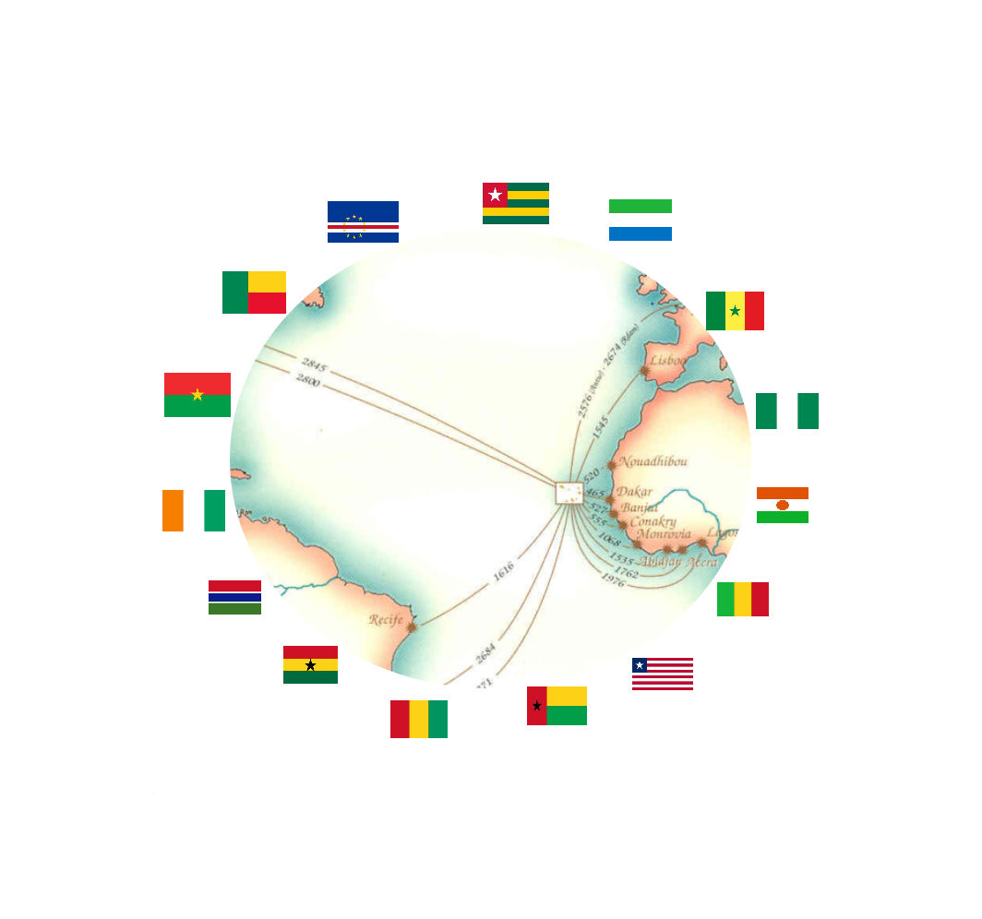
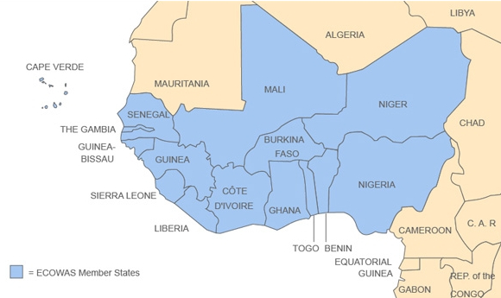


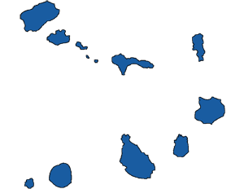
WWW.EMERGYS.TECH
Cabo verde
26 september
To
01 october
2022
PRAIA
SANTIAGO ISLAND
CABO VERDE
ATLANTIC BUSINESS FORUM
CAPE VERDE
A
LINK WITH MARKETS OF EXCELLENCE
Ref.E-EICV.01/2022/VD-E.01

Slide 2
WWW.EMERGYS.TECH
Cabo verde
26 september
To
October
2022
PRAIA
SANTIAGO ISLAND
CABO VERDE
Index | Pag | Index | Pag
Preamble | 3 | Position in the region of economic integration | 13
Summary of Atlantic Business Forum | 4 | Markets | 14
Atlantic Business Forum Program | 5 | The guest country | 15
Business Round preparation and execution steps | 6 | The geo-economic dimension of Cape Verde | 16
Spin-offs- University-Business Cooperation | 7 - 8 | Regional cooperation and integration | 17
Deadlines for expression of interest and registration | 9 | How to participate | 18
Steps of regional integration | 10 | Contacts | 19
Cape Verde a link with the markets of excellence | 11 - 12
Ref.E-EICV.01/2022/VD-E.01

Slide 3
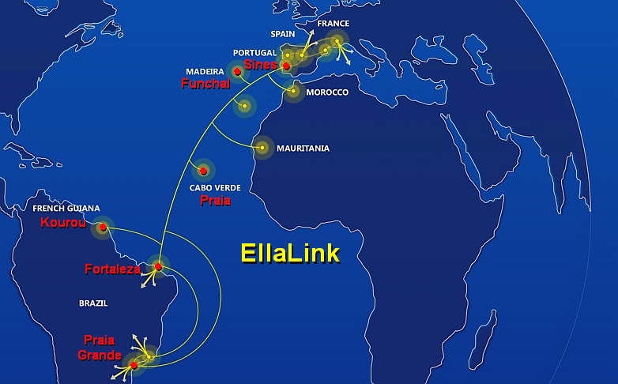


PREAMBLE
The Cape Verde archipelago was so named because it is located off the African promontory of the same name, 310 nautical miles, about 499 km from the African continent and about 36 hours of sea navigation and 50 minutes of air transport.. Cape Verde is part of a regional economic bloc, ECOWAS, with more than 407 million consumers and 221,724,638 internet users, which represents a penetration rate of 54.4% of the population, covering an area of 5,114,195 Km2.
Cape Verde is made up of 10 islands and 16 islets, occupying an area of ​​4,033 km2, with an exclusive economic zone of 734,265 km2. It is estimated that the number of Cape Verdean citizens residing in the diaspora, on the five continents, is much higher than those residing on the national territory. Estimating that the total Cape Verdean population exceeds two (2) million inhabitants. The Cape Verdean diaspora population is densely concentrated in the United States of America and Europe.
Cape Verde has a strategic geographical centrality, internationally recognized since 1494, at the crossroads of the African, European and American continent. Over time, it has been one of the most important routes for international trade to and from Europe, to Africa, America and Asia.
The present and the future in the development of international business, as well as in the relations between Peoples and Nations, is fundamentally and increasingly marked by the structuring factor, as a consequence of the new economy of the near future: the digital economy and data economy. Cape Verde is the route of one of the most important technological highways, which, thanks to an advanced optical fiber submarine cable, meets the growing need for data traffic between Europe, the Economic Community of West African States, ECOWAS, and Latin America. Directly linking Cape Verde with the corporate community and the business world, thus involving some of the most relevant international markets such as Brazil, ECOWAS and Europe, with immediate benefits for economic operators in the relevant markets.
Cape Verde is therefore a country open to the world, connected to the world and with strong links with markets of excellence, being a country absolutely prepared to provide economic operators, of all origins, with full access to markets, to namely the Single African Continental Free Trade Market, ALCCA, with 1.3 billion consumers. Cape Verde's strategic geo-economic position is internationally recognized, integrating markets and benefiting from positions in the most relevant economic regions.
Cape Verde thus has all the conditions and instruments of prime importance to promote the digital transition, welcome companies and business communities, refine borders and overcome the natural barriers of insularity, facilitating access to operators. economic, national and foreign, with whom they wish to operate from Cape Verde, without restriction, in markets of excellence, creating scales for companies of all sizes and all sectors of activity.
It is in this context that the business event called ATLANTIC BUSINESS FORUM takes place, under the slogan: «Cape Verde a link with markets of excellence», which aims to bring together companies, industries, investors, importers, exporters, economic operators in general., from all sectors and all origins, as well as institutions that are strongholds of development, focused on markets with high potential and opportunities, such as ECOWAS, l 'European Union (EU / GSP +), Brazil and the United States of America (AGOA).
SENEGAL
Pag 3
Ref.E-EICV.01/2022/VD-E.01

Slide 4
WWW.EMERGYS.TECH
EXECUTIVE SUMMARY OF THE PROGRAM
In September 2022, Cape Verde is hosting an International Business Forum, entitled «Atlantic Business Forum», under the slogan: «Cape Verde - a link with markets of excellence». In each edition of the Forum, there will be a specially invited country. In the 2022 edition it is Brazil.
■ Date of the event: September 26 – October 01, 2022;
■ Duration of the event: 3 days;
■ Location: City of Praia - Island of Santiago - Cape Verde;
■ The final program will be adjusted according to the profile of the registered participants;
■ Entities involved: local authorities, Embassies, investment agencies, companies, national and international financial institutions, local and external chambers of Agriculture, Commerce and industry, universities, scientific and technological institutions; Cooperation and Development Agencies; economic operators, in general, in all sectors of economic and entrepreneurial activity.
■ Participation in the International Business Forum, including:
  » Business Round on October 01, 2022 from 8:15 am to 7:00 pm and includes the presentation of SPIN-OFF;
  » Networking events;
  » Product and service presentation sessions by participating companies;
  » Presentation of business and partnership opportunities in each ECOWAS country;
  » Presentation of business opportunities and commercial partnerships with participating companies;
  » Identification of business opportunities in the following sectors: trade, industry, tourism, agriculture, logistics, food industry and ICT;
  » Interaction with participating chambers of commerce and industry.
The Business Forum entitled «Atlantic Business Forum» is structured in:
  » Networking Events;
  » Presentation of Business and Partnership opportunities in each ECOWAS Country;
  » Presentation of Business and Partnership opportunities with companies from different countries;
  » Identification of business opportunities in the following sectors: commerce, industry, tourism, agriculture, logistics, agri-food and ICT;
  » Local Chambers of Agriculture, Commerce and Industry.
The Business Forum entitled «Atlantic Business Forum» is structured in:
■ Three (3) Business Opportunities Presentation Sessions in each ECOWAS member country;
■ An economic, financial and entrepreneurial workshop with three (3) thematic panels:
» Panel I: «Private sector financing in ECOWAS»; and
  Painel II: «Taxation and Tax Incentives for Companies in the ECOWAS area».
» Panel III:«BRAZIL: The Potential and the Opportunity of Technical and Entrepreneurial Cooperation»
■ Six (6) thematic conferences under the slogan: «CAPE VERDE A LINK WITH MARKETS OF EXCELLENCE»:
  » Conference I:«Access to the ECOWAS preferential market»;
  » Conference II: «The potential of information and communication technology as a way of integrating Cape Verde into theMarkets of Excellence: The ECOWAS Market as a Case Study»;
  » Conference III:«Access to the preferential market of the United States of America»;
  » Conference IV:«Development of the digital economy in ECOWAS: an opportunity for the digital transition in the entrepreneurial development, market innovation and regional integration»; and
  » Conference V:«Access to the preferential market of the European Union»;
  » Conference VI:«BRAZIL: The Potential and the Opportunity of Technical and Entrepreneurial Cooperation»
■ A Business Round, previously scheduled, will take place on Obctobre 01, 2022. Each participating company will have a predefined deadline for the presentation of the products, services and business partnership opportunities that it wishes to submit to other participants, and also the SPIN-OFF presentations.
During the preparation, execution and initiatives after Business Forum, it will be taken into account the importance of universities and companies working in a network as a vehicle for the transfer of technology and technological innovations to the entrepreneurial sector.
The March 17 session will begin with the formal opening session of the Forum, which will be followed by 3 blocks of presentations. Each block will be represented by 5 ECOWAS member countries. Each block will last 2 hours, leaving each country 24 minutes to present business opportunities and entrepreneurial partnerships in the respective market.
Pag 4
Ref.E-EICV.01/2022/VD-E.01

Slide 5


2nd DAY - 17 MARCH
3rd DAY - 18 MARCH
www.atlanticbusinessforum.com
ACCREDITATION TO THE FORUM
07:00 – 08:00
ACCREDITATION TO THE FORUM
07:00 – 08:15
18 March 2022
Conference II
08:15 – 09:30
Conference II
«ACCESS TO THE PREFERENTIAL UNITED STATES MARKET»
Moderator: Cabo Verde
Speaker: USA / AGOA
1st DAY - 19 MARCH
OPENING CEREMONY
08:00 – 08:30
PRESENTATION OF OPPORTUNITIES :
■ Nigeria
■ Mali
■ Burkina Faso
■ Niger
■ Sierra Leone
BUSINESS ROUND
PRESENTATION OF OPPORTUNITIES :
■ Cabo Verde
■ Senegal
■ The Gambia
■ Ivory Coast
■ Benin
Coffee break
09:30 – 09:45
Conference III
«Development of the digital economy in ECOWAS: an opportunity for the digital transition in entrepreneurial development, market innovation and regional integration»
Moderator: Cabo Verde
Speaker: CEDEAO
ACCREDITATION
07:00 – 08:15
18 March 2022
Conference III
09:45 – 11:00
Coffee break
11:00 – 11:15
Business Round
08:15 – 10:15
18 March 2022
Conference IV
11:15 – 12:30
Conference IV
«ACCESS TO THE PREFERENTIAL EUROPEAN UNION MARKET»
Moderator: Cabo Verde
Speaker: UE / SPG +
2022
17 March
Business opportunities
Coffee break
10:15 – 10:45
2022
17 March
Business opportunities
Coffee break
16:30 – 17:00
Lunch
12:30 – 14:00
Panel I
«PRIVATE SECTOR FINANCING IN ECOWAS»
Moderator: Côte d’Ivoire
Speakers:
■ ECOWAS Investment and Development Bank
■ African Guarantee and Economic Cooperation Fund
■ International Finance Corporation – IFC
■ French Development Agency. AFD
Business Round
10:45 – 12:30
Coffee break
10:30 – 11:00
18 March 2022
Panel I
14:00 – 15:30
14:30 – 16:30
Lunch
12:30 – 14:00
08:30 – 10:30
Free time
> 19:00
2022
17 March
Access to Market
Coffee break
15:30 – 15:45
Presentation of the product opportunity
14:00 – 15:30
2022
17 March
Business opportunities
Conference V: «BRAZIL: The Potential and the Opportunity of Technical and Entrepreneurial Cooperation»
Moderator : Cabo Verde
Speakers:
■ Brazilian Cooperation Agency - ABC
Lunch
13:00 – 14:30
18 March 2022
Conference V
15:45 – 17:00
Coffee break
15:30 – 16:00
11:00 -13:00
17:00 -19:00
Coffee-Break
17:00 – 17:15
Conferência VI: “O potencial da tecnologia de informação e comunicação enquanto via de integração de Cabo Verde nos mercados de excelência: O mercado da CEDEAO como Case Study”
Panel II: «PALOPs: A Link of Excellence with the Single African Continental Free Trade Market»
Moderator: Cabo Verde
Speakers :
■ Angola
■ Mozambique
■ São Tomé and Priíncipe
■ Equatorial Guinea
■ African Development Bank – AfDB
■ African Export and Import Bank - Afreximbank
Presentation of the services opportunity
16:00 – 17:30
Conference I
«ACCESS TO THE ECOWAS PREFERENTIAL MARKET»
Moderator Cabo Verde
Speaker: CEDEAO
18 March 2022
Panel II
17:15 – 19:15
PRESENTATION OF OPPORTUNITIES:
■ Ghana
■ Togo
■ Guinea-Conakry
■ Guinea-Bissau
■ Libéria
Coffee break
17:30 – 18:00
Presentation of entrepreneurial partnership opportunities 18:00 – 19:30
18 March 2022
Closing session
18:15 – 18:30
18 March 2022
GALA DINNER
20:30 – 23:00
Pag 5

Slide 6
BUSINESS ROUND PREPARATION AND EXECUTION STEPS
www.atlanticbusinessforum.com
2nd STEP From
15/05/21
to
15/02/22
3rd STEP
From
16/02/22
to
28/02/22
4th STEP
19 March
08:15 – 12:30
1st STEP
15/05/21
Registration is open for expressions of interest to participate in the Business Round
Registration to participate in the Business Round and expression of interest for institutional meetings.
Registration deadline to participate in the business roundtable and time reservation for the presentation of products, services and partnership opportunities.
The holding of various meetings between participating companies and previously scheduled for March 19, 2022, from 8:15 am to 12:30 pm.
BUSINESS
ROUND
5th STEP
19 March
14:00 – 15:30
6th STEP
19 March
15:30 – 17:00
7th STEP
19 March
17:30 – 19:00
Product presentation session by participating companies. The time allotted for this presentation will be fixed in advance by the Organization.
Session of presentation of the Services by the participating companies. The time allotted for this presentation will be fixed in advance by the Organization.
Presentation session of partnership opportunities by participating companies. The time allotted for this presentation will be fixed in advance by the Organization.
Pag 6
Ref.E-EICV.01/2022/VD-E.01

Slide 7


SPIN-OFFs
AN OPPORTUNITY FOR UNIVERSITIES – BUSINESS COOPERATION
WWW.EMERGYS.TECH
GOVERNMENTS
[ Interface ]
■ National science and technology policy
■ National incentive system for research and development
■ Sector promotion networks
■ National funds and programs
For several centuries, universities and other public research organizations have had as central functions the creation of new knowledge through scientific research and its subsequent dissemination. The increasing globalization of the economy and the intensification of competition have made scientific and technological knowledge one of the most relevant factors of competitiveness in modern economies, thus strengthening the role of the institutions responsible for its production.
Spin-Offs, that is, the creation of new technology companies with the aim of exploring new products or services, have contributed significantly to innovation in processes and products, as well as in the transfer of technology and innovation to the productive sector, thus strengthening cooperation between universities and businesses. It is in this context that, in 1993, the concept of “Entrepreneurial University” emerged to contextualize the changes made in the relations between universities and society in general and, in particular, in the transfer of knowledge from the later to the economy.
Spin-Offs, as initiatives par excellence, of groups of researchers, in research centers and universities, assume a more relevant role in the context of both young entrepreneurship and the creation of new 'opportunities for companies to integrate innovation into their respective processes or products, or even to position themselves in the markets by relying on products and services that have already been scientifically and technologically tested in academia.
It is in this context that, within the framework of the Atlantic Business Forum, Business Forum, it is planned to bring together the companies participating in this event, commercial banks, venture capital companies, insurance companies, finance and business development institutions, and universities for the presentation of a set of innovative Spin-Offs likely to evolve in the market as companies and capable of attracting business partnerships and investors.
UNIVERSITIES
[Transferor]
■ Mission and strategy
■ Infrastructure and financial resources
■ Human, scientific and technical capital
■ Researcher networks
■ Basic science
■ Basic search
■ Applied research
■ Technology transfer
COMPANIES
[Transferee ]
■ Management planning
■ Technology management model
■ Process development
■ Product development
■ Production
■ Structures and mechanisms to support cooperation with other organizations
UNIVERSITY
Researcher networks - industry
Pag 7
Ref.E-EICV.01/2022/VD-E.01

Slide 8
WWW.EMERGYS.TECH
ENTREPRENEURIAL UNIVERSITY DEVELOPMENT MODEL
Entrepreneurial University
External environment that promotes innovative entrepreneurship
Laboratories
Technology transfer department
Marketing of scientific products
Research
Business ideas, inventions, university theses.
SPIN-OFFs
Business incubators
STAR-UPs
Research centers, Institutes
Subsidiaries and Affiliates
Marketing of scientific products
Research
Fonte: abacademies
Pag 8
Ref.E-EICV.01/2022/VD-E.01

Slide 9
DEADLINES FOR EXPRESSION OF INTEREST AND REGISTRATION
WWW.EMERGYS.TECH
Registration deadline to participate in the business roundtable and time reserve for the presentation of products, services and partnership opportunities.
Registration deadline to participate in the Business Forum and institutional meetings.
2022
March 17
PRESENTATION OF OPPORTUNITIES IN ECOWAS
2021
May
17
2022
February 15
2022
February 28
2022
March
19
2022
March
17 and 18
2022
March 18
WORKSHOPS AND THEMATIC CONFERENCES
Registration is open for expressions of interest to participate in the Business Forum and Business Round.
BUSINESS FORUM
BUSINESS ROUND
Pag 9
Ref.E-EICV.01/2022/VD-E.01

Slide 10


A FEW STEPS OF REGIONAL INTEGRATION
WWW.EMERGYS.TECH
Constitution.
The ECOWAS constitutional treaty was approved on the 28th of May 1975.
Membership of Cape Verde.
Cape Verde became a member of ECOWAS in 1976, immediately after obtaining the status of independent and sovereign state on July 5, 1975.
Liberalization of foreign trade.
Cancellation of import and export customs duties and removal of non-tariff barriers between member states for agricultural products, crafts and crude oil.
Single currency. Idea of ​​creation of the single currency of ECOWAS launched by the Conference of Heads of State and Government. Decision A / Dec6 / 12/85.
Monetary cooperation.
Adoption of an ECOWAS monetary cooperation program (PCMC).
1975
1976
1979
1983
1987
Liberalization of foreign trade. Cancellation of import and export customs duties and removal of non-tariff barriers between Member States of the industrial products.
Convergence criteria.
Adoption of the ECOWAS macroeconomic convergence criteria.
Accra Declaration. On April 30, the Heads of State and Government of 6 countries declared the institutionalization of the West African Monetary Zone (WAMZ), within the framework of the objective of the single currency zone of ECOWAS.
ZMAO Agreement. On December 15, 2000, in Bamako, capital of Mali, 5 heads of state and government signed the WAMZ Agreement.
Monitoring mechanism.
Adoption of a multilateral supervision mechanism within the framework of the coordination of the economic and financial policies of the Member States as a precondition for the creation of the Economic and Monetary Union (decision A (dec / 7/12/01)).
1990
1999
2000
2000
2001
Free movement of people. Recognition of the right to free movement of people and to work in ECOWAS.
Effective free movement. Effective visa-free movement in the region, for ECOWAS citizens limited to 90 days.
Vision 2020.
The adoption of the constitutive principles, which consists in the conversion of an ECOWAS of States into an ECOWAS of citizens.
Single currency of ECOWAS [ECO]. Adoption by the ECOWAS Convergence Council on May 25, 2009 of a “roadmap” for the ECOWAS single currency program [ECO] in 2020.
Free trade area. A free trade zone was created with the adoption of the ECOWAS Common External Tariff (CET) on October 25, 2013 in Dakar, applicable from January 2015.
2003
2006
2007
2009
2013
Page 10
Page 10
Ref.E-EICV.01/2022/VD-E.01

Slide 11
CAPE VERDE
A LINK WITH MARKETS OF EXCELLENCE
WWW.EMERGYS.TECH
LINK with markets
of
EXCELLENCE
AFRICA
■ECOWAS
■PALOP
EUROPE
■ EU / SPG ⁺
AMERICA
■BRAZIL
■AGOA
■CANADA
ATLANTIC BUSINESS FORUM
EXPORT
RE EXPORT
REGIONAL PLATFORMS
INVESTMENTS
ENTREPRENEURIAL PARTNERSHIPS
TECHNOLOGY PLATFORM
LOGISTICS PLATFORM
SERVICE PLATFORM
Page 11
Ref.E-EICV.01/2022/VD-E.01

Slide 12
CAPE VERDE- LINK WITH MARKETS OF EXCELLENCE
WWW.EMERGYS.TECH
CORE REGIONAL ECONOMIC BLOCKS :
■ ECOWAS MARKET:
  »15 Member countries
  »397.205.519 inhabitants
  »188.423.476 internet users
  »47.4 % Penetration [% Population]
■ EU / GSP + MARKET
  »27 Member countries
  »513.635.012 inhabitants
  »461.255.831 internet users
  »90.4 % Penetration [% Population]
■ AGOA:
  »333.812.486 inhabitants
  »292.892.868 internet users
  »89.0 % Penetration [% Population]
■ BRAZIL:
»210.867.954 inhabitants [ 2017 ]
  »149.057.635 internet users [ 2017 ]
  »70.7 % Penetration [% Population] [ 2017 ]
■ CANADA:
» 37,742,154 inhabitants [ 2017 ]
  » 35,477,625 internet users [ 2019 ]
  » 94.0 % Penetration [% Population] [ 2019 ]
■ PALOP:
  » 5 Member countries
» 68,807,417 inhabitants [ 2021 ]
  » 16,170,267 internet users [ 2020 ]
  » 23.5 % Penetration [% Population] [ 2020 ]
Cape Verde became a full member of ECOWAS in 1976, immediately after obtaining the status of independent and sovereign state on July 5, 1975. It is currently one of the 15 member countries of this community of countries and peoples.
Within the framework of economic cooperation, regional integration and trade, Cape Verde adhered in 2007 to the Special Partnership Agreement (EPA) with the European Union (EU) to promote cooperation, trade and investment, in particular through the Generalized System of Preferences (GSP +). The European Union is currently one of Cape Verde's most important development partners.
The African Growth and Opportunity Act (AGOA) provides preferential tax-free access to the United States of America for various products from Cape Verde. With the United States being one of Cape Verde's main partners, it is estimated that the Cape Verdean diaspora community residing there is larger than the population residing in Cape Verde.
Cape Verde and Brazil are part of the same economic and cultural bloc, the Community of Portuguese Speaking Countries (CPLP), share the same language, as well as a common historical journey. The potential for sharing between Cape Verde and Brazil extends to several areas, namely economic, commercial, scientific and technological.
Thanks to the New Opportunities for Africa program and other cooperation instruments available to Canada, in addition to trade, it is perhaps in the scientific and technological field, involving the academic institutions of Canada and Cape Verde, that the potential and opportunities are best presented in the short term, especially in the development of one of Cape Verde's most important natural resources: basaltic rocks.
The 5 African countries of Portuguese official language (PALOP): Angola; Cape Verde ; Guinea Bissau; Mozambique and São Tomé and Príncipe share a common language and history that spans more than 5 centuries. Angola, Mozambique and São Tomé and Principe offer positions in Cape Verde in the most relevant economic regions of the African continent (SADC, ECCAS and CEMAC), thus allowing the full integration of Cape Verde in the Market area. Unique African Continental Free Trade, ALCCA,. Cape Verde also offers these countries a position in the relevant economic region of ECOWAS.
Page 12
Ref.E-EICV.01/2022/VD-E.01

Slide 13
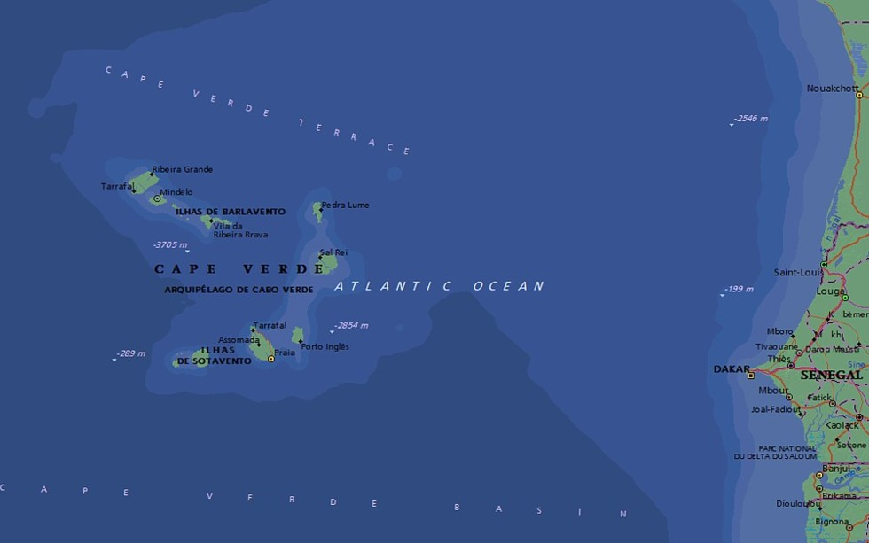
The importance of regional markets :
WWW.EMERGYS.TECH
» Elimination of customs barriers,
» Facilitation of the free movement of people and goods,
Position in the region of economic integration
Cape Verde is a member country
» Reciprocal opportunities for all countries and companies
» Tax and customs benefits.
Temporary storage space
» Storage with suspension of rights
» Tax-free export
Market of 400 million consumers
36 hours by sea
» Total exemption from indirect taxes
» Total exemption from taxes on income and dividends in the first 10 Years
.
188.423.476 of Internet users
50 minutes by air
» Customs incentives
Characterization and information
» Entrepreneurial development
Export and re-export
» Reduction of income tax in the first 5 years
» Network operation and cooperation
» Import and export to and from the large market of 400 million tax-free consumers
» Public facilitation instruments
» Free export of products
» Robustness and scale in business
» Import of raw materials into ECOWAS free of duties and taxes
Page 13
Ref.E-EICV.01/2022/VD-E.01

Slide 14
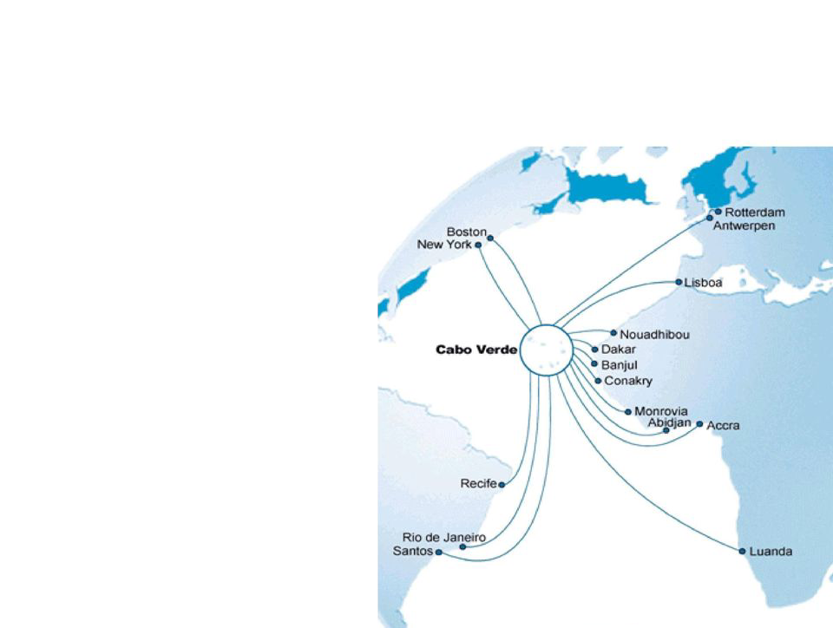
WWW.EMERGYS.TECH
Cape Verde enjoys a strategic geographical location, located in the middle of the Atlantic Ocean, west of Senegal, on the West African coast and presents exceptional conditions for privileged partnerships for business development in ECOWAS, with Brazil, with the European Union, and with the United States of America within the framework of AGOA.
This is why a strategy that favors the export and re-export from Cape Verde finds a reliable and fiscally advantageous framework in Cape Verdean legislation, namely: the concept of International Business Center (CIN) and the concept of International Service Delivery Center (CIPS).
MARkets
ECOWAS MARKET
15 Member countries
397.205.519 inhabitants
EU / GSP+ MARKET
Within the framework of economic cooperation, regional integration and trade, Cape Verde joined, in 2007, the Special Partnership Agreement (EPA) with the European Union (EU) to promote cooperation, trade and investments, in particular through the generalized system of preferences (GSP+) The GSP+ allows preferential access to Cape Verdean products exported to the EU market, free of quotas and tariffs.
188.423.476 internet users
27 Member countries
47.4 % Penetration [% Population]
513.635.012 inhabitants
461.255.831 internet users
90.4 % Penetration [% Population]
In this context, the relationship between Cape Verde and Brazil, at different levels, presents itself as a primordial opportunity, with indisputable advantages and benefits for the respective economic operators, scientific and technological agents.
AMERICAN MARKET¹
3 Member countries
582.422.594 inhabitants
461.255.831 internet users
+80.0 % Penetration [% Population]
The ECOWAS Trade Liberalization Program (ELTC) provides for the elimination of customs duties, taxes and measures of equivalent effect for products exported from Cape Verde to the 14 other ECOWAS member countries. As a market of 400 million consumers and rich in raw materials, Cape Verde can import these inputs from the ECOWAS region free of charge, process them and export finished products to this market free of taxes and fees.
¹ AGOA + Brazil + Canada
The Africa Growth and Opportunity Act (AGOA) provides preferential access to the United States of America for a variety of Cape Verde products, without taxes or quotas.
Pag 14
Ref.E-EICV.01/2022/VD-E.01

Slide 15

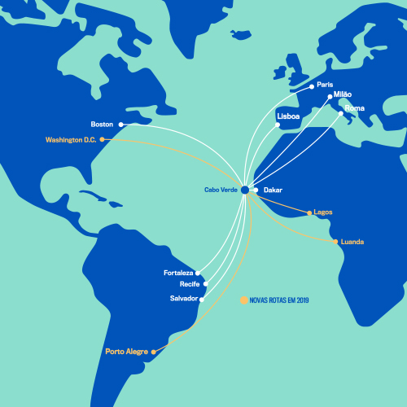
WWW.EMERGYS.TECH
In each edition of the “Atlantic Business Forum”, a country outside the ECOWAS region will be specially invited to participate. In the 2022 edition, Brazil is the guest country. Cape Verde and Brazil are an integral part of the same economic block, the Community of Portuguese Speaking Countries (CPLP), share a common language, the Portuguese language, as well as a common historical way.
The relationship between Cape Verde and Brazil, at different levels and dimensions, presents itself as a first-rate opportunity, with indisputable advantages and benefits for the respective economic operators, scientific and technological agents, who, due to their dimension and their characteristics, constitute an important opportunity as one of the possible means of giving muscle and scale to Cape Verdean companies, in their competitive position on the international market.
THE GUEST COUNTRY
BRAZIL
15 member countries
36 hours by sea
50 minutes by air
Market of 400 million consumers
Abundance of raw materials
Imports of goods: ＄113,440,000,000
8 French-speaking countries
Exports of goods: 113,062,000,000
5 English speaking countries
2 Portuguese speaking countries
8 Currencies
Currently, Brazil has more than 210,867,954 inhabitants; more than 149,057,635 internet users, which corresponds to more than 70.7% penetration [% population]; 26 states, also designated as units of the federation and a federal district, which houses the country's capital, the city of Brasilia.
The emergence of the first industries in Brazil took place in 1810. The organization of the Brazilian industrial sector began around 1827. By 1889, Brazil had about 600 private industries, with activities mainly in the consumer goods sector. Brazilian industry currently generates over 1.2 trillion reais (approximately $ 229.099 million) for its economy; it contributes around 21.6% of Brazil's GDP; represents 51% of Brazilian exports; employs over 12 million people. According to the map of companies in Brazil, made available at the end of 2020 by the Ministry of the Economy, Brazil had 19.7 million active companies. Each federal state has a Federation of Industries and a Federation of Commerce, grouping together the majority of industries and commercial establishments in Brazil.
Pag 15
Ref.E-EICV.01/2022/VD-E.01

Slide 16
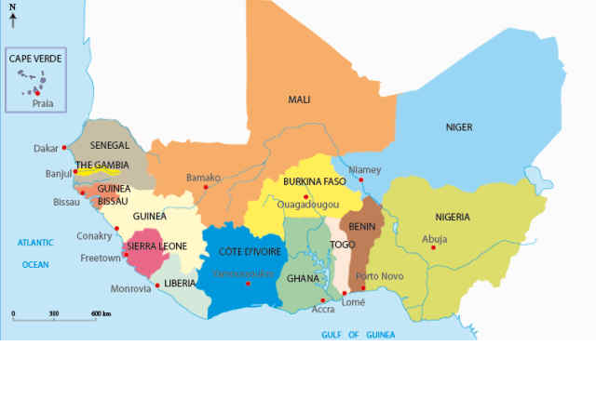
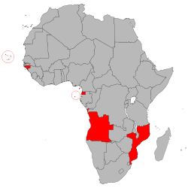
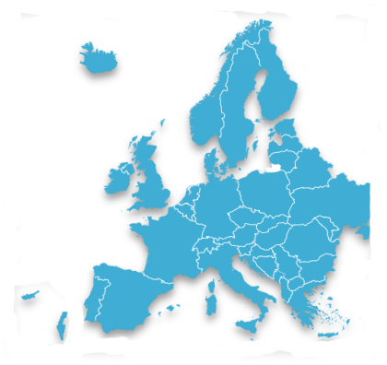
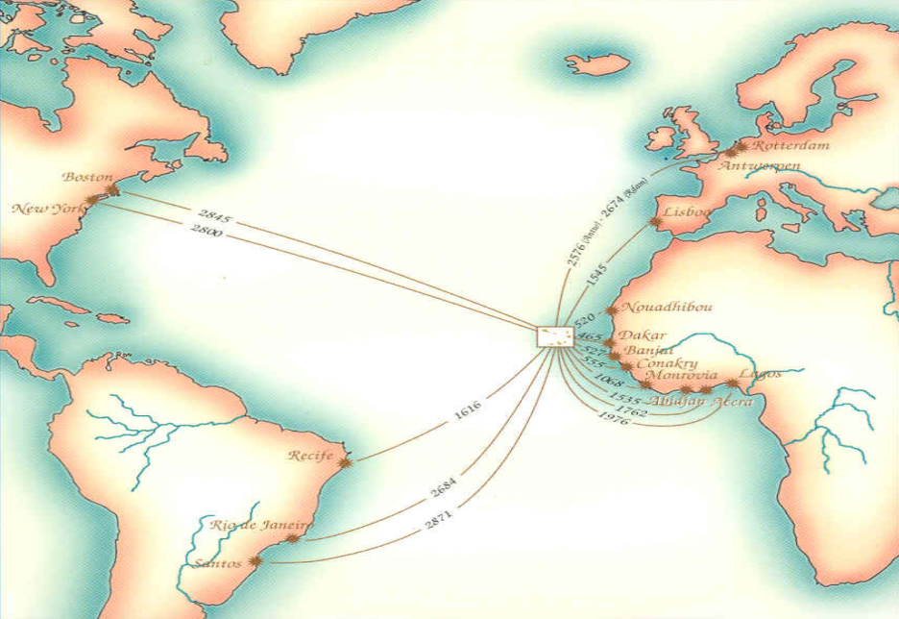
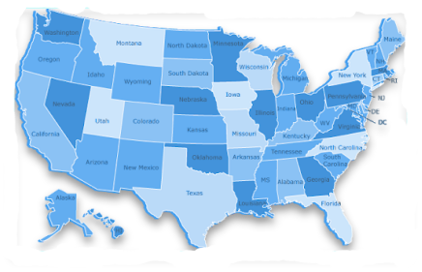
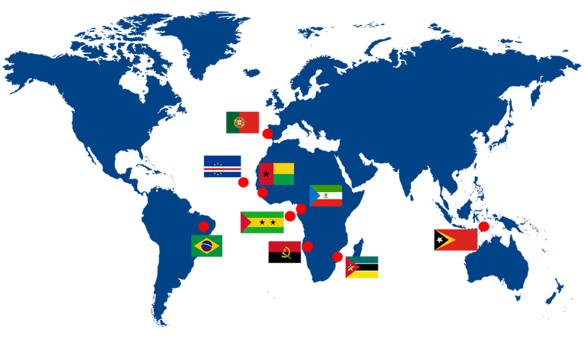
■SADC
■CEEAC
■CEMAC
■Angola » Mozambique
■Angola » Equatorial Guinea » São Tomé and Príncipe
■Equatorial Guinea
CABO VERDE
26 Countries
554.714.746 inh
ZEE: 734.265 Km2
Market position
Position in the economic region
15 Countries
397.205.519 inhabitants
188.423.476 Internet User
47.4 % Penetration [ % Pop.]
6 Countries
68.267.839 inh
14.624.555 Internet User
21.0 % Penetration [ % Pop.]
THE GEOECONOMIC DIMENSION
OF CABO VERDE
■
■European Union
■ASEAN
■MERCOSUR
■SADC
■CEEAC
■CEMAC
PALOP
■Portugal
■Timor - Leste
■Brazil
■Angola » Mozambique
■Angola » E. Guinea » São T. and Príncipe
■Equatorial Guinea
» Cape Verde is a PALOP member country
■
ECOWAS
» Cape Verde is a member country of ECOWAS
Position in the economic region
■
Market position
EU / SPG+
» Cape Verde is a member country of CPLP
» CAPE VERDE AND THE EUROPEAN UNION HAVE SPECIAL PARTNERSHIP AGREEMENTS
27 Countries
513.635.012 inhabitants
461.255.831Internet User
90.4 % Penetration [ % Pop.]
Market position
■
68 Countries
2.033.955.651 inh
■
USA / AGOA
■
CPLP
■ECOWAS - Economic Community of West African States
■PALOP - Portuguese Speaking African Countries
■CPLP - Community of Portuguese Speaking Countries
■SADC - Southern African Development Community
■ASEAN - Association of Southeast Asian Nations
■ECCAS - Economic Community of Central African States
■CEMAC - Central African Economic and Monetary Community
■EU / SPG+ - Generalised Scheme of Preferences
■USA / AGOA - African Growth and Opportunity Act
■MERCOSUR - Southern Common Market
» Cape Verde integrates a preferential system agreement with the United States
By sea, by air and by digital channel Cape Verde links its business to 2.8 billion consumers on 4 continents.
9 Countries
292.111.889 inhabitants
172.107.709 Internet User
61.4 % Penetration [ % Pop.]
333 812 486 inhabitants
292.892.868 Internet User
89.0 % Penetration [ % Pop.]
Ref.E-EICV.01/2022/VD-E.01

Slide 17
WWW.EMERGYS.TECH
COOPeRATION
and
Entrepreneurial development
REGIONAL MARKET DEVELOPMENT
TRADE
ECONOMIC AND COMMERCIAL COOPERATION
FOCUS ON THE
REGIONAL MARKET
COOPERATION
LOGISTICS AND MARITIME TECHNOLOGY PLATFORM
BALANCE OF PAYMENT BALANCE
EXTENSION
REGIONAL INTEGRATION
Industrialization, development and market expansion
Markets
Page 17
Ref.E-EICV.01/2022/VD-E.01

Slide 18
WWW.EMERGYS.TECH
HOW TO PARTICIPATE
All interested parties are invited to participate to the Business Forum on the theme: «Business Opportunities and Business Partnerships in the ECOWAS Space».
To participate in the Forum you need to register in advance, which can be done in one of the following ways
  1. Online registration through the platform www.atlanticbusinessforum.com; or
  2. Submission of a duly completed registration form that can be downloaded from the said platform.
For registration purposes, all instructions included in both the Event Regulations and the registration form should be strictly followed.
Cabo verde
17 - 19 MARCH
2022
PRAIA
SANTIAGO ISLAND
CABO VERDE
Pag 18
Ref.E-EICV.01/2022/VD-E.01

Slide 19
WWW.EMERGYS.TECH
Cabo verde
17 - 19 MARCH
2022
PRAIA
SANTIAGO ISLAND
CABO VERDE
ATLANTIC BUSINESS FORUM
Apartado nº 1042
Código Postal nº 7600
Praia
República de Cabo Verde
WhatsApp:+351 964 406 800
Viber:+351 964 406 800
Skype: setimocontinente
events@atlanticbusinessforum.com
www.atlanticbusinessforum.com
www.emergys.tech
Pag 19
Ref.E-EICV.01/2022/VD-E.01

