Slide 1


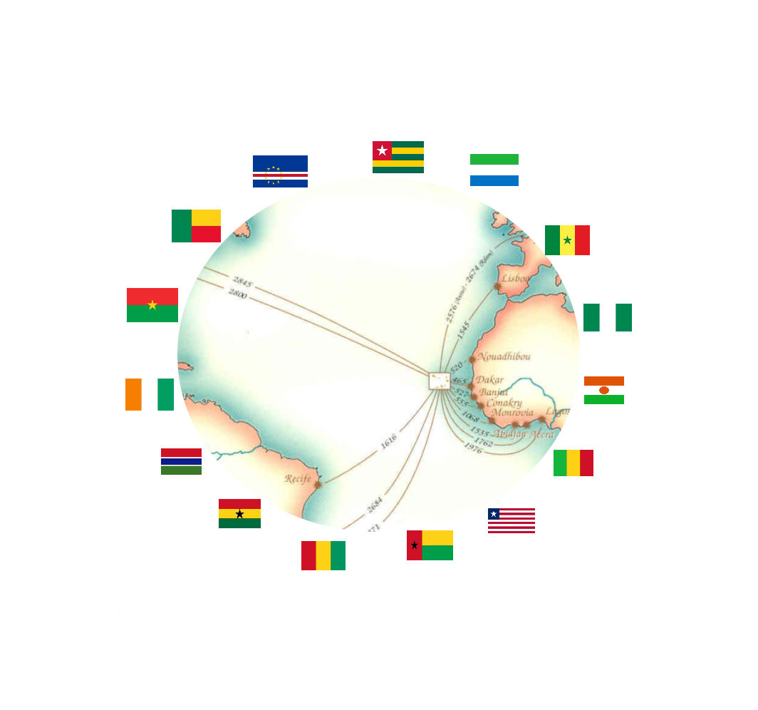
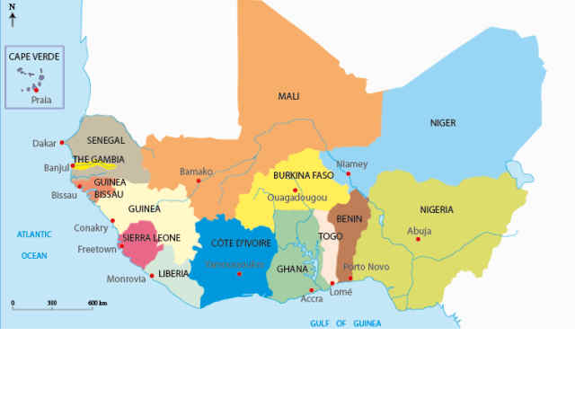
ecowas
overview
Ref.E-EICV.01/2021/VD-E.01

Slide 2
Objet | Pag | Objet | Pag. | Objet | Pag
Warning | 3 | Burkina Faso Economic Indicators | 23 - 25 | Liberia Economic Indicators | 44 - 45
ECOWAS | 4 | Cape Verde Economic Indicators | 26 - 29 | Mali economic indicators | 46 - 48
Some Steps of Regional Integration | 5 | Economic indicators of Côte d'Ivoire | 30 - 32 | Niger Economic Indicators | 49 - 51
ECOWAS Countries | 6 - 7 | Gambia Economic Indicators | 33 - 35 | Nigeria Economic Indicators | 52 - 54
The economic importance of ECOWAS | 8 | Ghana Economic Indicators | 36 - 38 | Senegal's economic indicators | 55 - 57
ECOWAS Economic Indicators | 9 - 18 | Guinea's economic indicators | 39 - 41 | Sierra Leone Economic Indicators | 58 - 60
Benin's economic indicators | 19 - 22 | Guinea Bissau Economic Indicators | 42 - 43 | Togo's economic indicators | 61 - 63
Focused on regional integration
Source:
■ World Bank
■ University of Sherbrooke - Canada
■ Doing Business - Latest data available
■ GSMA.
■ ECOWAS
■ AfDB
Centered on the market
PLANNING
Actions
Results
Technology and innovation
Strategic
Permanent benchmarking
Page 2
Ref.E-EICV.01/2021/VD-E.01

Slide 3
WARNING
This document contains general data relating to the economic indicators of the Economic Community of West African States, ECOWAS.
The data presented is the exclusive responsibility of EMERGYS and the company ABRIMAR INVESTMENT, S.A., and must in no case compromise the accuracy and thoroughness of the sources mentioned.
These data are intended exclusively to provide general information on certain economic indicators of ECOWAS member countries, which we believe may be useful information for anyone interested in this important regional economic block.
EMERGYS undertakes to correct any errors, flaws or omissions detected, as well as to keep this document permanently updated and as complete as possible, for the sake of rigor, thus making it available to economic operators in general and to all interested parties, a vision of the whole of this relevant Community of Nations, whose noble mission is to make the peoples of each of the 15 member countries happy and prosperous.
The names or designations of countries and territories, as well as the respective symbols presented, follow the official designations adopted by the United Nations.
All communications, requests for information or suggestions for corrections or improvements to this document should be addressed exclusively to: info@abrimarinvestment.com.
ABRIMAR INVESTMENT, S.A, is a Cape Verdean company specializing in investment and management of holdings.
ABRIMAR INVESTMENT, S.A, is the owner of EMERGYS.
Page 3
Ref.E-EICV.01/2021/VD-E.01

Slide 4
2. Commercial exchanges in West Africa, as well as the free movement of people and goods, are well anchored in the tradition of the region since the old and great West African civilizations, promoting the development of exchanges between the regions from the Sahel and the savannah, with a wide range of products, such as live cattle, hides and skins, poultry, timber and timber products. This century-old tradition of trade has generated a significant early mobility of people and goods in the West African region and has remained constant over the centuries, so we can consider that the Economic Community of West Africa, ECOWAS, is the heir and the precursor of this ancestral African tradition. Before the creation of the Economic Community of West African States, ECOWAS, on May 28, 1975, the territory of West Africa was made up of States with different historical and administrative experiences and realities which, together, dictated the borders of the 15 countries located in this geographical area and which currently form ECOWAS.
THE ECOWAS
ECOWAS MARKET
15 member countries
3. Although the Member States of the Community have three languages official languages, English, French and Portuguese, there are nevertheless more than one 1000 other local languages, including native languages cross-border and shared by people from different countries, namely Ewe, Fulfulde, Hausa, Mandingo, Wolof, Yoruba, Ibo, Ga, Creole, spoken by about 400 million inInhabitants over a vast area of 5,112,069 million square kilometers, corresponding to about 17% of the territory of the African continent. Before these countries lose their initial sovereignty, the region was home to many empires and kingdoms that spanned several centuries, namely those of Ghana, Songhai, Wolof, Oyo, Benin and Kanem Bornu. The diversity cultural, linguistic and ecological present both opportunities and challenges for the regional integration process. Will and determination to combine synergies at the political and are recognized as the basis for the creation of a economically and socially prosperous region.
397,205,519 inInhabitants
188,423,476 Internet users
MAIN RIVER
47.4% Penetration [ % Population ]
Níger River
4.180 km long
6.000 m3 / s average flow
Area: 5.112.069 Km²
2,117,700 km² area of ​​the basin
＄ 197,993,787,997 Import
＄ 138,363,847,400 Export
It crosses 5 countries:
Benin; Guinea; Mali; Niger; Nigeria.
more than 1,000 languages
8 French-speaking countries
4. The fundamental objectives of ECOWAS, which is to promote economic and political cooperation among member countries, are in tune with the history of its people, given that West African citizens, even in the period preceding the loss of their initial sovereignty, were already among most of the world's displaced populations, although mobility mainly occurred in the region. It is estimated that around 10 (ten) million West African migrants (4% of the regional population) reside in ECOWAS countries other than their own. The remaining migrants, around 7 (seven) million, reside mainly in North America and Europe. Cross-border migration, especially of women, involved in business activities represents a symbol of regional entrepreneurship and is a catalyst to promote regional integration.
5 English speaking countries
2 Portuguese-speaking countries
8 coins
1. The first stage of regional integration dates back to 1945, with the creation of the CFA Franc, Franc des Colonies Frenches d'Afrique, FCFA, which united the French-speaking countries of the region into a single monetary union. In 1964, the President of Liberia proposed a West African Economic Union which resulted in an agreement in 1965 between Côte d'Ivoire, Guinea, Liberia and Sierra Leone. The aforementioned 1965 agreement did not produce the desired results until 1972, when the Nigerian head of state and his Togolese counterpart embarked on a tour of the country.
region to promote the idea of ​​integration. In this sense, thanks to the benevolence of these efforts, projects were presented on the basis of which the Treaty of Lagos, capital of Nigeria, which established the Economic Community of West African States, ECOWAS, was developed in 1975. The Lagos Treaty was initially focused on economic policies and was subsequently revised which in 1993 allowed its scope and prerogatives to be extended.
5. In recent years, the population of West Africa has increased sharply, passing from 70 million to 400 million between 1950 and 2020. At the end of 2014, it represented about 40% of the population of sub-Saharan Africa. According to United Nations projections, West Africa's population is expected to reach 550 or 600 million by 2050, being the region with the youngest population in the world. In addition, with around 5% of the world's population and an area of ​​over 40% in sub-Saharan Africa, West Africa is the most densely populated on the continent.
6. An effective strategy to promote intra-ECOWAS trade as well as to stimulate ECOWAS exports to the external market is one of the first priorities defined by the highest regional authorities.
Ref.E-EICV.01/2021/VD-E.01

Slide 5


A FEW STEPS OF REGIONAL INTEGRATION
Constitution.
The ECOWAS constitutional treaty was approved on the 28th of May 1975.
Membership of Cape Verde.
Cape Verde became a member of ECOWAS in 1976, immediately after obtaining the status of independent and sovereign state on July 5, 1975.
Liberalization of foreign trade.
Cancellation of import and export customs duties and removal of non-tariff barriers between member states for agricultural products, crafts and crude oil.
Single currency. Idea of ​​creation of the single currency of ECOWAS launched by the Conference of Heads of State and Government. Decision A / Dec6 / 12/85.
Monetary cooperation.
Adoption of an ECOWAS monetary cooperation program (PCMC).
1975
1976
1979
1983
1987
Liberalization of foreign trade. Cancellation of import and export customs duties and removal of non-tariff barriers between Member States of the industrial products.
Convergence criteria.
Adoption of the ECOWAS macroeconomic convergence criteria.
Accra Declaration. On April 30, the Heads of State and Government of 6 countries declared the institutionalization of the West African Monetary Zone (WAMZ), within the framework of the objective of the single currency zone of ECOWAS.
ZMAO Agreement. On December 15, 2000, in Bamako, capital of Mali, 5 heads of state and government signed the WAMZ Agreement.
Monitoring mechanism.
Adoption of a multilateral supervision mechanism within the framework of the coordination of the economic and financial policies of the Member States as a precondition for the creation of the Economic and Monetary Union (decision A (dec / 7/12/01)).
1990
1999
2000
2000
2001
Free movement of people. Recognition of the right to free movement of people and to work in ECOWAS.
Effective free movement. Effective visa-free movement in the region, for ECOWAS citizens limited to 90 days.
Vision 2020.
The adoption of the constitutive principles, which consists in the conversion of an ECOWAS of States into an ECOWAS of citizens.
Single currency of ECOWAS [ECO]. Adoption by the ECOWAS Convergence Council on May 25, 2009 of a “roadmap” for the ECOWAS single currency program [ECO] in 2020.
Free trade area. A free trade zone was created with the adoption of the ECOWAS Common External Tariff (CET) on October 25, 2013 in Dakar, applicable from January 2015.
2003
2006
2007
2009
2013
Page 5
Ref.E-EICV.01/2021/VD-E.01

Slide 6
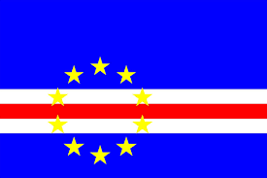
BENIN
BURKINA FASO
CABO VERDE
CÔTE D'IVOIRE
Population | : 11.801.151 | Inhabitants
Natural increase | : 2,70%
Urban population | : 47,90%
Density | : 102 | Inhabitants/km²
Middle age | : 18,0 | Years
Male life expectancy | : 59,9 | Years
Female life expectancy | : 63,0 | Years
Activity rate | : 71,70%
Literacy rate | : 34,70%
Official language | : French
Currency | : Franc CFA
Population | :20.321.378 | Inhabitants
Natural increase | :2,80%
Urban population | :30,00%
Density | :72 | Inhabitants/km²
Middle age | :17,0 | Years
Male life expectancy | :60,4 | Years
Female life expectancy | :61,9 | Years
Activity rate | :83,40%
Literacy rate | :23,60%
Official language | :French
Currency | :Franc CFA
Population | :549.935 | Inhabitants
Natural increase | :1,10%
Urban population | :66,20%
Density | :135 | Inhabitants/km²
Middle age | :20,0 | Years
Male life expectancy | :69,3 | Years
Female life expectancy | :76,0 | Years
Activity rate | :68,80%
Literacy rate | :81,20%
Official language | :Portuguese
Currency | :Escudos
Population | :25.716.544 | Inhabitants
Natural increase | :2,50%
Urban population | :51,20%
Density | :79 | Inhabitants/km²
Middle age | :19,0 | Years
Male life expectancy | :56,3 | Years
Female life expectancy | :58,7 | Years
Activity rate | :67,00%
Literacy rate | :48,70%
Official language | :French
Currency | :Franc CFA
GAMBIA
GHANA
GUINÉE
GUINÉE BISSAU
Population | :2.347.706 | Inhabitants
Natural increase | :2,90%
Urban population | :61,90%
Density | :225 | Inhabitants/km²
Middle age | :20,0 | Years
Male life expectancy | :60,4 | Years
Female life expectancy | :63,2 | Years
Activity rate | :77,30%
Literacy rate | ---
Official language | :English
Currency | :Dalasi
Population | :30.417.856 | Inhabitants
Natural increase | :2,20%
Urban population | :56,70%
Density | :131 | Inhabitants/km²
Middle age | :20,0 | Years
Male life expectancy | :62,7 | Years
Female life expectancy | :64,9 | Years
Activity rate | :77,20%
Literacy rate | :57,90%
Official language | :English
Currency | :Cedi
Population | :12.771.246 | Inhabitants
Natural increase | :2,80%
Urban population | :36,50%
Density | :51 | InInhabitants/km²
Middle age | :18,0 | Years
Male life expectancy | :60,5 | Years
Female life expectancy | :61,7 | Years
Activity rate | :82,30%
Literacy rate | :29,50%
Official language | :French
Currency | :Franc Guinéen
Population | :1.920.922 | Inhabitants
Natural increase | :2,50%
Urban population | :43,80%
Density | :67 | InInhabitants/km²
Middle age | :16,0 | Years
Male life expectancy | :56,0 | Years
Female life expectancy | :59,9 | Years
Activity rate | :72,90%
Literacy rate | ---
Official language | :Portuguese
Currency | :Franc CFA
Page 6
Ref.E-EICV.01/2021/VD-E.01

Slide 7
LIBERIA
MALI
NIGER
NIGERIA
Population | :4.937.374 | Inhabitants
Natural increase | :2,40%
Urban population | :51,60%
Density | :50 | Inhabitants/km²
Middle age | :16,0 | Years
Male life expectancy | :62,3 | Years
Female life expectancy | :65,1 | Years
Activity rate | :61,00%
Literacy rate | :51,9%
Official language | :English
Currency | :Dollar Libérien
Population | :19.658.031 | Inhabitants
Natural increase | :3,00%
Urban population | :43,10%
Density | :16 | Inhabitants/km²
Middle age | :16,0 | Years
Male life expectancy | :58,1 | Years
Female life expectancy | :59,6 | Years
Activity rate | :66,50%
Literacy rate | :24,0%
Official language | :French
Currency | :Franc CFA
Population | :200.963.599 | Inhabitants
Natural increase | :2,60%
Urban population | :51,20%
Density | :215 | Inhabitants/km²
Middle age | :18,0 | Years
Male life expectancy | :53,5 | Years
Female life expectancy | :55,2 | Years
Activity rate | :56,50%
Literacy rate | :69,1%
Official language | :English
Currency | :Naira
Population | :23.310.715 | Inhabitants
Natural increase | :3,80%
Urban population | :26,50%
Density | :16 | Inhabitants/km²
Middle age | :18,0 | Years
Male life expectancy | :60,9 | Years
Female life expectancy | :63,2 | Years
Activity rate | :64,70%
Literacy rate | :28,7%
Official language | :French
Currency | :Franc CFA
SENEGAL
SIERRA LEONE
TOGO
Population | :16.296.364 | Inhabitants
Natural increase | :2,70%
Urban population | :47,70%
Density | :82 | Inhabitants/km²
Middle age | :19,0 | Years
Male life expectancy | :65,5 | Years
Female life expectancy | :69,6 | Years
Activity rate | :57,40%
Literacy rate | :39,3%
Official language | :French
Currency | :Franc CFA
Population | :7.813.215 | Inhabitants
Natural increase | :2,10%
Urban population | :42,50%
Density | :106 | Inhabitants/km²
Middle age | :18,0 | Years
Male life expectancy | :53,5 | Years
Female life expectancy | :55,1 | Years
Activity rate | :66,90%
Literacy rate | :34,8%
Official language | :English
Currency | :Franc CFA
Population | :16.296.364 | Inhabitants
Natural increase | :2,70%
Urban population | :47,70%
Density | :82 | Inhabitants/km²
Middle age | :19,0 | Years
Male life expectancy | :65,5 | Years
Female life expectancy | :69,6 | Years
Activity rate | :57,40%
Literacy rate | :39,3%
Official language | :French
Currency | :Franc CFA
Page 7
Ref.E-EICV.01/2021/VD-E.01

Slide 8
The importance of ECOWAS as a regional market
» Elimination of customs barriers,
» Facilitate the free movement of people and goods,
THE ECONOMIC IMPORTANCE
OF ECOWAS
» Reciprocal opportunities for all countries and companies
» Tax and customs benefits..
15 member countries
Area of 5,112,069 million km2
Three official languages
188,423,476 Internet users
47.4% Penetration [% Population]
400 million consumers
600 million consumers in 2050
5% of the world's population
40% of the population of sub-Saharan Africa
Area greater than 40% of sub-Saharan
Characterization and information
» Entrepeunerial capacity
» Network operation and cooperation
Export and re-export
» Public facilitation instruments
» Export of goods and services: $ 197,993,787,997, in 2018;
» Product cost reduction through economies of scale
» Imports of goods and services: $ 138,363,847,400, in 2018;
» Free export of products
» Greater efficiency in production, marketing and administration
» Importation of raw materials between the 15 ECOWAS countries free of duties and taxes
» Competitive advantages thanks to the elimination of tariffs
» Large-scale consumption allowing greater product rotation
Page 8
Ref.E-EICV.01/2021/VD-E.01

Slide 9
Page 9
Ref.E-EICV.01/2021/VD-E.01

Slide 10
Page 10
Ref.E-EICV.01/2021/VD-E.01

Slide 11
Page 11
Ref.E-EICV.01/2021/VD-E.01

Slide 12
Page 12
Ref.E-EICV.01/2021/VD-E.01

Slide 13
Page 13
Ref.E-EICV.01/2021/VD-E.01

Slide 14
Page 14
Ref.E-EICV.01/2021/VD-E.01

Slide 15
Page 15
Ref.E-EICV.01/2021/VD-E.01

Slide 16
Page 16
Ref.E-EICV.01/2021/VD-E.01

Slide 17
Countries | Area | DIGITAL INCLUSION IN ECOWAS
 |  |  |  |  |  |  | SITUATION OF THE IMPLEMENTATION OF THE ECOWAS ADDITIONAL ACTS
 |  | Population | Internet users |  | Penetration | Growth of the Internet | Harmonization of policies | Access and interconnection | Legal regime | Digitization Plan | Radio frequencies | Protection of personal data | Electronic transactions
 | Km2 | 2020 (Est) | in 2000 | in 2020 | (% Population) | 2000 - 2020
Benin | 112 622 | 12 123 200 | 15 000 | 3 801 758 | 31.4 % | 25245,00% | √ | √ | √ | √ | √ | √ | √
Burkina Faso | 274 200 | 20 903 273 | 10 000 | 3 704 265 | 17.7 % | 36942,00% | √ | √ | √ | √ | √ | √ | √
Cabo Verde | 4 033 | 555 987 | 8 000 | 352 120 | 63.3 % | 4302,00% | √ | √ | √ | √ | √ | √ | √
Côte d'Ivoire | 322 463 | 26 378 274 | 40 000 | 11 953 653 | 45.3 % | 29784,00% | √ | √ | √ | √ | √ | √ | √
Gambia | 10 689 | 2 416 668 | 4 000 | 442 050 | 18.3 % | 10951,00% |  |  |  | √ | √ | √ | √
Ghana | 238 535 | 31 072 940 | 30 000 | 11 737 818 | 37.8 % | 39026,00% | √ | √ | √ | √ | √ | √ | √
Guinea | 245 836 | 13 132 795 | 8 000 | 2 411 672 | 18.4 % | 30046,00% | √ | √ | √ | √ | √ | √ | √
Guinea-Bissau | 36 125 | 1 968 001 | 1 500 | 250 000 | 12.7 % | 16567,00% | √ | √ | √ | √ | √ | √ | √
Liberia | 111 369 | 5 057 681 | 500 | 624 610 | 12,30% | 124822,00% | √ | √ | √ | √ | √ | √ | √
Mali | 1 240 192 | 20 250 833 | 18 800 | 12 480 176 | 61.6 % | 66284,00% | √ | √ | √ | √ | √ | √ | √
Niger | 1 267 000 | 24 206 644 | 5 000 | 2 781 266 | 11.5 % | 55525,00% | √ | √ | √ | √ | √ | √ | √
Nigeria | 923 768 | 206 139 589 | 200 000 | 126 078 999 | 61.2 % | 62939,00% | √ | √ | √ | √ | √ | √ | √
Senegal | 196 712 | 16 743 927 | 40 000 | 9 749 527 | 58.2 % | 24274,00% | √ | √ | √ | √ | √ | √ | √
Sierra Leone | 71 740 | 7 976 983 | 5 000 | 1 043 725 | 13.1 % | 20774,00% | √ | √ | √ | √ | √ | √ | √
Togo | 56 785 | 8 278 724 | 100 000 | 1 011 837 | 12.2 % | 912% | √ | √ | √ | √ | √ | √ | √
 |  |  |  |  |  |  |  | Legend:
 |  |  |  |  |  |  |  | √ | Laws / previous or existing decrees
 |  |  |  |  |  |  |  | √ | Transposition in progress
 |  |  |  |  |  |  |  | √ | Additional ECOWAS Acts
Page 17
Ref.E-EICV.01/2021/VD-E.01

Slide 18
Page 18
Ref.E-EICV.01/2021/VD-E.01

Slide 19
BENIN
Page 19
Ref.E-EICV.01/2021/VD-E.01

Slide 20
BENIN
Page 20
Ref.E-EICV.01/2021/VD-E.01

Slide 21
BENIN
Page 21
Ref.E-EICV.01/2021/VD-E.01

Slide 22
BENIN
BENIN
Page 22
Ref.E-EICV.01/2021/VD-E.01

Slide 23
BURKINA FASO
Page 23
Ref.E-EICV.01/2021/VD-E.01

Slide 24
BURKINA FASO
Page 24
Ref.E-EICV.01/2021/VD-E.01

Slide 25
BURKINA FASO
Page 25
Ref.E-EICV.01/2021/VD-E.01

Slide 26
CABO VERDE
Page 26
Ref.E-EICV.01/2021/VD-E.01

Slide 27
CABO VERDE
Page 27
Ref.E-EICV.01/2021/VD-E.01

Slide 28
CABO VERDE
Page 28
Ref.E-EICV.01/2021/VD-E.01

Slide 29
CABO VERDE
CABO VERDE
Page 29
Ref.E-EICV.01/2021/VD-E.01

Slide 30

CÔTE D'IVOIRE
Page 30
Ref.E-EICV.01/2021/VD-E.01

Slide 31
CÔTE D'IVOIRE
Page 31
Ref.E-EICV.01/2021/VD-E.01

Slide 32
CÔTE D'IVOIRE
CÔTE D'IVOIRE
Page 32

Slide 33

GAMBIA
Page 33
Ref.E-EICV.01/2021/VD-E.01

Slide 34
GAMBIA
Page 34
Ref.E-EICV.01/2021/VD-E.01

Slide 35
GAMBIA
Page 35
Ref.E-EICV.01/2021/VD-E.01

Slide 36
GHANA
Page 36
Ref.E-EICV.01/2021/VD-E.01

Slide 37
GHANA
Page 37
Ref.E-EICV.01/2021/VD-E.01

Slide 38
GHANA
Page 38
Ref.E-EICV.01/2021/VD-E.01

Slide 39
GUINEA
Page 39
Ref.E-EICV.01/2021/VD-E.01

Slide 40
GUINEA
Page 40
Ref.E-EICV.01/2021/VD-E.01

Slide 41
GUINEA
Page 41
Ref.E-EICV.01/2021/VD-E.01

Slide 42
GUINEA BISSAU
Page 42
Ref.E-EICV.01/2021/VD-E.01

Slide 43
GUINEA BISSAU
Page 43
Ref.E-EICV.01/2021/VD-E.01

Slide 44
LIBERIA
Page 44
Ref.E-EICV.01/2021/VD-E.01

Slide 45
LIBERIA
Page 45
Ref.E-EICV.01/2021/VD-E.01

Slide 46
MALI
Page 46
Ref.E-EICV.01/2021/VD-E.01

Slide 47
MALI
Page 47
Ref.E-EICV.01/2021/VD-E.01

Slide 48
MALI
Page 48
Ref.E-EICV.01/2021/VD-E.01

Slide 49
NIGER
Page 49
Ref.E-EICV.01/2021/VD-E.01

Slide 50
NIGER
Page 50
Ref.E-EICV.01/2021/VD-E.01

Slide 51
NIGER
Page 51
Ref.E-EICV.01/2021/VD-E.01

Slide 52
NIGERIA
Page 52
Ref.E-EICV.01/2021/VD-E.01

Slide 53
NIGERIA
Page 53
Ref.E-EICV.01/2021/VD-E.01

Slide 54
NIGERIA
Page 54
Ref.E-EICV.01/2021/VD-E.01

Slide 55
SENEGAL
Page 55
Ref.E-EICV.01/2021/VD-E.01

Slide 56
SENEGAL
Page 56
Ref.E-EICV.01/2021/VD-E.01

Slide 57
SENEGAL
Page 57
Ref.E-EICV.01/2021/VD-E.01

Slide 58
SIERRA LEONE
Page 58
Ref.E-EICV.01/2021/VD-E.01

Slide 59
SIERRA LEONE
Page 59
Ref.E-EICV.01/2021/VD-E.01

Slide 60
SIERRA LEONE
Page 60
Ref.E-EICV.01/2021/VD-E.01

Slide 61
TOGO
Page 61
Ref.E-EICV.01/2021/VD-E.01

Slide 62
TOGO
Page 62
Ref.E-EICV.01/2021/VD-E.01

Slide 63
TOGO
Page 63
Ref.E-EICV.01/2021/VD-E.01

