Slide 1


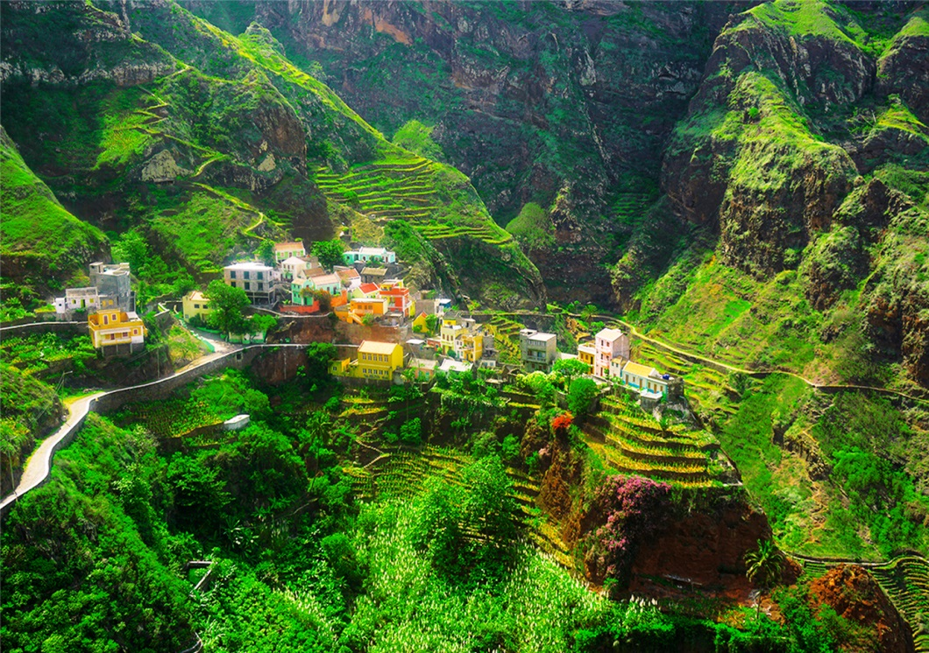


BASALT CONFERENCE
INTERNATIONAL CONFERENCE
BASALT the wealth of nations
program
26 – 28 sePtembEr
■
Praia
CaPE verde
Ref.E-EICV.01/2022/VD-E.01

Slide 2
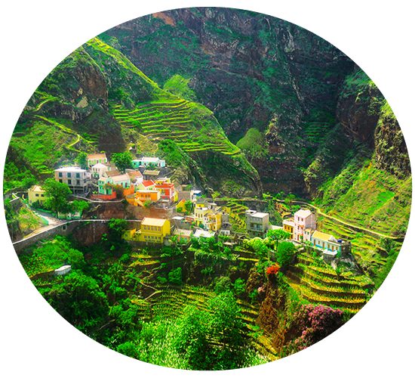


Item | Page | Item | Page
Preamble | 3 | Deadlines | 7
Conference Program - Day 1 | 4 | Event calendar | 8
Conference Program - Day 2 | 5 | Contacts | 9
Round Table Program - Day 3 | 6
program
26 – 28 sePtembEr
■
Praia
CaPE verde
Focused on Environmental Protection
Focused on innovation
PLAN
Actions
Results
Realistic
Strategic
Revaluation
Pag 2
Ref.E-EICV.01/2022/VD-E.01

Slide 3


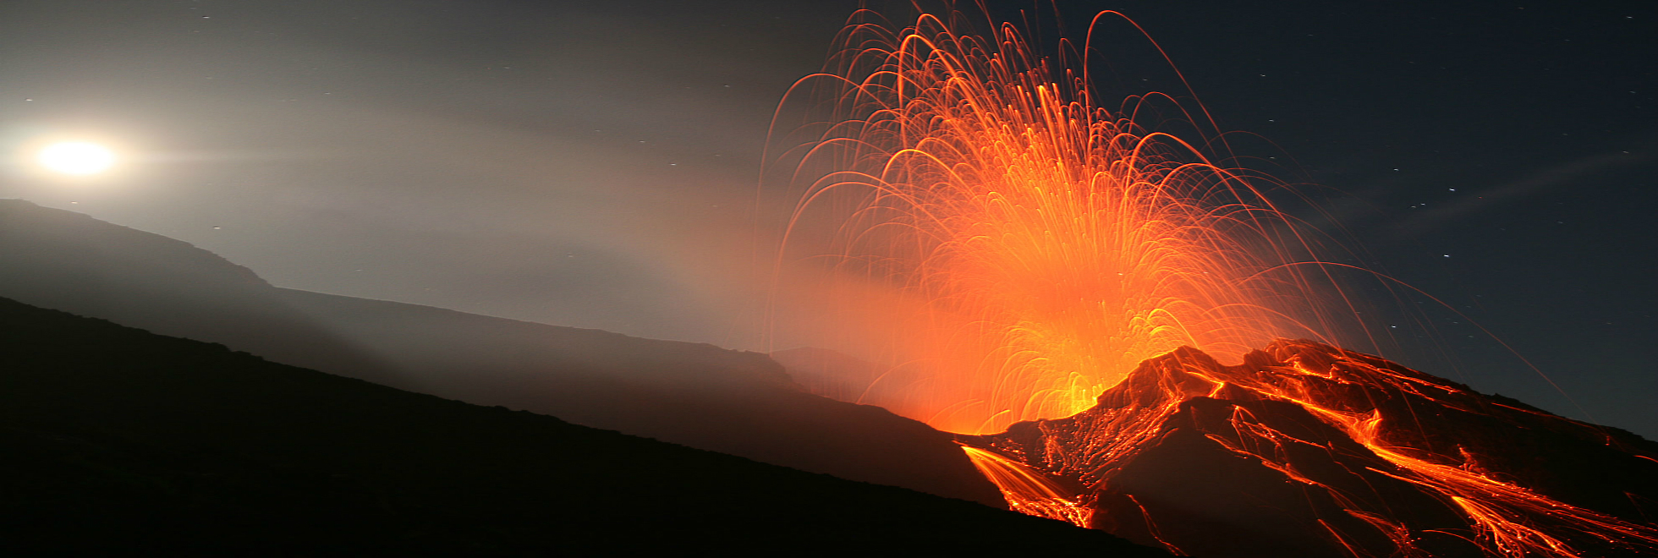

PREAMBLE
For a century, conventional fertilizers were the only solution proven that could produce enough food for the growing world population, and therefore the consideration of other fertilizer has gained little ground in the large-scale agricultural industry . But like pollution and fertilizer runoff artificial pose a greater threat to human health and environment, markets are increasingly looking for sustainable alternatives that can eliminate the waste that spillsfrom farms to streams.
The average fertilizer consumption in Africa is 10 kg / ha, or 10% of the world average, almost 20 times less than the Asian average (191 kg / ha) and 9 times less than the Latin American average (94 kg / ha). The misuse of fertilizers in Africa is mainly due to two factors: the high price of fertilizers given the low purchasing power of farmers and the lack of alternatives offered to producers and farmers.
The use of rock powders to fertilize the soil is a secular technique (the Inca and Egyptian civilizations have already relied on the use of rock by-products for the soil fertilization), which was left out, by the expansion of the use and supply of soluble fertilizers. However, the rise in the prices of these products has left an increasing number of farmers without the possibility of fertilizing the soil and thus guarantee a production compatible with their efforts and investments made.
It is in this context that Cape Verde will host an event international on the theme «APPLICATION OF BASALT POWDER IN AGRICULTURE - Its advantages as as fertilizer for agriculture». The event will take place from March 14 to 16 2022, at the Noble Hall of the National Assembly of Cape Verde, Praia.
The International Conference, entitled BASALT CONFERENCE, focuses on the application of basalt powder in agriculture as a fertilizer par excellence for agriculture, lasting three days, from March 14 to 16, 2022. A «Round Table of Integration and Debates» March 16 will close the event.
CONFERENCE
PROGRAM
14 - 16 MARCH
________■________
2022
PRAIA
CAPE VERDE
Pag 3
www.basaltconference.com
Ref.E-EICV.01/2022/VD-E.01

Slide 4
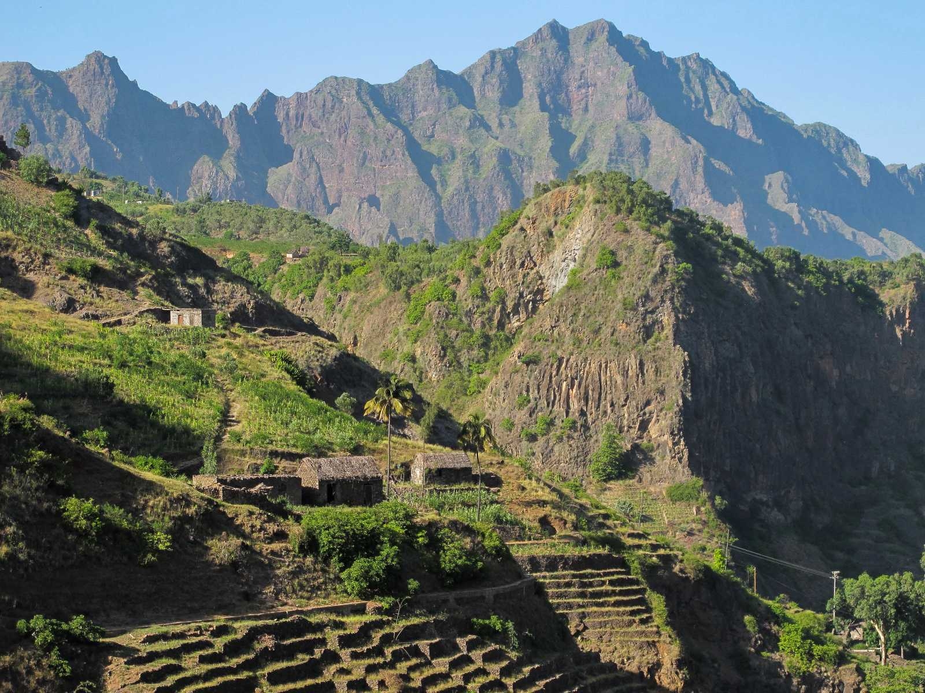
PROGRAM
DAY 14 March 2022
ACCREDITATION:
08:00 – 08:30
08:30 – 10:15
10:15 – 10:45
10:45 – 12:30
12:30 – 14:00
14:00 – 15:45
15:45 – 16:15
16:15 – 18:00
20:00 – 22:30
From 7:00
Opening ceremony
Conference I: «THE CURRENT STATE OF THE RESEARCH OF THE USE OF BASALT POWDER AND THE CONSOLIDATION OF ITS APPLICATION IN AGRICULTURE»
Speaker: Dr. Eder Martins – Researcher at EMBRAPA - Brazilian Agricultural Research Corporation
Moderador: Mrs Joanna Campe, Founder and executive director of RTE
Debate
Coffee Break
Conference II: «FROM THE RESEARCH TO THE LEGISLATION AND REGULATION OF THE APPLICATION OF BASALT POWDER IN AGRICULTURE : Brazil as Case Study»
Speaker: Prof. Suzi Huff Theodoro – Researcher at the University of Brasília
Moderator: Cabo Verde
Debate
Lunch
Conference III: «RECONSTRUCTION OF THE SOIL AND ENVIRONMENT THROUGH FINELY CRUSHED ROCKS TO INCREASE PRODUCTIVITY AND FOOD QUALITY»
Speaker: Prof. Bernardo Knapik – Researcher at Paraná State University - Brazil
Moderator: Cabo Verde
Debate
Coffee Break
Conference IV: «USE OF BASALT POWDER IN AGRICULTURE – Case Studiy»
Speaker: Prof. Emeritus Peter van Straaten – University of Guelph – Canada
Moderator: Ivory Coast
Debate
Welcome Reception
CONFERENCE
PROGRAM
14 - 16 MARCH
________■________
2022
PRAIA
CAPE VERDE
Pag 4
www.basaltconference.com
Ref.E-EICV.01/2022/VD-E.01

Slide 5
PROGRAM
DAY 15 March 2022
ACCREDITATION 08:30 – 10:15
10:15 – 10:45
10:45 – 12:30
12:30- 14:00
14:00 – 15:45
15:45 – 16:15
16:15 – 18:00
> 18:00
From 7:00
Conference V: «THE CHALLENGES OF SUSTAINABLE DEVELOPMENT: The need for nutrient management in agriculture»
Moderator: University Of The Gambia – The Gambia
Speaker: FAO - Food and Agriculture Organization of the United Nations
Debate
Coffee Break
Conference VI: «SOIL FERTILIZATION WITH ROCK POWDER AND FOOD PRODUCTION»
Moderator: Cabo Verde
Speaker: Prof. Emeritus Othon Henry Leonardos - University of Brasilia
Debate
Lunch
Panel I: «BASALT: AGROMINERAL POTENTIAL AND POSSIBILITIES OF A PRODUCTIVE CHAIN»
Moderator: Atlantic Technical University (UTA) – Cabo Verde
Speakers:
» MSc. Magda Bergmann - Researcher at Geological Survey of Brazil
» MSc. Andrea Sander - Researcher at Geological Survey of Brazil
Debate
Coffee Break
Conference VII: «THE AGRICULTURAL DEVELOPMENT CHAIN ON THE AFRICAN CONTINENT - From production to industrialization and distribution»
Moderator: Chamber of Commerce, Industry, Agriculture and Services of Sotavento - CCISSS - Cape Verde
Speaker: African Development Bank - AfdB
Debate
FREE TIME
CONFERENCE
PROGRAM
14 - 16 MARCH
________■________
2022
PRAIA
CAPE VERDE
Remark: Some of the names indicated are still being confirmed.
Pag 5
www.basaltconference.com
Ref.E-EICV.01/2022/VD-E.01

Slide 6
PROGRAM
DAY 16 March 2022
THE ROUND TABLE PROGRAM
BASALT POWDER IN AGRICULTURE
FOOD QUALITY AND ENVIRONMENTAL PROTECTION
«ROUND TABLE OF INTEGRATION AND DEBATES»
ACCREDITATION : From 7:30
08:00 – 09:30
09:30 – 10:00
10:00 – 10:30
10:30 – 12:00
12:00 – 12:30
12:30 – 14:00
14:00 – 15:30
15:30 – 16:00
16:00 – 16:30
16:30 – 18:00
18:00 – 18:30
20:30 – 23:00
Theme I: Research, Legislation, Regulation and Technology of «Rochagem»
Moderator: University of The Gambia – The Gambia
Interventions of Experts:
■ CILSS - Permanent Interstate Committee for Drought Control in the Sahel
■ Prof. Suzi Huff Theodoro – Researcher at the University of Brasilia
■ Prof. Émérite Peter van Straaten – Research Fellow at the University of Guelph - Canada
■ Prof. Eder de Souza Martins – Researcher at EMBRAPA (Brazilian Society for Agro-Livestock Research)
■ Mrs Joanna Campe, Founder and executive director of RTE
Debates
Coffee break
Theme II: Fertilization of agricultural soils and protection of the environment
Moderator: Cheikh Anta Diop University of Dakar – Senegal
Interventions of Experts:
■ Directorate of Agriculture and Rural Development of ECOWAS
■ ARAA - Regional Agency for Agriculture and Food
■ University of Cape Verde
■ Prof. Emeritus Othon Henry Leonardos - Researcher at the University of Brasilia
Debates
Lunch
Theme III: The Agromineral Potential of Basalt and its specificities
Moderator: Ghana Agricultural Chamber of Commerce
Interventions of Experts:
■ MSc. Magda Bergmann - Researcher of the Geological Survey of Brazil
■ MSc. MSc. Andrea Sander - Researcher of the Geological Survey of Brazil
■ Prof. Emeritus Peter van Straaten - Research Fellow at the University of Guelph - Canada
■ University of Yaoundé - Cameroon
Debates
Coffee break
Theme IV: Agricultural profitability and quality control of food produced
Moderator: University of Cape Verde
Interventions of Experts:
■ FAO – Food and Agriculture Organization of the United Nations
■ ENSA - National School of Agronomy of Yamoussoukro – Côte d’Ivoire
■ Food and Applied Nutrition Department (DANA) -Benin
■ Prof. Bernardo Knapik - Researcher at Estadual do Paraná University - Brazil
Debates
Closing ceremony of the International Conference
Welcome dinner «THE FLAVORS OF ECOWAS»
CONFERENCE
PROGRAM
14 - 16 MARCH
________■________
2022
PRAIA
CAPE VERDE
Remark: Some of the names indicated are still being confirmed.
Pag 6
www.basaltconference.com
Ref.E-EICV.01/2022/VD-E.01

Slide 7
DEADLINES FOR EXPRESSION OF INTEREST AND REGISTRATION
Registration deadline to participate in the Round Table
Registration deadline to participate in the International Conference and institutional meetings
CONFERENCE
PROGRAM
14 - 16 MARCH
________■________
2022
PRAIA
CAPE VERDE
2021
17
May
2022
15
February
2022
28
February
2022
14 and 15
March
2022
16
March
Registration opens for expressions of interest and participation in the International Conference
ROUND TABLE
INTERNACIONAL CONFERENCE
Pag 7
www.basaltconference.com
Ref.E-EICV.01/2022/VD-E.01

Slide 8

 |  |  |  | INTERNATIONAL CONFERENCE PLANNING
CABO VERDE 2022
BASALT CONFERENCE
INTERNATIONAL CONFERENCE |  |  |  |  |  |  |  |  | ROUNDTABLE OF INTEGRATION AND DEBATES
14 - 16 MARCH 2022 |  |  |  |  |  |  |  |  | 16 MARCH 2022
APPLICATION OF BASALT POWDER IN AGRICULTURE AND BASALT FIBER IN INDUSTRY |  |  |  |  |  |  |  |  | BASALT POWDER IN AGRICULTURE
Its advantages as fertilizer for agriculture and basalt fiber for industry |  |  |  |  |  |  |  |  | The Quality of Food and the Protection of The Environment
14 MARCH 2022 |  |  |  |  |  |  |  |  | 16 MARCH 2022
ACCREDITATION: from 7:00 a.m. |  |  |  |  |  |  |  |  | ACCREDITATION: from 7:00 a.m.
08:00 | - | 08:30 | Opening ceremony |  |  |  |  |  | 08:00 | - | 09:30 | Theme I: Research, Legislation, Regulation and Technology of «Rochagem»
08:30 | - | 10:15 | Conference I |  |  |  |  |  | 09:30 | - | 10:00 | Debates
10:15 | - | 10:45 | Coffee Break |  |  |  |  |  | 10:00 | - | 10:30 | Coffee Break
10:45 | - | 12:30 | Conference II |  |  |  |  |  | 10:30 | - | 12:00 | Theme II: Fertilization of agricultural soils and environmental protection
12:30 | - | 14:00 | Lunch |  |  |  |  |  | 12:00 | - | 12:30 | Debates
14:00 | - | 15:45 | Conference III |  |  |  |  |  | 12:30 | - | 14:00 | Lunch
15:45 | - | 16:15 | Coffee Break |  |  |  |  |  | 14:00 | - | 15:30 | Theme III: The Potential of Basalt as an Agromineral and its Specificities
16:15 | - | 18:00 | Conference IV |  |  |  |  |  | 15:30 | - | 16:00 | Debates
 |  |  |  |  |  |  |  |  | 16:00 | - | 16:30 | Coffee Break
>18:00 | - |  | FREE TIME |  |  |  |  |  | 16:30 | - | 18:00 | Theme IV: Agricultural profitability and quality control of food produced
 |  |  |  |  |  |  |  |  | 18:00 | - | 18:30 | Debates
15 MARCH 2022
ACCREDITATION: from 7:00 a.m.
08:30 | - | 10:15 | Conference V |  |  |  |  |  | 18:30 | - | 19:00 | Closing ceremony of the International Conference
10:15 | - | 10:45 | Coffee Break |  |  |  |  |  | 20:00 | - | 22:30 | Welcome dinner «THE FLAVORS OF ECOWAS»
10:45 | - | 12:30 | Conference VI
12:30 | - | 14:00 | Lunch
14:00 | - | 15:45 | Panel I
15:45 | - | 16:15 | Coffee Break
16:15 | - | 18:00 | Conference VII
>18:00 | - | FREE TIME
Ref.E-EICV.01/2022/VD-E.01

Slide 9
CONFERENCE
PROGRAM
14 - 16 MARCH
________■________
2022
PRAIA
CAPE VERDE
www.basaltconference.com
BASALT CONFERENCE
Apartado nº 1042
Código Postal nº 7600
Praia
República de Cabo Verde
WhatsApp:+351 964 406 800
Viber:+351 964 406 800
Skype: setimocontinente
info@atlanticbusinessforum.com
www.atlanticbusinessforum.com
www.emergys.tech
Pag 9
www.basaltconference.com
Ref.E-EICV.01/2022/VD-E.01

