Slide 1


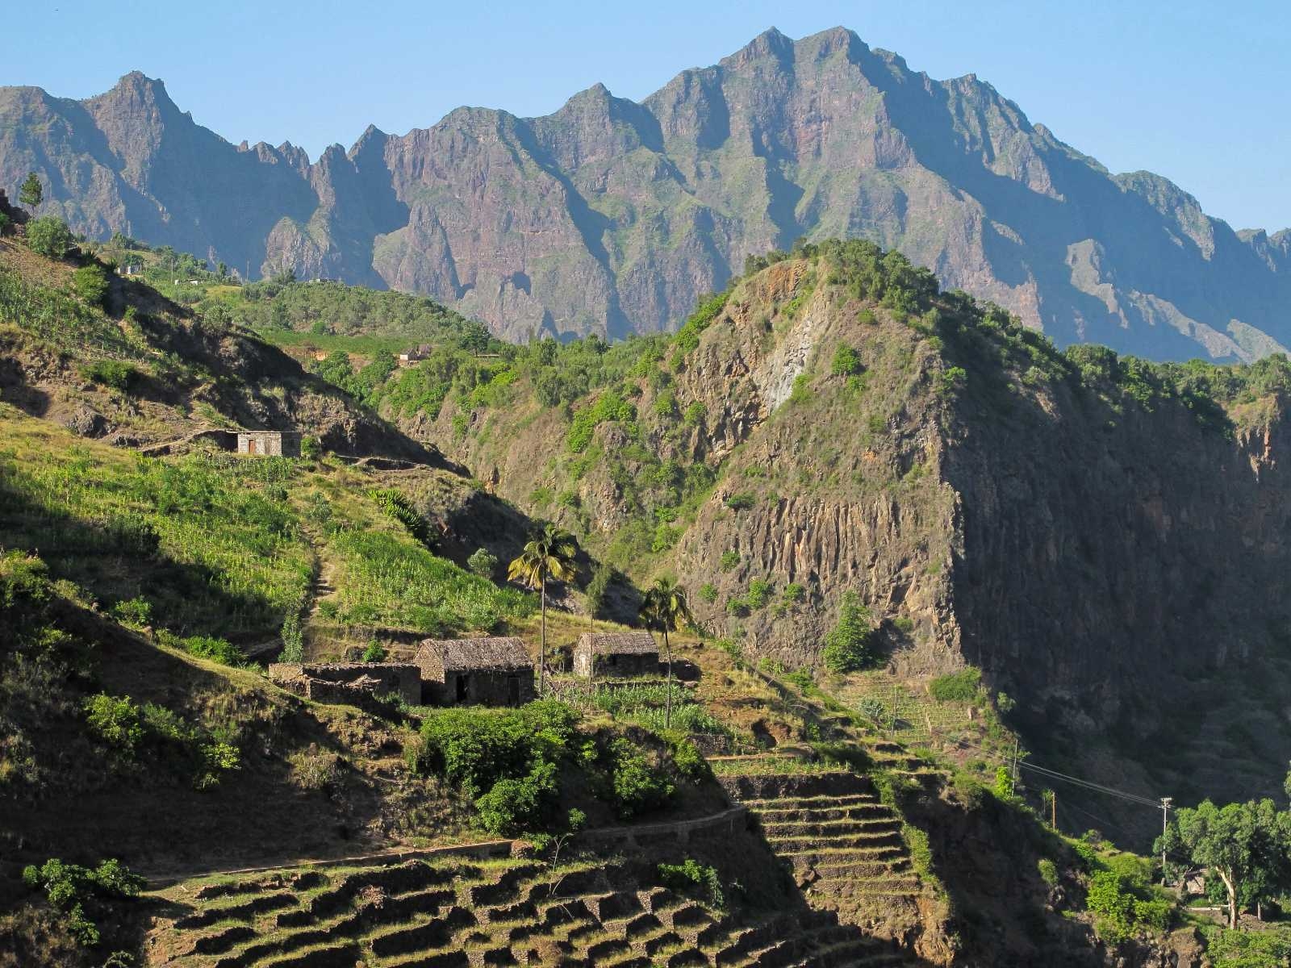


INTERNATIONAL
CONFERENCE
07- 09 JUNE
________■________
2021
PRAIA
CAPE VERDE
PROGRAMME
www.basaltconference.com

Slide 2
Item | Page | Item | Page
Preamble | 3 | Summary of the Business Forum Program | 7
Conference Programme - Day 1 | 4 | Deadlines | 8
Conference Programme - Day 2 | 5 | Events Schedule | 9
Conference Programme - Day 3 | 6 | Contacts | 10
CONFERENCE
PROGRAMME
07- 09 JUNE
________■________
2021
PRAIA
CAPE VERDE
www.basaltconference.com
Focused on Environmental Protection
Centred on Innovation
PLAN
Actions
Results
Realist
Strategic
Revaluation

Slide 3
PREAMBLE
Cape Verde will host an international event on the theme «APPLICATION OF BASALT POWDER IN AGRICULTURE - Its Benefits as Fertilizer for Agriculture». The event will take place from June 07 to 11, 2021, at the Noble Hall of the National Assembly of Cape Verde, Praia.
The event has two components: an International Conference and a Business Forum. Each event component has a specific programming.
The International Conference, entitled BASALT CONFERENCE, focuses on the application of basalt powder in agriculture lasting three days, from June 07 to 09, 2021. An «Integration Round Table and Debates» will close the event.
In parallel, there will be a Business Forum, entitled ATLANTIC BUSINESS FORUM, of three days, from June 9 to 11, 2021, includes a round table on business on June 9, 2021, focused on Business Opportunities and Business Partnerships, involving African companies, with particular emphasis on those of ECOWAS, with companies of other origins, in particular from Europe and Brazil.
CONFERENCE
PROGRAMME
07- 09 JUNE
________■________
2021
PRAIA
CAPE VERDE
www.basaltconference.com

Slide 4
PROGRAMME
DAY 07 June 2021
ACCREDITATION:
08:00 – 08:30
08:30 – 10:15
10:15 – 10:45
10:45 – 12:30
12:30 – 14:00
14:00 – 15:45
15:45 – 16:15
16:15 – 18:00
20:00 – 22:30
From 7:00
Opening ceremony
Conference I: «THE CURRENT STATE OF THE RESEARCH OF THE USE OF BASALT POWDER AND THE CONSOLIDATION OF ITS APPLICATION IN AGRICULTURE»
Speaker: Dr. Eder Martins – Researcher at EMBRAPA - Brazilian Agricultural Research Corporation
Moderador: Cabo Verde
Debate
Coffee Break
Conference II: «FROM THE RESEARCH TO THE LEGISLATION AND REGULATION OF THE APPLICATION OF BASALT POWDER IN AGRICULTURE : Brazil as Case Study»
Speaker: Prof. Suzi Huff Theodoro – Researcher at the University of Brasília
Moderator: Cabo Verde
Debate
Lunch
Conference III: «RECONSTRUCTION OF THE SOIL AND ENVIRONMENT THROUGH FINELY CRUSHED ROCKS TO INCREASE PRODUCTIVITY AND FOOD QUALITY»
Speaker: Prof. Bernardo Knapik – Researcher at Paraná State University - Brazil
Moderator : Cabo Verde
Debate
Coffee Break
Conference IV: «USE OF BASALT POWDER IN AGRICULTURE – Case Studiy»
Speaker: Prof. Emeritus Peter van Straaten – University of Guelph – Canada
Moderator: Côte d’Ivoire
Debate
Welcome Reception
CONFERENCE
PROGRAMME
07- 09 JUNE
________■________
2021
PRAIA
CAPE VERDE
Remark: Some of the names indicated are still being confirmed.

Slide 5
PROGRAMME
DAY 08 June 2021
ACCREDITATION:
08:30 – 10:15
10:15 – 10:30
10:30 – 12:15
12:15 – 13:45
13:45 – 15:30
15:30 – 15:45
15:45 – 17:30
17:30 – 17:45
17:45 – 19:30
>19:30
from 7:00
Panel I: «THE CURRENT STATE OF THE RESEARCH OF THE USE OF SILICATIC ROCKS IN SOIL CORRECTION AND FERTILIZATION - State of the Art in Africa »
Moderator: Cabo Verde
Speakers:
» CILSS - Permanent Interstate Committee for Drought Control in the Sahel
» University of Poitiers - France
» University of Stellenbosch - South Africa
» Prof Jean Pierre Tchouankoue - University of Yaoundé - Cameroon
» Prof Vincent Kato – Ministry of Energy and Minerals of Uganda
Debate
Coffee Break
Painel II: «THE CHALLENGES OF SUSTAINABLE DEVELOPMENT: - The need for strategic management of nutrients in agriculture»
Moderator: Cabo Verde
Speakers:
» Ministry of Agriculture and Rural Development of Côte d'Ivoire
» ARAA - Regional Agency for Agriculture and Food
» Directorate of Agriculture and Rural Development of ECOWAS
» Ministry of Agriculture of The Gambia
» National Fund for Agricultural Development (FNDA) - Benin
Debate
Lunch
Conference V: «THE CHALLENGES OF AGRICULTURAL PRODUCTION AND PROCESSING
IN WEST AFRICA - An opportunity for industrialization»
Moderador : Cabo Verde
Speaker: FAO – Food and Agriculture Organization of the United Nations
Debate
Coffee Break
Conference VI: «SOIL FERTILIZATION WITH ROCK POWDER AND FOOD PRODUCTION»
Moderator: Cabo Verde
Speaker: Prof. Emeritus Othon Henry Leonardos, Researcher at the University of Brasília
Debate
Coffee Break
Painel III: «BASALTS: AGROMINERAL POTENTIAL AND PRODUCTIVE CHAIN OPPORTUNITIES »
Moderator: Cabo Verde
Speaker:
MSc. Magda Bergmann - Researcher at Geological Survey of Brazil
MSc. Andrea Sander - Researcher at Geological Survey of Brazil
FREE TIME
CONFERENCE
PROGRAMME
07- 09 JUNE
________■________
2021
PRAIA
CAPE VERDE
Remark: Some of the names indicated are still being confirmed.

Slide 6
PROGRAMME
THE ROUND TABLE PROGRAM
BASALT POWDER IN AGRICULTURE
FOOD QUALITY AND ENVIRONMENTAL PROTECTION
«ROUND TABLE OF INTEGRATION AND DEBATES»
DAY 09 June 2021
ACCREDITATION : From 7:30
08:00 – 09:30
09:30 – 09:45
09:45 – 11:15
11:15 – 11:30
11:30 – 13:00
13:00 – 14:30
14:30 – 16:00
16:00 – 16:15
20:30 – 23:00
Theme I: Research, Legislation, Regulation and Technology of «Rochagem»
Moderator: ANMCV - National Association of Municipalities of Cape Verde
Interventions of Experts:
■ Prof. Suzi Huff Theodoro – Researcher at the University of Brasilia
■ Prof. Émérite Peter van Straaten – Research Fellow at the University of Guelph - Canada
■ Prof. Eder de Souza Martins – Researcher at EMBRAPA (Brazilian Society for Agro-Livestock Research)
Debates
Coffee break
Theme II: Fertilization of agricultural soils and protection of the environment
Moderator Chambre de commerce, d‘Industrie, d‘Agriculture et de Services de Sotavento - CCIASS (Cap-Vert)
Interventions of Experts:
■ Directorate of Agriculture and Rural Development of ECOWAS
■ ARAA - Regional Agency for Agriculture and Food
■ Prof. Emeritus Othon Henry Leonardos - Researcher at the University of Brasilia
Debates
Coffee break
Theme III: The Agromineral Potential of Basalt and its specificities
Moderator: Cape Verde Civil Engineering Laboratory
Interventions of Experts:
■ MSc. Magda Bergmann - Researcher of the Geological Survey of Brazil
■ MSc. MSc. Andrea Sander - Researcher of the Geological Survey of Brazil
■ Prof. Emeritus Peter van Straaten - Research Fellow at the University of Guelph - Canada
■ Prof Jean Pierre Tchouankoue - University of Yaoundé - Cameroon
Debates
Lunch
Theme IV: Agricultural profitability and quality control of food produced
Moderator:University of Cape Verde
Interventions of Experts:
■ FAO – Food and Agriculture Organization of the United Nations
■ ENSA - National School of Agronomy of Yamoussoukro – Côte d’Ivoire
■ Prof. Bernardo Knapik - Researcher at Estadual do Paraná University - Brazil
Debates
Closing Session of the Conference
Welcome dinner «THE FLAVORS OF ECOWAS»
CONFERENCE
PROGRAMME
07- 09 JUNE
________■________
2021
PRAIA
CAPE VERDE
Remarque: Certains des noms mentionnés sont encore en cours de confirmation.

Slide 7

PROGRAMME
3rd DAY - 11 JUNE
2021
11 June
Panel II
ECONOMIC AND FINANCIAL WORKSHOP
Panel II
«PRIVATE SECTOR FINANCING IN ECOWAS»
1st DAY - 9 JUNE
2nd DAY - 10 JUNE
BUSINESS ROUND
PRESENTATIONS
■ Cabo Verde
■ Senegal
■ The Gambia
■ Cote d’Ivoire
■ Benin
PRESENTATIONS
■ Nigeria
■ Mali
■ Burkina Faso
■ Niger
■ Sierra Leone
Moderator: Cabo Verde
Speaker:
■ ECOWAS Investment and Development Bank
■ African Guarantee and Economic Cooperation Fund
■ African Development Bank - AfDB
■ International Finance Corporation – IFC
■ French Development Agency - AFD
Accreditation - 08:00 – 08:15
8:00 – 10:00
Business Round
Coffee-Break
08:15 – 10:15
10:00 – 10:30
2021
11 June
Conference II
Coffee-Break
Conference II
«ACCESS TO THE PREFERENTIAL UNITED STATES MARKET»
10:15 – 10:45
Coffee-Break
Business Round
2021
10 June
Business Opportunities
2021
10 June
Business Opportunities
Moderator: Cabo Verde
Speaker: USA / AGOA
16:30 – 17:00
10:45 – 12:30
10:30 – 12:30
Lunch
Coffee-Break
Lunch
12:30 – 14:00
10:30 – 11:00
08:30 – 10:30
14:30 – 16:30
12:30 – 14:00
Conference III
«THE DEVELOPMENT OF THE DIGITAL ECONOMY IN ECOWAS: The Importance of TIC in the Develepment of Start-Ups, Market Innovation and Regional Integration»
Business Round
2021
11 June
Panel III
14:00 – 15:30
2021
10 June
Business Opportunities
Free time
2021
10 June
Market
Opportunity
Moderator: Cabo Verde
Speaker: ECOWAS
> 18:30
Lunch
2021
9 June
Opening Session
of Business Forum
13:00 – 14:30
14:00 – 16:00
Coffee-Break
11:00 -13:00
17:00 -18:30
16:00 – 16:30
2021
11 June
Conference III
Conference IV
«ACCESS TO THE PREFERENTIAL EUROPEAN UNION MARKET»
17:00 – 17:15
PRESENTATIONS
■ Gana
■ Togo
■ Guinea
■ Guinea-Bissau
■ Liberia
Conference I
«ACCESS TO THE ECOWAS PREFERENTIAL MARKET»
Moderator: Cabo Verde
Speaker: UE / SPG +
ECONOMIC WORKSHOP
16:30 – 18:30
Panel I:
BRAZIL: The Potential and the Opportunity of Technical and Entrepreneurial Cooperation.
Moderator: Cabo Verde
Speaker: CEDEAO
17:15 – 19:15
2021
11 June
Cloning session
2021
11 June
GALA DINNER
Remark: Some of the names indicated are still being confirmed.
Pag 7
18:30 – 19:00
20:30 – 23:00

Slide 8

DEADLINES FOR EXPRESSION OF INTEREST AND REGISTRATION
Deadline for the expression of interest in participating in the business network
Deadline for registration to participate in the business round
2021
10 June
PRESENTATION OF OPPORTUNITIES IN ECOWAS
2020
01
August
2021
31
January
2021
30
April
2021
09
June
2021
10 AND 11
June
2021
11 June
ACCESS TO PREFERENTIAL MARKETS
Registration opens for expressions of interest and participation in the Forum
BUSINESS FORUM
BUSINESS ROUND
Pag 8

Slide 9

 |  |  |  |  |  |  |  |  | EVENTS AGENDA
BASALT CONFERENCE |  |  |  |  |  |  |  |  |  |  | ATLANTIC BUSINESS FORUM
INTERNATIONAL CONFERENCE |  |  |  |  |  | ROUNDTABLE OF INTEGRATION AND DEBATES |  |  |  |  | BUSINESS ROUND
07 - 08 JUNE 2021 |  |  |  |  |  | 09 JUNE 2021 |  |  |  |  | 09 JUNE 2021
APPLICATION OF BASALT POWDER IN AGRICULTURE |  |  |  |  |  | BASALT POWDER IN AGRICULTURE |  |  |  |  | BUSINESS OPPORTUNITIES AND PARTNERSHIP
Its Benefits as Fertilizer for Agriculture |  |  |  |  |  | The Quality of Food and the Protection of The Environment |  |  |  |  | 08:00 | - | 08:15 | Accreditation of Business Round
 |  |  |  |  |  |  |  |  |  |  | 08:15 | - | 10:15 | Business Round
 |  |  |  |  |  |  |  |  |  |  | 10:15 | - | 10:45 | Coffee-Break
DAY 1 |  |  |  |  |  | DAY 3 |  |  |  |  | 10:45 | - | 12:30 | Business Round
07 JUNE 2021 |  |  |  |  |  | 09 JUNE 2021 |  |  |  |  | 12:30 | - | 14:00 | Lunch
ACCREDITATION: From 7:00 |  |  |  |  |  | ACCREDITATION: From 7:00 |  |  |  |  | 14:00 | - | 15:30 | Business Round
08:00 | - |  | 08:30 | Opening ceremony |  | 08:30 | - | 16:00 | Roundtable of Integration and Dabates |  | 17:00 | - | 17:15 | Opening Ceremony of the ATLANTIC BUSINESS FORUM
08:30 | - |  | 10:15 | Conference I: |  | 08:30 | - | 08:45 | Introduction to Meeting |  | 17:00 | - | 19:15 | Panel I: «BRAZIL: The Potential and the Opportunity of Technical and Entrepreneurial Cooperation»
10:15 | - |  | 10:45 | Coffee Break |  | 08:45 | - | 10:15 | Interventions of Experts |  | 10 JUNE 2021
10:45 | - |  | 12:30 | Conference II: |  |  |  |  | Debates |  | ACCREDITATION: From 7:00
12:30 | - |  | 14:00 | Lunch |  | 10:15 | - | 10:45 | Coffee Break |  | 08:30 | - | 10:30 | Presentation of Opportunities in ECOWAS
14:00 | - |  | 15:45 | Conference a III: |  | 10:45 | - | 12:00 | Interventions of Experts |  | 10:30 | - | 11:00 | Coffee Break
15:45 | - |  | 16:15 | Coffee Break |  |  |  |  | Debates |  | 11:00 | - | 13:00 | Presentation of Opportunities in ECOWAS
16:15 | - |  | 18:00 | Conference IV: |  | 12:00 | - | 13:30 | Lunch |  | 13:00 | - | 14:30 | Lunch
 |  |  |  |  |  |  |  |  |  |  | 14:30 | - | 16:30 | Presentation of Opportunities in ECOWAS
20:00 | - |  | 22:30 | Welcome Reception |  | 13:30 | - | 16:00 | Interventions of Experts |  | 16:30 | - | 17:00 | Coffee Break
DAY 2 |  |  |  |  |  |  |  |  | Debates |  | 17:00 | - | 18:30 | Conference I - ACCESS TO THE ECOWAS PREFERENTIAL MARKET
08 JUNE 2021 |  |  |  |  |  |  |  |  |  |  | >18:30 | - | FREE TIME
ACCREDITATION: From 7:00 |  |  |  |  |  |  |  |  |  |  | 11 JUNE 2021
08:30 |  | - | 10:15 | Panel I: |  | 16:00 | - | 16:15 | Closing Session of the Conference |  | ACCREDITATION: From 7:00
10:15 |  | - | 10:30 | Coffee Break |  |  |  |  |  |  | 08:00 | - | 10:00 | Painel II - PRIVATE SECTOR FINANCING IN ECOWAS
10:30 |  | - | 12:00 | Panel II: |  | 20:30 | - | 23:00 | Welcome Dinner «THE FLAVORS OF ECOWAS» |  | 10:00 | - | 10:30 | Coffee Break
12:00 |  | - | 13:30 | Lunch |  |  |  |  |  |  | 10:30 | - | 12:30 | Conference II - ACCESS TO THE PREFERENTIAL UNITED STATES MARKET
13:30 |  | - | 15:15 | Conference V: |  |  |  |  |  |  | 12:30 | - | 14:00 | Lunch
15:15 |  | - | 15:30 | Coffee Break |  |  |  |  |  |  | 14:00 | - | 16:00 | Conference III - THE DEVELOPMENT OF THE DIGITAL ECONOMY IN ECOWAS
15:30 |  | - | 17:15 | Conference VI: |  |  |  |  |  |  | 16:00 | - | 16:30 | Coffee Break
17:15 |  | - | 17:30 | Coffee Break : |  |  |  |  |  |  | 16:30 | - | 18:30 | Conference IV - ACCESS TO THE PREFERENTIAL EUROPEAN UNION MARKET
 |  |  |  |  |  |  |  |  |  |  | 18:30 | - | 19:00 | Closing Session of the Atlantic Business Forum
17:30 |  | - | 19:15 | Panel III : |  |  |  |  |  |  | 20:30 | - | 23:00 | GALA DINNER
>18:30 |  | - | FREE TIME

Slide 10
09 -11 JUNE
________■________
2021
PRAIA
SANTIAGO ISLAND
CABO VERDE
www.basaltconference.com
CONTACTS
BASALT CONFERENCE
WhatsApp:+351 964 406 800
Viber:+351 964 406 800
Skype: setimocontinente
info@basaltconference.com
www.basaltconference.com
Pag 10

