Slide 1


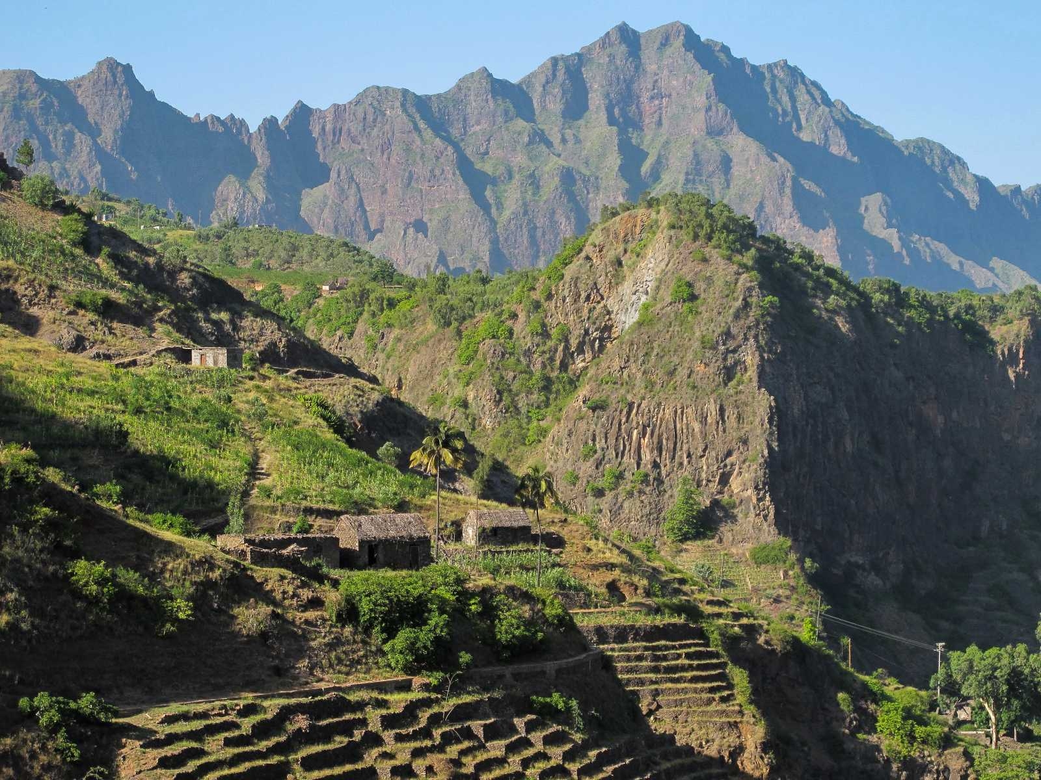


INTERNATIONAL
CONFERENCE
07- 09 JUNE
________■________
2021
PRAIA
CAPE VERDE
PROGRAMME
www.basaltconference.com

Slide 2
Item | Page | Item | Page
Preamble | 3 | Summary of the Business Forum Program | 7
Conference Programme - Day 1 | 4 | Deadlines | 8
Conference Programme - Day 2 | 5 | Events Schedule | 9
Conference Programme - Day 3 | 6 | Contacts | 10
CONFERENCE
PROGRAMME
07- 09 JUNE
________■________
2021
PRAIA
CAPE VERDE
www.basaltconference.com
Focused on Environmental Protection
Centred on Innovation
PLAN
Actions
Results
Realist
Strategic
Revaluation

Slide 3
PREAMBLE
Cabo Verde will host an international event on the theme «APPLICATION OF BASALT POWDER IN AGRICULTURE AND BASALT FIBER IN INDUSTRY - Its advantages as Fertilizer and Reinforcement of Composite Materials». The event will take place on 7 -9 June 2021, in the Noble Hall of the Parliament of Cabo Verde, city of Praia.
The International Conference is focused on the application of basalt powder in agriculture and basalt fiber in industry and lasts three days, 7 - 9 June 2021.
In parallel, a three-day Business Forum, called ATLANTIC BUSINESS FORUM, will take place, from June 9 to 11, 2021, includes a business roundtable on June 9, 2021, focused on Business Opportunities and Business Partnerships, involving African companies, with particular emphasis on those of ECOWAS, with companies from other origins, especially from Europe and Brazil. Each component of the event has a specific program.
CONFERENCE
PROGRAMME
07- 09 JUNE
________■________
2021
PRAIA
CAPE VERDE
www.basaltconference.com

Slide 4
PROGRAMME
DAY 07 June 2021
ACCREDITATION:
08:00 – 08:30
08:30 – 10:15
10:15 – 10:45
10:45 – 12:30
12:30 – 14:00
14:00 – 15:45
15:45 – 16:15
16:15 – 18:00
20:00 – 22:30
From 7:00
Opening ceremony
Conference I: «THE CURRENT STATE OF THE RESEARCH OF THE USE OF BASALT POWDER AND THE CONSOLIDATION OF ITS APPLICATION IN AGRICULTURE»
Speaker: Dr. Eder Martins – Researcher at EMBRAPA - Brazilian Agricultural Research Corporation
Moderador: Cabo Verde
Debate
Coffee Break
Conference II: «FROM THE RESEARCH TO THE LEGISLATION AND REGULATION OF THE APPLICATION OF BASALT POWDER IN AGRICULTURE : Brazil as Case Study»
Speaker: Prof. Suzi Huff Theodoro – Researcher at the University of Brasília
Moderator: Cabo Verde
Debate
Lunch
Conference III: «RECONSTRUCTION OF THE SOIL AND ENVIRONMENT THROUGH FINELY CRUSHED ROCKS TO INCREASE PRODUCTIVITY AND FOOD QUALITY»
Speaker: Prof. Bernardo Knapik – Researcher at Paraná State University - Brazil
Moderator : Cabo Verde
Debate
Coffee Break
Conference IV: «USE OF BASALT POWDER IN AGRICULTURE – Case Studiy»
Speaker: Prof. Emeritus Peter van Straaten – University of Guelph – Canada
Moderator: Cabo Verde
Debate
Welcome Reception
CONFERENCE
PROGRAMME
07- 09 JUNE
________■________
2021
PRAIA
CAPE VERDE

Slide 5
PROGRAMME
DAY 08 June 2021
ACCREDITATION:
08:30 – 10:15
10:15 – 10:45
10:45 – 12:30
12:30 – 14:00
14:00 – 15:45
15:45 – 16:15
16:15 – 18:00
>18:00
from 7:00
Panel I: «THE CURRENT STATE OF THE RESEARCH OF THE USE OF SILICATIC ROCKS IN SOIL CORRECTION AND FERTILIZATION - State of the Art in Africa »
Moderator: Cabo Verde
Speakers:
» University of Yaoundé - Cameroon
» University of Poitiers - France
» University of Stellenbosch - South Africa
» University of Antananarivo - Madagascar
» CILSS - Permanent Interstate Committee for Drought Control in the Sahel
Debate
Coffee Break
Painel II: «THE CHALLENGES OF SUSTAINABLE DEVELOPMENT: - The need for strategic management of nutrients in agriculture»
Moderator: Cabo Verde
Speakers:
» Ministry of Agriculture and Rural Development of Côte d'Ivoire
» FAO – Food and Agriculture Organization of the United Nations
» ARAA - Regional Agency for Agriculture and Food
» Directorate of Agriculture and Rural Development of ECOWAS
» Ministry of Agriculture of The Gambia
Debate
Lunch
Conference V: «BASALTS: AGROMINERAL POTENTIAL AND PRODUCTIVE CHAIN OPPORTUNITIES »
Speaker: Dra Magda Bergmann - Researcher at Geological Survey of Brazil
Moderator: Cabo Verde
Debate
Coffee Break
Conferência VI: «SOIL FERTILIZATION WITH ROCK POWDER AND FOOD PRODUCTION»
Speaker: Prof. Emeritus Othon Henry Leonardos, Researcher at the University of Brasília
Moderator: Cabo Verde
Debate
Free time
CONFERENCE
PROGRAMME
07- 09 JUNE
________■________
2021
PRAIA
CAPE VERDE

Slide 6
PROGRAMME
DAY 09 June 2021
ACCREDITATION:
08:30 – 10:15
10:15 – 10:45
10:45 – 12:30
12:30- 14:00
14:00 – 16:00
16:00 – 16:30
20:30 – 23:00
from 7:00
Conference VI: «THE ORNAMENTAL ROCKS SECTOR - The potential of Basalt as an ornamental rock»
Moderador : Cabo Verde
Speaker: The BRGM - Bureau de Recherches Géologiques et Minières (France)
Debate
Coffee Break
Conference VII: «THE CHALLENGES OF AGRICULTURAL PRODUCTION AND PROCESSING IN WEST AFRICA - An opportunity for industrialization»
Moderador : Cabo Verde
Speaker: Directorate-General for Agriculture and Rural Development - European Commission
Debate
Lunch
Panel III: «THE ROLE OF THE BASALT INDUSTRY IN ECONOMIC COOPERATION AND STRENGTHENING REGIONAL INTEGRATION – An Asset in Economic Cooperation and Trade between Cabo Verde, Senegal and The Gambia»
Moderador : Cabo Verde
Speakers:
» Cabo Verde
» Ministry of Mines and Geology of Senegal
» Ministry of Transport, Works and Infrastructure of The Gambia
» African Development Bank - AfDB
» ECOWAS Bank for Investment and Development – EBID
» International Finance Corporation - IFC
Debate
Closing ceremony of the International Conference
Welcome Dinner «THE FLAVORS OF ECOWAS»
CONFERENCE
PROGRAMME
07- 09 JUNE
________■________
2021
PRAIA
CAPE VERDE

Slide 7

PROGRAMME
3rd DAY - 11 JUNE
2021
11 June
Panel I
ECONOMIC AND FINANCIAL WORKSHOP
Panel I
«PRIVATE SECTOR FINANCING IN ECOWAS»
1st DAY - 9 JUNE
2nd DAY - 10 JUNE
BUSINESS ROUND
PRESENTATIONS
■ Cabo Verde
■ Senegal
■ The Gambia
■ Cote d’Ivoire
■ Benin
PRESENTATIONS
■ Nigeria
■ Mali
■ Burkina Faso
■ Niger
■ Sierra Leone
Moderator: Cabo Verde
Speaker:
■ ECOWAS Investment and Development Bank
■ African Guarantee and Economic Cooperation Fund
■ African Development Bank - AfDB
■ International Finance Corporation - IFC
Accreditation - 08:00 – 08:15
8:00 – 10:00
Business Round
Coffee-Break
08:15 – 10:15
10:00 – 10:30
2021
11 June
Conference II
Coffee-Break
Conference II
«ACCESS TO THE PREFERENTIAL UNITED STATES MARKET»
10:15 – 10:45
Coffee-Break
Business Round
2021
10 June
Business Opportunities
2021
10 June
Business Opportunities
Moderator: Cabo Verde
Speaker: USA / AGOA
16:30 – 17:00
10:45 – 12:30
10:30 – 12:30
Lunch
Coffee-Break
Lunch
12:30 – 14:00
10:30 – 11:00
08:30 – 10:30
14:30 – 16:30
13:00 – 14:30
ECONOMIC AND FINANCIAL WORKSHOP
Panel II - «THE DEVELOPMENT OF THE DIGITAL ECONOMY IN AFRICA: The Importance of Start-Ups in Market Innovation and Youth Entrepreneurship»
Business Round
2021
11 June
Panel II
14:00 – 15:30
2021
10 June
Business Opportunities
Free time
2021
10 June
Market
Opportunity
Moderator: Cabo Verde
Speaker:
■ ECOWAS Commission
■ Startup Europe Partnership - SEP
■ French Development Agency - AFD
■ CGAP - Consultative Group to Assist the Poor
> 18:30
Lunch
14:30 – 16:30
2021
9 June
Opening Session
of Business Forum
13:00 – 14:30
Coffee-Break
11:00 -13:00
17:00 -18:30
16:30 – 17:00
2021
11 June
Conference III
Conference III
«ACCESS TO THE PREFERENTIAL EUROPEAN UNION MARKET»
PRESENTATIONS
■ Gana
■ Togo
■ Guinea
■ Guinea-Bissau
■ Liberia
Conference I
«ACCESS TO THE ECOWAS PREFERENTIAL MARKET»
15:30 – 16:00
Moderator: Cabo Verde
Speaker: UE / SPG +
Moderator: Cabo Verde
Speaker: CEDEAO
17:00 – 19:00
ECONOMIC WORKSHOP
2021
11 June
Opening Session
2021
11 June
GALA DINNER
BRAZIL: The Potential and the Opportunity of Technical and Entrepreneurial Cooperation.
16:00 – 18:00
Remark: Some of the names indicated are still being confirmed.
Pag
19:00 – 19:30
20:30 – 23:00

Slide 8

DEADLINES FOR EXPRESSION OF INTEREST AND REGISTRATION
Deadline for the expression of interest in participating in the business network
Deadline for registration to participate in the business round
2021
10 June
PRESENTATION OF OPPORTUNITIES IN ECOWAS
2020
01
August
2021
31
January
2021
30
April
2021
09
June
2021
10 AND 11
June
2021
11 June
ACCESS TO PREFERENTIAL MARKETS
Registration opens for expressions of interest and participation in the Forum
BUSINESS FORUM
BUSINESS ROUND
Pag

Slide 9

EVENTS AGENDA
INTERNATIONAL CONFERENCE |  |  |  |  |  | INTERNATIONAL CONFERENCE |  |  |  |  | ATLANTIC BUSINESS FORUM
07 to 09 JUNE 2021 |  |  |  |  |  | 09 JUNE 2021 |  |  |  |  | 09 - 11 JUNE 2021
Application of Basalt Powder in Agriculture and Basalt Fiber in Industry |  |  |  |  |  | Application of Basalt Powder in Agriculture and Basalt Fiber in Industry |  |  |  |  | 08:00 | - | 08:15 | ACCREDITATION OF BUSINESS ROUND
 |  |  |  |  |  |  |  |  |  |  | 08:15 | - | 12:30 | BUSINESS ROUND
07 June 2021 |  |  |  |  |  | 09 June 2021 |  |  |  |  | 12:30 | - | 14:00 | LUNCH
ACCREDITATION:From 7:00 |  |  |  |  |  | ACCREDITATION:From 7:00 |  |  |  |  | 14:00 | - | 15:30 | BUSINESS ROUND
08:00 | - |  | 08:30 | Opening Ceremony |  | 08:30 | - | 10:15 | Conference VII |  | 15:30 | - | 18:00 | ECONOMIC WORKSHOP
08:30 | - |  | 10:15 | Conference I: |  | 10:15 | - | 10:45 | Coffee Break |  | 10 JUNE 2021
10:15 | - |  | 10:45 | Coffee Break |  | 10:45 | - | 12:30 | Conference VIII |  | ACCREDITATION:From 7:00
10:45 | - |  | 12:30 | Conference II: |  | 12:30 | - | 14:00 | Lunch |  | 08:00 | - | 08:30 | Opening Ceremony
12:30 | - |  | 14:00 | Lunch |  | 14:00 | - | 16:00 | Panel IV |  | 08:30 | - | 10:30 | Presentation of Opportunities in ECOWAS
14:00 | - |  | 15:45 | Conference III: |  |  |  |  |  |  | 10:30 | - | 11:00 | Coffee Break
15:45 | - |  | 16:15 | Coffee Break |  |  |  |  |  |  | 11:00 | - | 13:00 | Presentation of Opportunities in ECOWAS
16:15 | - |  | 18:00 | Conference IV: |  |  |  |  |  |  | 13:00 | - | 14:30 | Lunch
 |  |  |  |  |  |  |  |  |  |  | 14:30 | - | 16:30 | Presentation of Opportunities in ECOWAS
20:00 | - |  | 22:30 | Welcome Reception |  | 16:00 | - | 16:30 | Closing Session |  | 16:30 | - | 17:00 | Coffee Break
 |  |  |  |  |  |  |  |  |  |  | 17:00 | - | 18:30 | Conference I - ACCESS TO THE ECOWAS PREFERENTIAL MARKET
08 June 2021 |  |  |  |  |  | 20:30 | - | 23:00 | Welcome Dinner «THE FLAVORS OF ECOWAS» |  | >18:30 | - | Free time
ACCREDITATION: From 7:00 |  |  |  |  |  |  |  |  |  |  | 11 JUNE 2021
08:30 |  | - | 10:15 | Panel I: |  |  |  |  |  |  | ACCRÉDITATION: From 7:00
10:15 |  | - | 10:45 | Coffee Break |  |  |  |  |  |  | 08:00 | - | 10:00 | Panel I - PRIVATE SECTOR FINANCING IN ECOWAS
10:45 |  | - | 12:30 | Panel II: |  |  |  |  |  |  | 10:00 | - | 10:30 | Coffee Break
12:30 |  | - | 14:00 | Lunch |  |  |  |  |  |  | 10:30 | - | 12:30 | Panel II - THE DEVELOPMENT OF THE DIGITAL ECONOMY IN AFRICA
14:00 |  | - | 15:45 | Conference V: |  |  |  |  |  |  | 12:30 | - | 14:00 | Lunch
15:45 |  | - | 16:15 | Coffee Break |  |  |  |  |  |  | 14:00 | - | 16:00 | Conference II - ACCESS TO THE PREFERENTIAL UNITED STATES MARKET
16:15 |  | - | 18:00 | Conference VI: |  |  |  |  |  |  | 16:00 | - | 16:30 | Coffee Break
 |  |  |  |  |  |  |  |  |  |  | 16:30 | - | 18:30 | Conference III -ACCESS TO THE PREFERENTIAL EUROPEAN UNION MARKET
 |  |  |  |  |  |  |  |  |  |  | 18:30 | - | 19:00 | Closing Session of the Business Forum
>18:30 |  | - | Temps libre |  |  |  |  |  |  |  | 20:30 | - | 23:00 | GALA DINNER
Pag

Slide 10
09 -11 JUNE
________■________
2021
PRAIA
SANTIAGO ISLAND
CABO VERDE
www.basaltconference.com
CONTACTS
BASALT CONFERENCE
WhatsApp:+351 964 406 800
Viber:+351 964 406 800
Skype: setimocontinente
info@basaltconference.com
www.basaltconference.com
Pag

