Slide 1



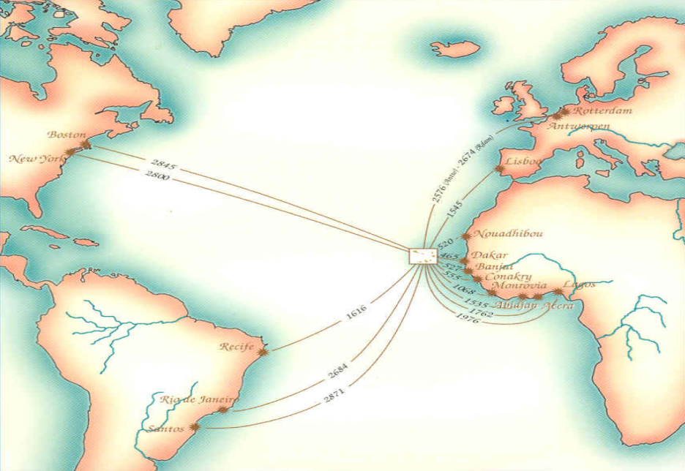
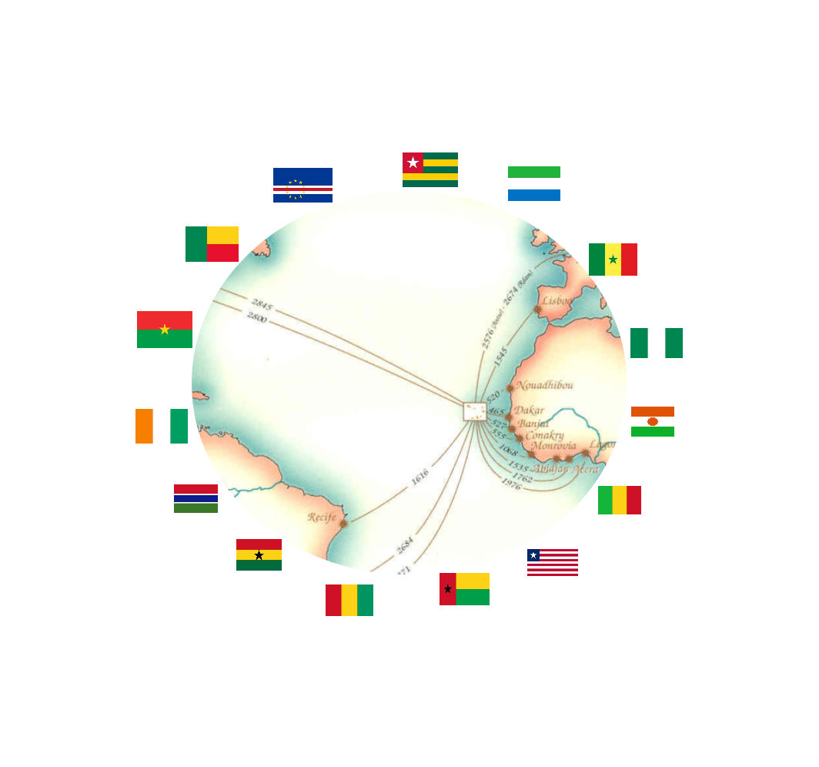


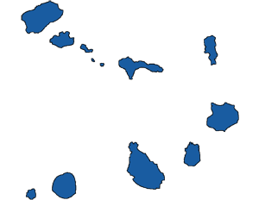
BUSINESS
ROUND
BRIDGE TO MARKETS
PRODUCTS AND SERVICES
SUSTAINABILITY
AND RESILIENCE
09 JUNE
________■________
2021
PRAIA
SANTIAGO ISLAND
CABO VERDE
WARRANTY AND
OPPORTUNITY
IMPORT
AND
EXPORT
FROM
CAPE VERDE
TO THE WORLD
PARTNERSHIPS
AND
COMMITMENTS
PROMOTE
AND
DISSEMINATE
Stability
Consolidation
Warranty
Transparency
Trust
Competence
Efficiency
Excellence
INNOVATE
IN PRODUCTS
HOSPITALITY
AND ADDED VALUE
INNOVATE
IN PROCESSES
DIGITAL
ECONOMY
Cabo Verde, the place where departure and destination converge
Mobilize
Undertake
Expand
Growth
NETWORK
ECOWAS
Share
15 country
Synergy
Sustainability
Opportunity
Simplicity
A market with strong potential
Resilience
Pag

Slide 2
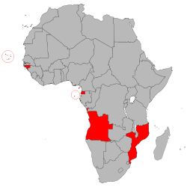
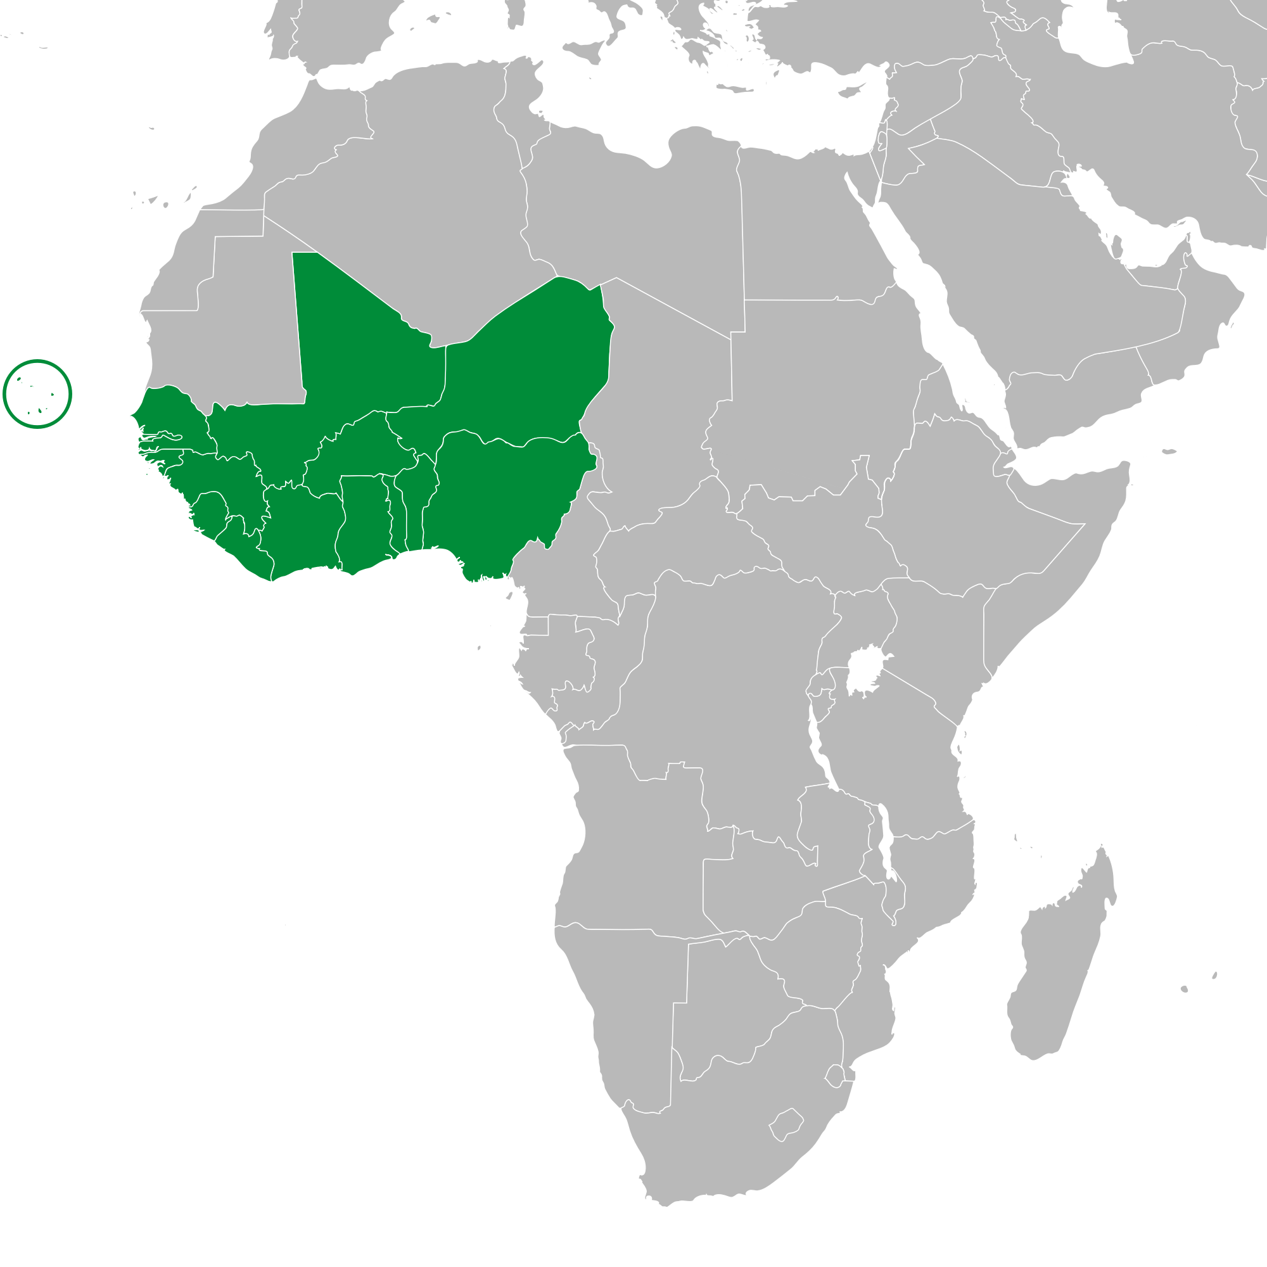
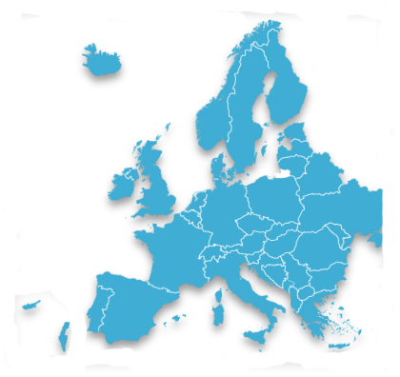
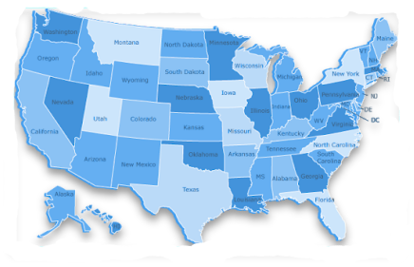
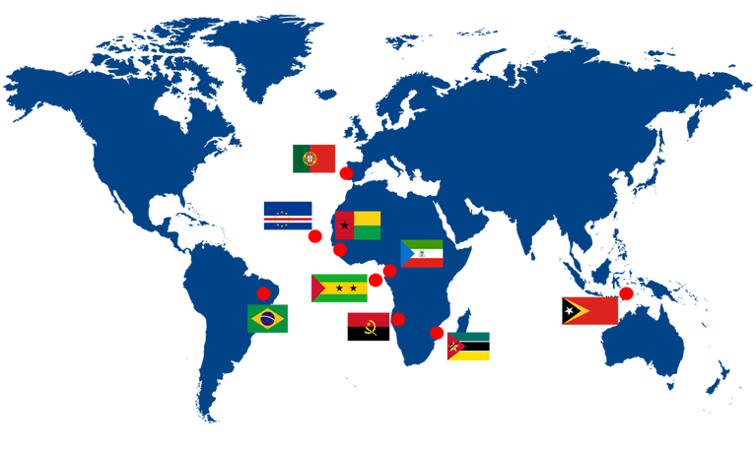
26 Countries
554.714.746 inh
■SADC
■CEEAC
■CEMAC
■Angola » Mozambique
■Angola » Equatorial Guinea » São Tomé and Príncipe
■Equatorial Guinea
CABO VERDE
ZEE: 734.265 Km2
Market position
Position in the economic region
15 Countries
397.205.519 inh
188.423.476 Internet User
47.4 % Penetration [ % Pop.]
6 Countries
68.267.839 inh
14.624.555 Internet User
21.0 % Penetration [ % Pop.]
■
THE GEOECONOMIC DIMENSION OF CABO VERDE
■European Union
■ASEAN
■MERCOSUR
■SADC
■CEEAC
■CEMAC
PALOP
■Portugal
■Timor - Leste
■Brazil
■Angola » Mozambique
■Angola » E. Guinea » São T. and Príncipe
■Equatorial Guinea
Member State
■
ECOWAS
Member State
Market position
Position in the economic region
■
EU / SPG+
Special agreement
Market position
27 Countries
513.635.012 inh
■
461.255.831Internet User
90.4 % Penetration [ % Pop.]
68 Countries
2.033.955.651 inh
■
USA / AGOA
Special agreement
Member State
CPLP
■ECOWAS -Economic Community of West African States
■PALOP - Portuguese Speaking African Countries
■CPLP - Community of Portuguese Speaking Countries
■SADC - Southern African Development Community
■ASEAN - Association of Southeast Asian Nations
■ECCAS - Economic Community of Central African States
■CEMAC - Central African Economic and Monetary Community
■EU / SPG+ - Generalised Scheme of Preferences
■USA / AGOA - African Growth and Opportunity Act
■MERCOSUR - Southern Common Market
By sea, by air and by digital channel Cape Verde links its business to 2.8 billion consumers on 4 continents.
9 Countries
292.111.889 inh
172.107.709 Internet User
61.4 % Penetration [ % Pop.]
333 812 486 inh
292.892.868 Internet User
89.0 % Penetration [ % Pop.]
www.atlanticbusinessforum.com

Slide 3
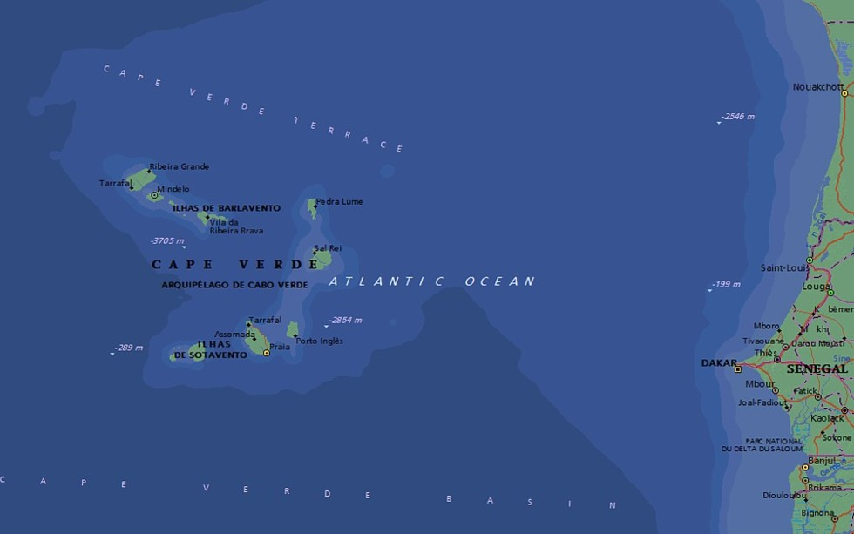
09 JUNE
________■________
2021
PRAIA
SANTIAGO ISLAND
CABO VERDE
36 hours by sea
50 min by sea flight
Pag

