Slide 1








BUSINESS
ROUND
16 MARCH
________■________
2022
PRAIA
CAPE VERDE
CONTACTS
EVENT
Apartado nº 1042
Código Postal nº 7600
Praia
República de Cabo Verde
WhatsApp:+351 964 406 800
Viber:+351 964 406 800
Skype: setimocontinente
events@atlanticbusinessforum.com
www.atlanticbusinessforum.com
www.emergys.tech
Ref.E-EICV.01/2022/VD-E.01

Slide 2

16 MARCH
________■________
2022
PRAIA
CAPE VERDE
Index | Pag | Index | Pag
Preamble | 3 | The responsibility of Associated Partners | 8
The Stages of the Business Round | 4 | Legal Assistence and Interpreter | 9
The Business Round | 5 | The Programme | 10
Business Round Methodology | 6 | Deadlines for expression of Internet and registration | 11
Business Round Methodology | 6 | How to participate | 12
Benefits of the Forum Business Round | 7 | Contacts | 13
The main benefits of participating in Business Round | 7
Support to Business and entrepreneurial initiatives | 7
The activities of Associated Partners | 7
BUSINESS ROUND
WhatsApp:+351 964 406 800
Skype: setimocontinente
www.businessround.emergys.pt
info@atlanticbusinessforum.com
www. atlanticbusinessforum.com

Slide 3
PREAMBLE
The BUSINESS ROUND of the Business Forum entitled «ATLANTIC BUSINESS FORUM» will include meetings between business leaders, businessmen, and entrepreneurs from different regions, namely from America, Africa, Brazil, Europe and other origins.
The areas of interest are, among others: supply and demand of business opportunities; supply and demand of business partnerships and expertise; supply and demand of products (all types); supply and demand of services (all types); and supply and demand of equipment (all types).
BUSINESS ROUND
PROGRAM
16 MARCH
________■________
2022
PRAIA
CAPE VERDE
Focused on business
Opportunity Centred
PLAN
Actions
Results
Realistic
Strategic
Revaluation

Slide 4
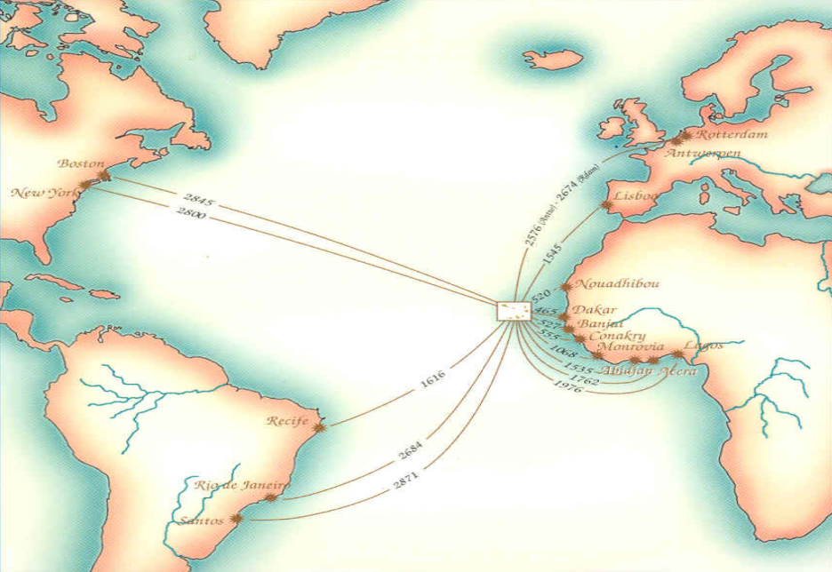

BUSINESS ROUND
PROGRAM
16 MARCH
________■________
2022
PRAIA
CAPE VERDE
BRIDGE TO MARKETS
PRODUCTS AND SERVICES
SUSTAINABILITY
AND RESILIENCE
WARRANTY AND
OPPORTUNITY
IMPORT
AND
EXPORT
FROM
CAPE VERDE
TO THE WORLD
PARTNERSHIPS
AND
COMMITMENTS
PROMOTE
AND
DISSEMINATE
Stability
Consolidation
Warranty
Transparency
Trust
Competence
Efficiency
Excellence
INNOVATE
IN PRODUCTS
HOSPITALITY
AND ADDED VALUE
INNOVATE
IN PROCESSES
DIGITAL
ECONOMY
Cabo Verde, the place where departure and destination converge
Mobilize
Undertake
Expand
Growth
NETWORK
ECOWAS
Share
15 country
Synergy
Sustainability
Opportunity
Simplicity
A market with strong potential
Resilience
Pag 4

Slide 5
BUSINESS ROUND STEPS
The Business Round will take place on 09 June 2021, from 8:00 to 15:30, in Cabo Verde. People who will participate must register in the Business Executive category. The Business Round consists of three steps:
STEP 1: Registration of participants and submission of their profiles. Participants, after registration, must submit their profiles for the Business Round from 01 August 2021.
STEP 2: Management and coordination of meetings between participants registered in the system, from the beginning of the registration until 30 April 2021.
STEP 3: On 15 May 2021, the Agenda of the scheduled meetings will be sent to all registered participants, indicating the profiles of their homologues who should also be registered for the relevant scheduled business meetings.
The BUSINESS ROUND of the Business Forum entitled «ATLANTIC BUSINESS FORUM» will include meetings between business leaders, businessmen, and entrepreneurs from different regions of the globe. The areas of interest are, among others: supply and demand of business opportunities; supply and demand of business partnerships and expertise; supply and demand of products (all types); supply and demand of services (all types); and supply and demand of equipment (all types).
As the registrations become effective, the applicants will receive, weekly updates on expressions of interest presented for different business lines .
BUSINESS ROUND METHODOLOGY
The Business Round meetings of the FORUM will be coordinated according to the profiles and objectives of each registered Executive or Entrepreneur. The management will be done by a team that will use specialized software for this purpose. Each participant can directly generate a specific agenda according to his objectives or with the help of assistants. For this purpose, each registered Executive or Entrepreneur will be able to carry out an analysis of the companies and entrepreneurs with whom he wishes to meet and request a meeting through the computer system. The meeting will be scheduled if the counterpart accepts the request for the meeting. No meeting shall be scheduled unless the specific objectives have been defined in advance.
However, it is important to clarify that the Organization does not guarantee that the participants will have the intended meetings since the objective of the Business Round is the planning and the coordination of important and quality meetings, with specific and well-defined objectives. The scheduling and coordination of meetings depend on the existence of a counterpart willing to meet with the representatives of the registered companies or entrepreneurs, with very clear objectives. Participants must have the authority to make decisions.
Pag 5

Slide 6
BENEFITS OF THE FORUM BUSINESS ROUND
If your company or activity is linked to trade, import and export, logistics, investment and business participation, exercising the function of executive innovation, information technology, marketing, e-commerce, agriculture, livestock, tourism, hotels, training or consulting, a meeting in the Business Round can offer you important business opportunities, as well as help you find solutions to expand your market, connecting you to partners or potential strategic partners in a market of high potential and full of business opportunities.
The main benefits of participating in the Business Round of the Forum are :
■ Saving time and logistics: each executive or entrepreneur, through the Business Round, can hold up, to 16 meetings of 30 minutes each, during 09 June 2021, and each of the meetings is prepared in advance, which will enable concrete results according to the defined objectives. If your company registers for example 4 leaders, it can hold up to 64 important meetings with leaders from 20 countries on a single day, which in other circumstances would mean weeks or even months of travel, stays, coordination and time required for that purpose.
■ Expansion of your base of business contacts and meeting other players in your main sector by creating alliances and partnerships that allow you to expand your business network.
■ Establish contacts with the main companies and professionals in the sector of your activity that would otherwise be very difficult to achieve.
■ Expand your commercial and business networks in the African, American and other continent markets.
SUPPORT TO BUSINESS AND ENTREPRENEURIAL INITIATIVES
ATLANTIC BUSINESS FORUM and its network of strategic partners, ASSOCIATED PARTNERS, support your company by helping same to be positionned in the markets before, during and after the event.
The hereafter Partners, called ASSOCIATED PARTNERS, plan, direct and coordinate the activities related to the marketing and sale of products and/or services managed by ATLANTIC BUSINESS FORUM, also supporting the companies and entrepreneurs in the markets where they operate.
The activities of ASSOCIATED PARTNERS consist of the following points:
■ Coordination of the activities of the business network in the geographical region under their management
■ Definition and management of the market under their control;
■ Planning and scheduling of meetings;
■ Survey of business opportunities and needs of companies in the network;
■ Preparation of proposals;
■ Negotiation with public entities that are responsible for attracting foreign investments to the respective country in order to obtain legal benefits and advantages for the interested companies;
■ Quality assurance of business initiatives in the territory where the network companies operate;
■ Market analysis;
■ Ensure business between customers and suppliers;
Pag 6

Slide 7
The responsibility of ASSOCIATED PARTNERS includes in particular the following:
■ Coordinate and manage the interests of network companies in the areas in which they operate;
■ Validate and monitor the proposals submitted by the companies in the network;
■ Monitor the businesses promoted by the companies in the network;
■ Produce regular reports and promote information on business opportunities and partnerships with the private sector in the respective countries;
■ Monitor the satisfaction of local businesses that are part of the business network;
■ Propose solutions and conditions for the supply of products and services;
■ Update the database of customers, suppliers and companies of the network in general;
■ Propose a list of priority products for the market under their coordination;
■ Prepare periodic reports on market needs ;
■ Define promotional campaigns for their commercial territory;
■ Ensure compliance with sales targets; define and monitor deviations from them, implementing corrective actions if necessary;
■ Study and analyse the various market segments and distribution channels, propose policies to be adopted;
■ Create and monitor the implementation of a regular marketing plan.
For the June 2021 event in Cabo Verde, the Business Round will be on 09 June 2021, from 8:00 to 15:30.
The functions of the ASSOCIATED PARTNER are very important and in each country where ATLANTIC BUSINESS FORUM operates, there will be a team coordinated by the ASSOCIATED PARTNER, complementing their action with that of the manager representing ATLANTIC BUSINESS FORUM.
Pag 7

Slide 8

LEGAL ASSISTANCE AND INTERPRETER :
Two specialized teams will be permanently available to BUSINESS ROUND participants throughout the day of June 9, 2021:
1. A team of interpreters in three languages: Portuguese; French and English; and
2. A legal team.
These two teams will remain available, after the event and throughout the entire time, to support the participants in the formalization and business consolidation in the ECOWAS market
Legal Aid for Businesses
With the legal protection insurance of specialists, you have everything in hand as an entrepreneur to deal with legal issues of any kind, in all ECOWAS countries.
09 JUNE
________■________
2021
PRAIA
SANTIAGO ISLAND
CABO VERDE
As a participant in ATLANTIC BUSINESS FORUM, focus on your company and your business, specialists take charge with wisdom in all legal and fiscal matters, for you and for your company, for all ECOWAS countries.
Pag 8

Slide 9
PROGRAMME
3rd DAY - 11 JUNE
2021
11 June
Panel II
ECONOMIC AND FINANCIAL WORKSHOP
Panel II
«PRIVATE SECTOR FINANCING IN ECOWAS»
1st DAY - 9 JUNE
2nd DAY - 10 JUNE
BUSINESS ROUND
PRESENTATIONS
■ Cabo Verde
■ Senegal
■ The Gambia
■ Cote d’Ivoire
■ Benin
PRESENTATIONS
■ Nigeria
■ Mali
■ Burkina Faso
■ Niger
■ Sierra Leone
Moderator: Cabo Verde
Speaker:
■ ECOWAS Investment and Development Bank
■ African Guarantee and Economic Cooperation Fund
■ African Development Bank - AfDB
■ International Finance Corporation - IFC
Accreditation - 08:00 – 08:15
8:00 – 10:00
Business Round
Coffee-Break
08:15 – 10:15
10:00 – 10:30
2021
11 June
Conference II
Coffee-Break
Conference II
«ACCESS TO THE PREFERENTIAL UNITED STATES MARKET»
10:15 – 10:45
Coffee-Break
Business Round
2021
10 June
Business Opportunities
2021
10 June
Business Opportunities
Moderator: Cabo Verde
Speaker: USA / AGOA
16:30 – 17:00
10:45 – 12:30
10:30 – 12:30
Lunch
Coffee-Break
Lunch
12:30 – 14:00
10:30 – 11:00
08:30 – 10:30
14:30 – 16:30
12:30 – 14:00
ECONOMIC AND FINANCIAL WORKSHOP
Panel III - «THE DEVELOPMENT OF THE DIGITAL ECONOMY IN AFRICA: The Importance of Start-Ups in Market Innovation and Youth Entrepreneurship»
Business Round
2021
11 June
Panel III
14:00 – 15:30
2021
10 June
Business Opportunities
Free time
2021
10 June
Market
Opportunity
Moderator: Cabo Verde
Speaker:
■ ECOWAS Commission
■ ANPROTEC - Brazil
■ French Development Agency - AFD
> 18:30
Lunch
2021
9 June
Opening Session
of Business Forum
13:00 – 14:30
14:00 – 16:00
Coffee-Break
11:00 -13:00
17:00 -18:30
16:00 – 16:30
2021
11 June
Conference III
Conference III
«ACCESS TO THE PREFERENTIAL EUROPEAN UNION MARKET»
17:00 – 17:15
PRESENTATIONS
■ Gana
■ Togo
■ Guinea
■ Guinea-Bissau
■ Liberia
Conference I
«ACCESS TO THE ECOWAS PREFERENTIAL MARKET»
Moderator: Cabo Verde
Speaker: UE / SPG +
ECONOMIC WORKSHOP
16:30 – 18:30
Panel I
BRAZIL: The Potential and the Opportunity of Technical and Entrepreneurial Cooperation.
17:15 – 19:15
Moderator: Cabo Verde
Speaker: CEDEAO
2021
11 June
Opening Session
2021
11 June
GALA DINNER
Remark: Some of the names indicated are still being confirmed.
Pag 9
18:30 – 19:00
20:30 – 23:00

Slide 10
DEADLINES FOR EXPRESSION OF INTEREST AND REGISTRATION
Deadline for the expression of interest in participating in the business network
Deadline for registration to participate in the business round
2021
10 June
PRESENTATION OF OPPORTUNITIES IN ECOWAS
2020
01
August
2021
31
January
2021
30
April
2021
09
June
2021
10 AND 11
June
2021
11 June
ACCESS TO PREFERENTIAL MARKETS
Registration opens for expressions of interest and participation in the Forum
BUSINESS FORUM
BUSINESS ROUND
Pag 10

Slide 11
HOW TO PARTICIPATE
All interested parties are invited to participate to the Business Forum on the theme: «Business Opportunities and Business Partnerships in the ECOWAS Space».
To participate in the Forum you need to register in advance, which can be done in one of the following ways:
1. Online registration through the platform www.businessround.emergys.pt ; or
2. Submission of a duly completed registration form that can be downloaded from the said platform.
For registration purposes, all instructions included in both the Event Regulations and the registration form should be strictly followed.
09 JUNE
________■________
2021
PRAIA
SANTIAGO ISLAND
CABO VERDE
Pag 11

Slide 12

09 JUNE
________■________
2021
PRAIA
SANTIAGO ISLAND
CABO VERDE
CONTACTS
BUSINESS FORUM
WhatsApp:+351 964 406 800
Viber:+351 964 406 800
Skype: setimocontinente
www.businessround.emergys.pt
info@atlanticbusinessforum.com
www.atlanticbusinessforum.com
Pag 12

