Slide 1
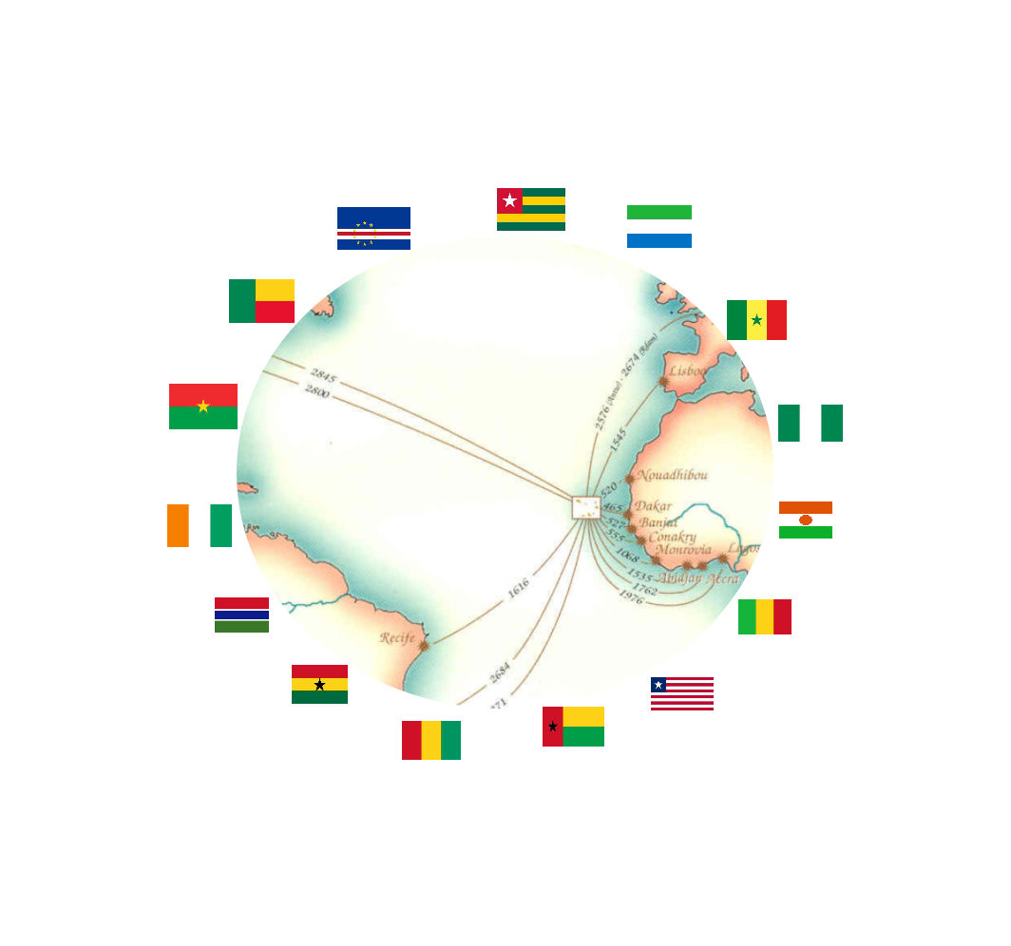
ecowas
overview

Slide 2
Objet | Pag | Objet | Pag. | Objet | Pag
Warning | 3 | Indicateurs économiques du Burkina Faso | 21 - 23 | Indicateurs économiques du Liberia | 42 - 43
La CEDEAO | 4 | Indicateurs économiques du Cabo Verde | 24 - 27 | Indicateurs économiques du Mali | 44 - 46
Quelques Étapes d’'Intégration Régionale | 5 | Indicateurs économiques de la Côte d’Ivoire | 28 - 30 | Indicateurs économiques du Niger | 47 - 49
Les Pays de la CEDEAO | 6 - 7 | Indicateurs économiques de la Gambia | 31 - 33 | Indicateurs économiques du Nigeria | 50 - 52
L’importance économiques de la CEDEAO | 8 | Indicateurs économiques du Ghana | 34 - 36 | Indicateurs économiques du Senegal | 53 - 55
Indicateurs économiques de la CEDEAO | 9 - 17 | Indicateurs économiques de la Guinée | 37 - 39 | Indicateurs économiques de la Sierra Leone | 56 - 58
Indicateurs économiques du Bénin | 18 - 20 | Indicateurs économiques de la Guinée Bissau | 40 - 41 | Indicateurs économiques du Togo | 59 - 61
Axé sur l'intégration régionale
Source:
■ Banque mondiale
■ Université de Sherbrooke – Canada
■ Doing Business - Dernières données disponibles.
Centré sur le marché
PLANIFICATION
Actions
Résultats
Technologie et innovation
Stratégique
Benchmarking permanente
Page 2

Slide 3
WARNING
This document contains general data relating to the economic indicators of the Economic Community of West African States, ECOWAS.
The data presented is the exclusive responsibility of EMERGYS and the company ABRIMAR INVESTMENT, S.A., and must in no case compromise the accuracy and thoroughness of the sources mentioned.
These data are intended exclusively to provide general information on certain economic indicators of ECOWAS member countries, which we believe may be useful information for anyone interested in this important regional economic block.
EMERGYS undertakes to correct any errors, flaws or omissions detected, as well as to keep this document permanently updated and as complete as possible, for the sake of rigor, thus making it available to economic operators in general and to all interested parties, a vision of the whole of this relevant Community of Nations, whose noble mission is to make the peoples of each of the 15 member countries happy and prosperous.
The names or designations of countries and territories, as well as the respective symbols presented, follow the official designations adopted by the United Nations.
All communications, requests for information or suggestions for corrections or improvements to this document should be addressed exclusively to: info@abrimarinvestment.com. [ABRIMAR INVESTMENT, S.A, is a Cape Verdean company specializing in investment and management of holdings.
ABRIMAR INVESTMENT, S.A, is the owner of EMERGYS. ].
Page 3

Slide 4
2. Commercial exchanges in West Africa, as well as the free movement of people and goods, are well anchored in the tradition of the region since the old and great West African civilizations, promoting the development of exchanges between the regions from the Sahel and the savannah, with a wide range of products, such as live cattle, hides and skins, poultry, timber and timber products. This century-old tradition of trade has generated a significant early mobility of people and goods in the West African region and has remained constant over the centuries, so we can consider that the Economic Community of West Africa, ECOWAS, is the heir and the precursor of this ancestral African tradition. Before the creation of the Economic Community of West African States, ECOWAS, on May 28, 1975, the territory of West Africa was made up of States with different historical and administrative experiences and realities which, together, dictated the borders of the 15 countries located in this geographical area and which currently form ECOWAS.
THE ECOWAS
ECOWAS MARKET
15 member countries
3. Although the Member States of the Community have three languages official languages, English, French and Portuguese, there are nevertheless more than one 1000 other local languages, including native languages cross-border and shared by people from different countries, namely Ewe, Fulfulde, Hausa, Mandingo, Wolof, Yoruba, Ibo, Ga, Creole, spoken by about 400 million inhabitants over a vast area of 5,112,069 million square kilometers, corresponding to about 17% of the territory of the African continent. Before these countries lose their initial sovereignty, the region was home to many empires and kingdoms that spanned several centuries, namely those of Ghana, Songhai, Wolof, Oyo, Benin and Kanem Bornu. The diversity cultural, linguistic and ecological present both opportunities and challenges for the regional integration process. Will and determination to combine synergies at the political and are recognized as the basis for the creation of a economically and socially prosperous region.
397,205,519 inhabitants
188,423,476 Internet users
MAIN RIVER
47.4% Penetration [ % Population ]
Níger River
4.180 km long
6.000 m3 / s average flow
Area: 5.112.069 Km²
2,117,700 km² area of ​​the basin
＄ 197,993,787,997 Import
＄ 138,363,847,400 Export
It crosses 5 countries:
Benin; Guinea; Mali; Niger; Nigeria.
more than 1,000 languages
8 French-speaking countries
4. The fundamental objectives of ECOWAS, which is to promote economic and political cooperation among member countries, are in tune with the history of its people, given that West African citizens, even in the period preceding the loss of their initial sovereignty, were already among most of the world's displaced populations, although mobility mainly occurred in the region. It is estimated that around 10 (ten) million West African migrants (4% of the regional population) reside in ECOWAS countries other than their own. The remaining migrants, around 7 (seven) million, reside mainly in North America and Europe. Cross-border migration, especially of women, involved in business activities represents a symbol of regional entrepreneurship and is a catalyst to promote regional integration.
5 English speaking countries
2 Portuguese-speaking countries
8 coins
1. The first stage of regional integration dates back to 1945, with the creation of the CFA Franc, Franc des Colonies Françaises d'Afrique, FCFA, which united the French-speaking countries of the region into a single monetary union. In 1964, the President of Liberia proposed a West African Economic Union which resulted in an agreement in 1965 between Côte d'Ivoire, Guinea, Liberia and Sierra Leone. The aforementioned 1965 agreement did not produce the desired results until 1972, when the Nigerian head of state and his Togolese counterpart embarked on a tour of the country.
region to promote the idea of ​​integration. In this sense, thanks to the benevolence of these efforts, projects were presented on the basis of which the Treaty of Lagos, capital of Nigeria, which established the Economic Community of West African States, ECOWAS, was developed in 1975. The
The Lagos Treaty was initially focused on economic policies and was subsequently revised which in 1993 allowed its scope and prerogatives to be extended.
5. In recent years, the population of West Africa has increased sharply, passing from 70 million to 400 million between 1950 and 2020. At the end of 2014, it represented about 40% of the population of sub-Saharan Africa. According to United Nations projections, West Africa's population is expected to reach 550 or 600 million by 2050, being the region with the youngest population in the world. In addition, with around 5% of the world's population and an area of ​​over 40% in sub-Saharan Africa, West Africa is the most densely populated on the continent.
6. An effective strategy to promote intra-ECOWAS trade as well as to stimulate ECOWAS exports to the external market is one of the first priorities defined by the highest regional authorities.

Slide 5
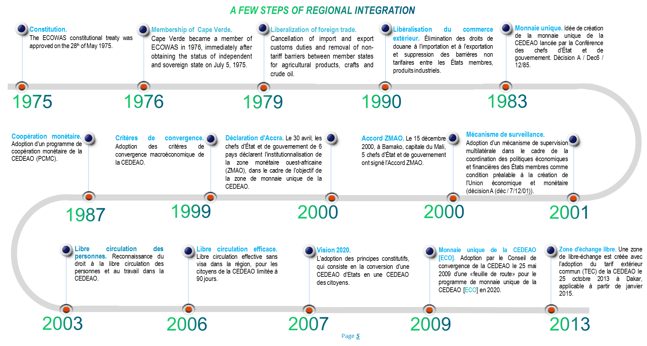

Slide 6

BENIN
BURKINA FASO
CABO VERDE
CÔTE D'IVOIRE
Population | : 11.801.151 | Habitants
Accroissement naturel | : 2,70%
Population urbaine | : 47,90%
Densité | : 102 | Habitants/km²
Age moyen | : 18,0 | Années
L'espérance de vie homme | : 59,9 | Années
L'espérance de vie famme | : 63,0 | Années
Taux d'activité | : 71,70%
Taux d'alphabétisation | : 34,70%
Langue officielle | : Français
Devise | : Franc CFA
Population | :20.321.378 | Habitants
Accroissement naturel | :2,80%
Population urbaine | :30,00%
Densité | :72 | Habitants/km²
Age moyen | :17,0 | Années
L'espérance de vie homme | :60,4 | Années
Esperança de vida mulheres | :61,9 | Années
Taux d'activité | :83,40%
Taxa de alfabetização | :23,60%
Língua oficial | :Français
Moeda | :Franc CFA
Population | :549.935 | Habitants
Accroissement naturel | :1,10%
Population urbaine | :66,20%
Densité | :135 | Habitants/km²
Age moyen | :20,0 | Années
L'espérance de vie homme | :69,3 | Années
Esperança de vida mulheres | :76,0 | Années
Taux d'activité | :68,80%
Taxa de alfabetização | :81,20%
Língua oficial | :Portugais
Moeda | :Escudos
Population | :25.716.544 | Habitants
Accroissement naturel | :2,50%
Population urbaine | :51,20%
Densité | :79 | Habitants/km²
Age moyen | :19,0 | Années
L'espérance de vie homme | :56,3 | Années
Esperança de vida mulheres | :58,7 | Années
Taux d'activité | :67,00%
Taxa de alfabetização | :48,70%
Língua oficial | :Français
Moeda | :Franc CFA
GAMBIA
GHANA
GUINÉE
GUINÉE BISSAU
Population | :2.347.706 | Habitants
Accroissement naturel | :2,90%
Population urbaine | :61,90%
Densité | :225 | Habitants/km²
Age moyen | :20,0 | Anos
L'espérance de vie homme | :60,4 | Anos
L'espérance de vie famme | :63,2 | Anos
Taux d'activité | :77,30%
Taux d'alphabétisation | ---
Langue officielle | :Anglais
Devise | :Dalasi
Population | :30.417.856 | Habitants
Accroissement naturel | :2,20%
Population urbaine | :56,70%
Densité | :131 | Habitants/km²
Age moyen | :20,0 | Anos
L'espérance de vie homme | :62,7 | Anos
L'espérance de vie famme | :64,9 | Anos
Taux d'activité | :77,20%
Taux d'alphabétisation | :57,90%
Langue officielle | :Anglais
Devise | :Cedi
Population | :12.771.246 | Habitants
Accroissement naturel | :2,80%
Population urbaine | :36,50%
Densité | :51 | habitantes/km²
Age moyen | :18,0 | Anos
L'espérance de vie homme | :60,5 | Anos
L'espérance de vie famme | :61,7 | Anos
Taux d'activité | :82,30%
Taux d'alphabétisation | :29,50%
Langue officielle | :Français
Devise | :Franc Guinéen
Population | :1.920.922 | Habitants
Accroissement naturel | :2,50%
Population urbaine | :43,80%
Densité | :67 | habitantes/km²
Age moyen | :16,0 | Anos
L'espérance de vie homme | :56,0 | Anos
L'espérance de vie famme | :59,9 | Anos
Taux d'activité | :72,90%
Taux d'alphabétisation | ---
Langue officielle | :Portugais
Devise | :Franc CFA
Page 6

Slide 7
LIBERIA
MALI
NIGER
NIGERIA
Population | :4.937.374 | Habitants
Accroissement naturel | :2,40%
Population urbaine | :51,60%
Densité | :50 | Habitants/km²
Age moyen | :16,0 | Anos
L'espérance de vie homme | :62,3 | Anos
L'espérance de vie famme | :65,1 | Anos
Taux d'activité | :61,00%
Taux d'alphabétisation | :51,9%
Langue officielle | :Inglês
Devise | :Dollar Libérien
Population | :19.658.031 | Habitants
Accroissement naturel | :3,00%
Population urbaine | :43,10%
Densité | :16 | Habitants/km²
Age moyen | :16,0 | Anos
L'espérance de vie homme | :58,1 | Anos
L'espérance de vie famme | :59,6 | Anos
Taux d'activité | :66,50%
Taux d'alphabétisation | :24,0%
Langue officielle | :Francês
Devise | :Franc CFA
Population | :200.963.599 | Habitants
Accroissement naturel | :2,60%
Population urbaine | :51,20%
Densité | :215 | Habitants/km²
Age moyen | :18,0 | Anos
L'espérance de vie homme | :53,5 | Anos
L'espérance de vie famme | :55,2 | Anos
Taux d'activité | :56,50%
Taux d'alphabétisation | :69,1%
Langue officielle | :Inglês
Devise | :Naira
Population | :23.310.715 | Habitants
Accroissement naturel | :3,80%
Population urbaine | :26,50%
Densité | :16 | Habitants/km²
Age moyen | :18,0 | Anos
L'espérance de vie homme | :60,9 | Anos
L'espérance de vie famme | :63,2 | Anos
Taux d'activité | :64,70%
Taux d'alphabétisation | :28,7%
Langue officielle | :Francês
Devise | :Franc CFA
SENEGAL
SERRA LEONE
TOGO
Population | :16.296.364 | Habitants
Accroissement naturel | :2,70%
Population urbaine | :47,70%
Densité | :82 | Habitants/km²
Age moyen | :19,0 | Anos
L'espérance de vie homme | :65,5 | Anos
L'espérance de vie famme | :69,6 | Anos
Taux d'activité | :57,40%
Taux d'alphabétisation | :39,3%
Langue officielle | :Francês
Devise | :Franc CFA
Population | :7.813.215 | Habitants
Accroissement naturel | :2,10%
Population urbaine | :42,50%
Densité | :106 | Habitants/km²
Age moyen | :18,0 | Anos
L'espérance de vie homme | :53,5 | Anos
L'espérance de vie famme | :55,1 | Anos
Taux d'activité | :66,90%
Taux d'alphabétisation | :34,8%
Langue officielle | :Francês
Devise | :Franc CFA
Population | :16.296.364 | Habitants
Accroissement naturel | :2,70%
Population urbaine | :47,70%
Densité | :82 | Habitants/km²
Age moyen | :19,0 | Anos
L'espérance de vie homme | :65,5 | Anos
L'espérance de vie famme | :69,6 | Anos
Taux d'activité | :57,40%
Taux d'alphabétisation | :39,3%
Langue officielle | :Francês
Devise | :Franc CFA
Page 7

Slide 8
L'importance de la CEDEAO en tant que marché régional
» Élimination des barrières douanières,
» Faciliter la libre circulation des personnes et des biens,
L’IMPORTANCE
ÉCONOMIQUE DE LA CEDEAO
» Des opportunités réciproques pour tous les pays et entreprises
» Avantages fiscaux et douaniers.
15 pays membres
Superficie de 5.112.069 de millions de Km²
Trois langues officielles
188.423.476 utilisateurs d'Internet
47.4 % Pénétration [ % Population]
400 millions de consommateurs
600 millions de consommateurs en 2050
5% de la population mondiale
40% de la population de l'Afrique subsaharienne
Superficie supérieure à 40% de l'Afrique subsaharienne
Caractérisation et information
» Capacitation entrepeuneriel
» Fonctionnement et coopération en réseau
Exportation et réexportation
» Instruments publics de facilitation
» Exportation de biens et services : $ 197,993,787,997, en 2018;
» Réduction du coût du produit grâce aux économies d'échelle
» Importations de biens et services : $ 138,363,847,400, en 2018;
» Une plus grande efficacité dans la production, la commercialisation et l'administration
» Exportation gratuite des produits
» Importation de matières premières entre les 15 pays de la CEDEAO en franchise de droits et taxes
» Avantages concurrentiels grâce à la suppression des tarifs
» Consommation à grande échelle permettant une plus grande rotation des produits
Page 8

Slide 9
Page 9

Slide 10
Page 10

Slide 11
Page 11

Slide 12
Page 12

Slide 13
Page 13

Slide 14
Page 14

Slide 15
Page 15

Slide 16
Page 16

Slide 17
BENIN
Page 17

Slide 18
BENIN
Page 18

Slide 19
BENIN
Page 19

Slide 20
BENIN
Page 20

Slide 21
BURKINA FASO
Page 21

Slide 22
BURKINA FASO
Page 22

Slide 23
BURKINA FASO
Page 23

Slide 24
CABO VERDE
Page 24

Slide 25
CABO VERDE
Page 25

Slide 26
CABO VERDE
Page 26

Slide 27
CABO VERDE
Page 27

Slide 28

CÔTE D'IVOIRE
Page 28

Slide 29
CÔTE D'IVOIRE
Page 29

Slide 30
CÔTE D'IVOIRE
Page 30

Slide 31

GAMBIA
Page 31

Slide 32
GAMBIA
Page 32

Slide 33
GAMBIA
Page 33

Slide 34
GHANA
Page 34

Slide 35
GHANA
Page 35

Slide 36
GHANA
Page 36

Slide 37
GUINÉE
Page 37

Slide 38
GUINÉE
Page 38

Slide 39
GUINÉE
Page 39

Slide 40
GUINÉE BISSAU
Page 40

Slide 41
GUINÉE BISSAU
Page 41

Slide 42
LIBERIA
Page 42

Slide 43
LIBERIA
Page 43

Slide 44
MALI
Page 44

Slide 45
MALI
Page 45

Slide 46
MALI
Page 46

Slide 47
NIGER
Page 47

Slide 48
NIGER
Page 48

Slide 49
NIGER
Page 49

Slide 50
NIGERIA
Page 50

Slide 51
NIGERIA
Page 51

Slide 52
NIGERIA
Page 52

Slide 53
SENEGAL
Page 53

Slide 54
SENEGAL
Page 54

Slide 55
SENEGAL
Page 55

Slide 56
SIERRA LEONE
Page 56

Slide 57
SIERRA LEONE
Page 57

Slide 58
SIERRA LEONE
Page 58

Slide 59
TOGO
Page 59

Slide 60
TOGO
Page 60

Slide 61
TOGO
Page 61
Page 61

