Slide 1


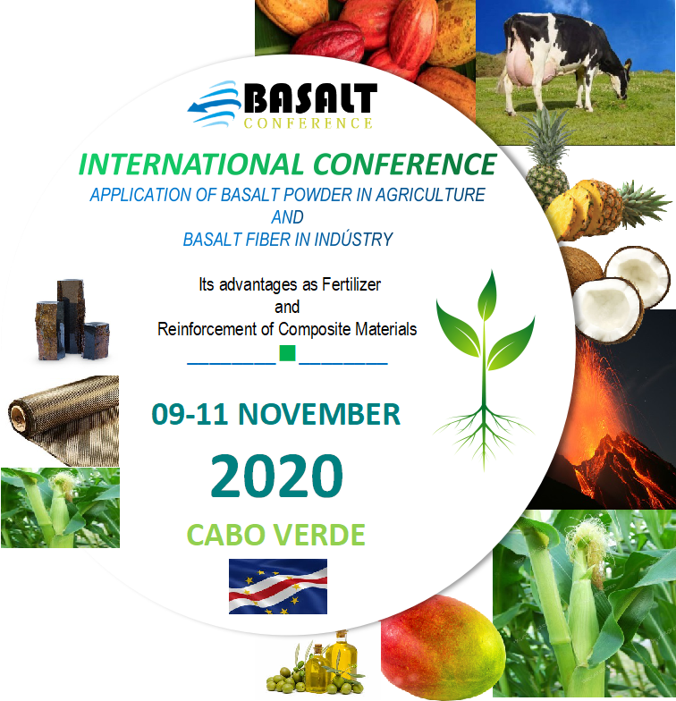

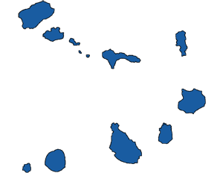
EVENT
FRAMEWORK
9 -11 NOVEMBER
________■________
2020
CABO VERDE

Slide 2
Item | Page | Item | Page
EVENT FRAMEWORK | 3 | MAIN OBJECTIVES OF THE EVENT | 5
PREAMBLE | 4 | PROGRAM OPERATION | 6
 |  | CONTACTS | 7
Focused on Environmental Protection
Centred on Innovation
PLAN
Actions
Results
Realist
9 -11 NOVEMBER
________■________
2020
CABO VERDE
Strategic
Revaluation

Slide 3
EVENT FRAMEWORK
The African continent is rich in natural resources. A high percentage of its population is engaged in food production. In addition, about 70% of this population live on agriculture with a contribution of women for 60 to 80% of the produced and traded food. Thus, Agriculture plays a catalytic role in driving African growth and wealth sharing. According to NEPAD data, 65% of the planet's uncultivated fertile land are located in the African continent., 10% of the continent's renewable freshwater resources and agricultural production have grown of 160% over the last 30 years.
Africa has currently about 1.3 billion inhabitants, representing 17% of the world's population. However, studies predict that this number will reach 4.5 billion by 2100, the equivalent of 40% of the world's population by the end of this century. This is mainly because the African continent is experiencing a declining mortality rate and a rising birth rate, with direct implications for both food supply and food security.
The agricultural sector in West Africa, where Cabo Verde is located, is both a challenge and an opportunity for regional development and for the projection of the region's economy on a global scale. The West African economic bloc, consisting of 15 member states, about 400 million inhabitants, with very heterogeneous characteristics and a strong agricultural presence in their economies, has a high potential for the development of agro-industries and related industries. The private sector is dominated by micro and small companies and the population is predominantly young, thus facing the region with relevant challenges of internationalization of its companies. On the other hand, the digitization of the economy is still at an embryonic phase, despite the high penetration rate, with a great potential for the short-term economic development.
To overcome the poor performance of the region's agricultural sector, substantial use of fertilizers is a prerequisite for successful efforts to improve agricultural productivity, thus addressing the growing challenge of meeting the population’s food needs, in terms of both quantity and quality. In June 2006, African leaders met in Abuja, Nigeria, with the goal of taking measures to live up to the importance of fertilizers for an African Green Revolution. The main outcome of this summit, the Abuja Declaration on Fertilizers for an African Green Revolution, confirmed the commitment of African Heads of State to achieve a rapid increase in fertilizer use on the continent, raising the average of 9 kg / ha in 2006 to at least 50 kg / ha in 2015. The Declaration also set out concrete actions and measures to accelerate the availability and accessibility of fertilizers on the continent, an objective that has not so far been achieved.
The average use of fertilizer in Africa is 10 kg / ha, equivalent to 10% of the world average, almost 20 times less than the Asian average (191 kg / ha) and 9 times less than the Latin American average (94 kg / ha). Poor use of fertilizers in Africa is mainly due to two factors: the high price of the fertilizers in view of farmers' weak purchasing power and the lack of alternatives offered to producers and farmers.
Over the last decades, relevant applied research centers, universities and governments have been looking for viable alternatives to traditional chemical fertilizers, aiming at increasing agricultural profitability, food quality and environmental protection. The application of basalt powder in agriculture and basalt fiber in industry has proved to be a solution to the challenges faced by the contemporary society, both now and in the future. It is in this context that Cabo Verde will host in 2020 an international event with the slogan «BASALT-THE WEALTH OF THE NATIONS».
This event is structured basically in two components: an International Conference and a International Business Forum. The International Conference, 9 -11 November 2020 is focused on the application of basalt powder in agriculture and basalt fiber in industry. The three-day International Business Forum, 11 -13 November 2020, includes a Business Round on 11 November 2020.
9 -11 NOVEMBER
________■________
2020
CABO VERDE

Slide 4
PREAMBLE
Over the course of several decades, relevant applied research centers have achieved significant successes, which have resulted in a growing use of basalt powder in agriculture. Basalt powder offers unquestionable advantages over traditional chemical fertilizers in terms of increased agricultural production, increased efficiency of nutrient use by plants and by ensuring the good quality of the food produced, or for its relevant contribution to environmental protection and low cost of application.
The application of basalt fiber in industry, particularly in the construction, aeronautics, wind industry, electronics, shipbuilding, military industry, sports equipment, fireproof textile materials, and automotive industries, puts basalt fiber in the center of the present and future industrial development, because it has better physical and mechanical properties, greater strengthness and lightness, and is also resistant to shocks and corrosion. The application of basalt fiber in the industry thus presents itself as a growing alternative to the traditional fibers used in the manufacturing of polyhedral composites such as fiberglass, carbon fiber and aramid.
On the other hand, it is generally agreed that there is a close relationship between economic development and technological progress. The cooperation between universities, research and development centers, and the productive system has been strengthened in recent decades, involving various sectors and trends, notably in the chemical industry, microelectronics, biotechnology and particularly in the agro-food industry, where technical and technological progress is accelerated.
The Science, Technology and Innovation trio, involving various development actors, plays an important role in shaping the countries' development model and for the national and sectoral public policies, the growth, the improvement of the competitiveness and enhancing the economic and financial conditions of the productive sector, as well as improving the quality of life of the citizens.
Leading authors emphasize the importance of the cooperation between universities and industry, which can be established in four points: support for general research, support for cooperative researches, support in the knowledge transfer, and the effective technology transfer.
Universities are at the forefront of scientific innovation whereas it is in the companies, industries and services that the technical and technological changes oriented to the products, services and processes are driven. In this sense, the alliance between the University and Industry is a fundamental instrument for the development of the nations. In addition to its main fucntion of teaching and research, the University has a new and growing challenge in the area where it operates: the economic challenge.
It is in this context that the International Conference will be held with the theme «APPLICATION OF BASALT POWDER IN AGRICULTURE AND BASALT FIBER IN INDUSTRY - Its advantages as a Fertilizer and Reinforcement of Composite Materials».
9 -11 NOVEMBER
________■________
2020
CABO VERDE

Slide 5
MAIN OBJECTIVES OF THE EVENT
». To present the state of the art of research and application of basalt powder in agriculture and basalt fiber in industry;
». To disseminate the latest findings on technological advances and the application of basalt fiber in industrial innovation as well as future perspectives;
». To consolidate the results of the research carried out by African scientists on the application of basalt powder in agriculture as an alternative source of nutrients for tropical African soils, in addition to foster and encourage partnerships with their external homologues;
». To enter the application of basalt powder in agriculture as a viable and appropriate technology to the public policy orientation to diversify the types of inputs used in agriculture for soil fertilization in Africa;
». To analyse and set up the mechanisms and procedures to be adopted in the legislation and regulation of basalt powder marketing practices as an alternative to the traditional plant fertilizers and nutrients;
». To define and adopt strategies for the promotion of the basalt powder application technology in agriculture so that it can be taken as an appropriate medium for environmental sustainability and agricultural production, to meet the needs of the internal and regional market, in particular to meet the needs of family farming throughout the ECOWAS space and in Africa in general;
». To position the potential of basalt powder application in agriculture as a suitable mechanism for rejuvenating semi-degraded soils in ECOWAS and in Africa in general;
». To promote the creation of a network of researchers involving Universities, Research and Development Centers, Business Associations and Companies , both in the projects and programmes research and in the marketing of basalt powder for agriculture and the Basalt fiber for industry;
». To promote and consolidate the Cooperation and Partnerships University – Industry ;
». To issue a document where the most relevant works and communications presented at the event will be inserted and which will serve as a guide for future works.
9 -11 NOVEMBER
________■________
2020
CABO VERDE

Slide 6
PROGRAMME OPERATION
The International Conference on «APPLICATION OF BASALT POWDER IN AGRICULTURE AND BASALT FIBER IN INDUSTRY - Its Advantages as Fertilizer and Reinforcing Composite Materials» is organized in 8 (eight) Thematic Conferences and 4 (four) Thematic Panels, lasting three days.
The moderator of each Thematic Conference / Panel has 10 minutes to introduce the topic. Following the intervention of the invited speakers and the speakers for each of the thematic panels and conferences, there will be a debate period in which participants will generally have the opportunity to speak actively.
Each speaker, who will be a reference expert on each topic, will have 1 hour and 45 minutes to present his topic, including the debate period.
The registration, paper submission, as well as all relevant information are available at www.basaltconference.com. Additional information may be obtained through the email address events@basaltconference.com or other contact details on these websites, namely the Technical Secretariat of the Event.
There will be also a social programme as a part of the event where participants in general and guests in particular can enjoy a pleasant stay in Cabo Verde before, during and after the five days of the event.
Several packages and guided tours to the main places of tourist attractions, both in Praia, the capital city of the country, and in other islands, are also available. Guided tours to some basalt exploration sites in Cabo Verde will also be organized.
In the evenings, two periods of social programmes are reserved. On the first day of the event, a welcome reception is organized to the delegations participating to the event and on the last day of the event it will be a Welcome Dinner «THE FLAVORS OF ECOWAS».
Three working languages with simultaneous translation will be available: Portuguese; English and French.
The Technical Secretariat of the event will be permanently accessible and available to meet all special and particular needs of the participants.
9 -11 NOVEMBER
________■________
2020
CABO VERDE

Slide 7
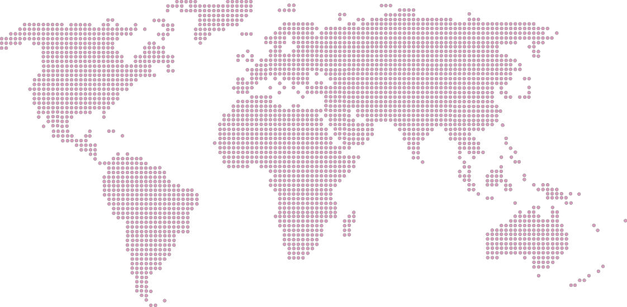
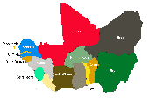
CONTACTS
BASALT CONFERENCE
WhatsApp:+351 964 406 800
Viber:+351 964 406 800
Skype: setimocontinente
info@atlanticbusinesscenter.com
forum@atlanticbusinesscenter.com
www.atlanticbusinesscenter.com
9 -11 NOVEMBER
________■________
2020
CABO VERDE

