Slide 1


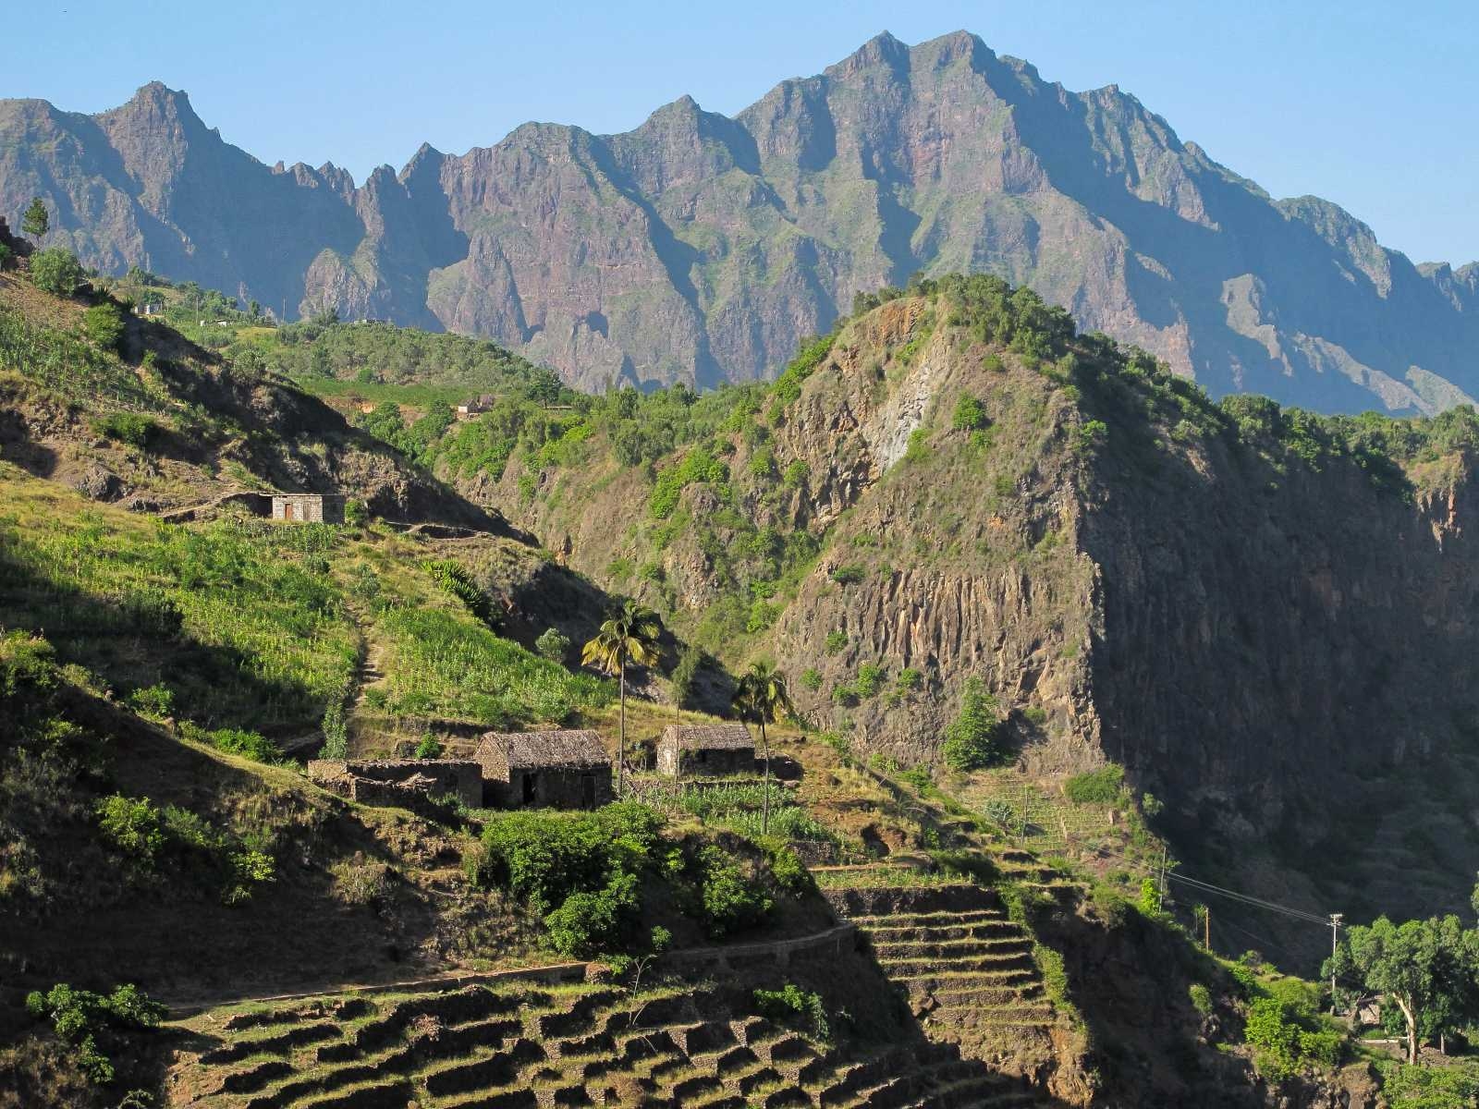


INTERNATIONAL
CONFERENCE
07- 09 JUNE
________■________
2021
PRAIA
CAPE VERDE
PROGRAMME
www.basaltconference.com

Slide 2
Item | Page | Item | Page
Preamble | 3 | Summary of the Business Forum Program | 7
Conference Programme - Day 1 | 4 | Deadlines | 8
Conference Programme - Day 2 | 5 | Events Schedule | 9
Conference Programme - Day 3 | 6 | Contacts | 10
CONFERENCE
PROGRAMME
07- 09 JUNE
________■________
2021
PRAIA
CAPE VERDE
www.basaltconference.com
Focused on Environmental Protection
Centred on Innovation
PLAN
Actions
Results
Realist
Strategic
Revaluation

Slide 3
PREAMBLE
Cape Verde will host an international event on the theme «APPLICATION OF BASALT POWDER IN AGRICULTURE - Its Benefits as Fertilizer for Agriculture». The event will take place from June 07 to 11, 2021, at the Noble Hall of the National Assembly of Cape Verde, Praia. The event has two components: an International Conference and a Business Forum.
The International Conference, entitled BASALT CONFERENCE, focuses on the application of basalt powder in agriculture lasting three days, from June 07 to 09, 2021. An «Integration Round Table followed by Debates» will close the event.
In parallel, there will be a Business Forum, entitled ATLANTIC BUSINESS FORUM, of three days, from June 9 to 11, 2021, includes a round table on business on June 9, 2021, focused on Business Opportunities and Business Partnerships, involving African companies, with particular emphasis on those of ECOWAS, with companies of other origins, in particular from Europe and Brazil. Each event component has a specific programming.
CONFERENCE
PROGRAMME
07- 09 JUNE
________■________
2021
PRAIA
CAPE VERDE
www.basaltconference.com

Slide 4
PROGRAMME
DAY 07 June 2021
ACCREDITATION:
08:00 – 08:30
08:30 – 10:15
10:15 – 10:45
10:45 – 12:30
12:30 – 14:00
14:00 – 15:45
15:45 – 16:15
16:15 – 18:00
20:00 – 22:30
From 7:00
Opening ceremony
Conference I: «THE CURRENT STATE OF THE RESEARCH OF THE USE OF BASALT POWDER AND THE CONSOLIDATION OF ITS APPLICATION IN AGRICULTURE»
Speaker: Dr. Eder Martins – Researcher at EMBRAPA - Brazilian Agricultural Research Corporation
Moderador: Cabo Verde
Debate
Coffee Break
Conference II: «FROM THE RESEARCH TO THE LEGISLATION AND REGULATION OF THE APPLICATION OF BASALT POWDER IN AGRICULTURE : Brazil as Case Study»
Speaker: Prof. Suzi Huff Theodoro – Researcher at the University of Brasília
Moderator: Cabo Verde
Debate
Lunch
Conference III: «RECONSTRUCTION OF THE SOIL AND ENVIRONMENT THROUGH FINELY CRUSHED ROCKS TO INCREASE PRODUCTIVITY AND FOOD QUALITY»
Speaker: Prof. Bernardo Knapik – Researcher at Paraná State University - Brazil
Moderator : Cabo Verde
Debate
Coffee Break
Conference IV: «USE OF BASALT POWDER IN AGRICULTURE – Case Studiy»
Speaker: Prof. Emeritus Peter van Straaten – University of Guelph – Canada
Moderator: Côte d’Ivoire
Debate
Welcome Reception
CONFERENCE
PROGRAMME
07- 09 JUNE
________■________
2021
PRAIA
CAPE VERDE
Remark: Some of the names indicated are still being confirmed.

Slide 5
PROGRAMME
DAY 08 June 2021
ACCREDITATION:
08:30 – 10:15
10:15 – 10:45
10:45 – 12:30
12:30 – 14:00
14:00 – 15:45
15:45 – 16:15
16:15 – 18:00
>18:00
from 7:00
Panel I: «THE CURRENT STATE OF THE RESEARCH OF THE USE OF SILICATIC ROCKS IN SOIL CORRECTION AND FERTILIZATION - State of the Art in Africa »
Moderator: Cabo Verde
Speakers:
» CILSS - Permanent Interstate Committee for Drought Control in the Sahel
» University of Poitiers - France
» University of Stellenbosch - South Africa
» Prof Jean Pierre Tchouankoue - University of Yaoundé - Cameroon
» Prof Vincent Kato – Ministry of Energy and Minerals of Uganda
Debate
Coffee Break
Painel II: «THE CHALLENGES OF SUSTAINABLE DEVELOPMENT: - The need for strategic management of nutrients in agriculture»
Moderator: Cabo Verde
Speakers:
» Ministry of Agriculture and Rural Development of Côte d'Ivoire
» ARAA - Regional Agency for Agriculture and Food
» Directorate of Agriculture and Rural Development of ECOWAS
» Ministry of Agriculture of The Gambia
Debate
Lunch
Painel III: «BASALTS: AGROMINERAL POTENTIAL AND PRODUCTIVE CHAIN OPPORTUNITIES »
Moderator: Cabo Verde
Speaker:
MSc. Magda Bergmann - Researcher at Geological Survey of Brazil
MSc. Andrea Sander - Researcher at Geological Survey of Brazil
Debate
Coffee Break
Conference V: «SOIL FERTILIZATION WITH ROCK POWDER AND FOOD PRODUCTION»
Speaker: Prof. Emeritus Othon Henry Leonardos, Researcher at the University of Brasília
Moderator: Cabo Verde
Debate
Free time
CONFERENCE
PROGRAMME
07- 09 JUNE
________■________
2021
PRAIA
CAPE VERDE
Remark: Some of the names indicated are still being confirmed.

Slide 6
PROGRAMME
DAY 09 June 2021
ACCREDITATION:
08:30 – 10:15
10:15 – 10:45
10:45 – 12:30
12:30- 14:00
14:00 – 16:00
16:00 – 16:30
20:30 – 23:00
from 7:00
Conference VI: «THE ORNAMENTAL ROCKS SECTOR - The potential of Basalt as an ornamental rock»
Moderador : Cabo Verde
Speaker: The BRGM - Bureau de Recherches Géologiques et Minières (France)
Debate
Coffee Break
Conference VII: «THE CHALLENGES OF AGRICULTURAL PRODUCTION AND PROCESSING IN WEST AFRICA - An opportunity for industrialization»
Moderador : Cabo Verde
Speaker: FAO – Food and Agriculture Organization of the United Nations
Debate
Lunch
Panel IV: «THE ROLE OF THE BASALT INDUSTRY IN ECONOMIC COOPERATION AND STRENGTHENING REGIONAL INTEGRATION – An Asset in Economic Cooperation and Trade between Cabo Verde, Senegal and The Gambia»
Moderador : Cabo Verde
Speakers:
» Cabo Verde
» Ministry of Mines and Geology of Senegal
» Ministry of Transport, Works and Infrastructure of The Gambia
» African Development Bank - AfDB
» ECOWAS Bank for Investment and Development – EBID
» International Finance Corporation - IFC
Debate
Closing ceremony of the International Conference
Welcome Dinner «THE FLAVORS OF ECOWAS»
CONFERENCE
PROGRAMME
07- 09 JUNE
________■________
2021
PRAIA
CAPE VERDE
Remark: Some of the names indicated are still being confirmed.

Slide 7
PROGRAMME
LE PROGRAMME DE LA TABLE RONDE
La POUDRE DE BASALTE DANS L’AGRICULTURE
LA QUALITÉ DES ALIMENTS ET la PROTECTION De l’ENVIRONNEMENT
«TABLE RONDE D’INTEGRATION ET LE DÉBAT»
DAY 09 June 2021
Accueil des participants: À partir de 7:30
08:00 – 09:30
09:30 – 09:45
09:45 – 11:15
11:15 – 11:30
11:30 – 13:00
13:00 – 14:30
14:30 – 16:00
20:30 – 23:00
Thème I: Recherche, Législation, Réglementation et Technologie de «Rochagem»
Modérateur: ANMCV - Association Nationale des Municipalités du Cap-Vert
Interventions des Experts:
■ Prof. Suzi Huff Theodoro – Chercheur à l'Université de Brasilia
■ Prof. Émérite Peter van Straaten – Chercheur à l’Université de Guelph – Canadá
■ Prof. Eder de Souza Martins – Chercheur à l’EMBRAPA (Société Brésilienne de Recherche Agro-élevage)
Débats
Pause-café
Thème II: Fertilisation des sols agricoles et protection de l'environnement
Modérateur: Chambre de commerce, d‘Industrie, d‘Agriculture et de Services de Sotavento - CCIASS (Cap-Vert)
Interventions des Experts:
■ Direction de l'Agriculture et du Développement Rural - Commission de la CEDEAO
■ ARAA - Agence régionale pour l'agriculture et l'alimentation
■ Prof. Émérite Othon Henry Leonardos, Chercheur à l’Université de Brasilia
Débats
Pause-café
Thème III: Le Potentiel du Basalte comme Agrominéral et ses Spécificités
Modérateur : Laboratoire de génie civil du Cap-Vert
Interventions des Experts:
■ MSc. Magda Bergmann - Chercheur du Service Géologique du Brésil
■ MSc. Andrea Sander - Chercheur du Service Géologique du Brésil
■ Prof. Émérite Peter van Straaten – Chercheur à l’Université de Guelph – Canadá
■ Prof Jean Pierre Tchouankoue - Université de Yaoundé - Cameroun
Débats
Déjeuner
Thème IV: Rentabilité agricole et contrôle de la qualité des aliments produits
Modérateur: Université du Cap Vert
Interventions des Experts:
■ FAO - Organisation des Nations Unies pour l'alimentation et l'agriculture
■ ENSA - École Nationale Supérieure d‘Agronomie de Yamoussoukro – Côte d’Ivoire
■ Prof. Bernardo Knapik – Chercheur à l’Université Estadual do Paraná – Brésil
Débats
Dîner de bienvenue «LES SAVEURS DE LA CEDEAO»
CONFERENCE
PROGRAMME
07- 09 JUNE
________■________
2021
PRAIA
CAPE VERDE
Remark: Some of the names indicated are still being confirmed.

Slide 8

PROGRAMME
3rd DAY - 11 JUNE
2021
11 June
Panel II
ECONOMIC AND FINANCIAL WORKSHOP
Panel II
«PRIVATE SECTOR FINANCING IN ECOWAS»
1st DAY - 9 JUNE
2nd DAY - 10 JUNE
BUSINESS ROUND
PRESENTATIONS
■ Cabo Verde
■ Senegal
■ The Gambia
■ Cote d’Ivoire
■ Benin
PRESENTATIONS
■ Nigeria
■ Mali
■ Burkina Faso
■ Niger
■ Sierra Leone
Moderator: Cabo Verde
Speaker:
■ ECOWAS Investment and Development Bank
■ African Guarantee and Economic Cooperation Fund
■ African Development Bank - AfDB
■ International Finance Corporation - IFC
Accreditation - 08:00 – 08:15
8:00 – 10:00
Business Round
Coffee-Break
08:15 – 10:15
10:00 – 10:30
2021
11 June
Conference II
Coffee-Break
Conference II
«ACCESS TO THE PREFERENTIAL UNITED STATES MARKET»
10:15 – 10:45
Coffee-Break
Business Round
2021
10 June
Business Opportunities
2021
10 June
Business Opportunities
Moderator: Cabo Verde
Speaker: USA / AGOA
16:30 – 17:00
10:45 – 12:30
10:30 – 12:30
Lunch
Coffee-Break
Lunch
12:30 – 14:00
10:30 – 11:00
08:30 – 10:30
14:30 – 16:30
13:00 – 14:30
ECONOMIC AND FINANCIAL WORKSHOP
Panel III - «THE DEVELOPMENT OF THE DIGITAL ECONOMY IN AFRICA: The Importance of Start-Ups in Market Innovation and Youth Entrepreneurship»
Business Round
2021
11 June
Panel III
14:00 – 15:30
2021
10 June
Business Opportunities
Free time
2021
10 June
Market
Opportunity
Moderator: Cabo Verde
Speaker:
■ ECOWAS Commission
■ ANPROTEC - Brazil
■ French Development Agency - AFD
> 18:30
Lunch
14:30 – 16:30
2021
9 June
Opening Session
of Business Forum
13:00 – 14:30
Coffee-Break
11:00 -13:00
17:00 -18:30
16:30 – 17:00
2021
11 June
Conference III
Conference III
«ACCESS TO THE PREFERENTIAL EUROPEAN UNION MARKET»
PRESENTATIONS
■ Gana
■ Togo
■ Guinea
■ Guinea-Bissau
■ Liberia
Conference I
«ACCESS TO THE ECOWAS PREFERENTIAL MARKET»
15:30 – 16:00
Moderator: Cabo Verde
Speaker: UE / SPG +
ECONOMIC WORKSHOP
Moderator: Cabo Verde
Speaker: CEDEAO
17:00 – 19:00
Panel I:
BRAZIL: The Potential and the Opportunity of Technical and Entrepreneurial Cooperation.
2021
11 June
Opening Session
2021
11 June
GALA DINNER
16:00 – 18:00
Remark: Some of the names indicated are still being confirmed.
Pag 8
19:00 – 19:30
20:30 – 23:00

Slide 9

DEADLINES FOR EXPRESSION OF INTEREST AND REGISTRATION
Deadline for the expression of interest in participating in the business network
Deadline for registration to participate in the business round
2021
10 June
PRESENTATION OF OPPORTUNITIES IN ECOWAS
2020
01
August
2021
31
January
2021
30
April
2021
09
June
2021
10 AND 11
June
2021
11 June
ACCESS TO PREFERENTIAL MARKETS
Registration opens for expressions of interest and participation in the Forum
BUSINESS FORUM
BUSINESS ROUND
Pag 9

Slide 10

EVENTS AGENDA
INTERNATIONAL CONFERENCE |  |  |  |  |  | INTERNATIONAL CONFERENCE |  |  |  |  | ATLANTIC BUSINESS FORUM
07 to 09 JUNE 2021 |  |  |  |  |  | 09 JUNE 2021 |  |  |  |  | 09 - 11 JUNE 2021
Application of Basalt Powder in Agriculture and Basalt Fiber in Industry |  |  |  |  |  | Application of Basalt Powder in Agriculture and Basalt Fiber in Industry |  |  |  |  | 08:00 | - | 08:15 | ACCREDITATION OF BUSINESS ROUND
 |  |  |  |  |  |  |  |  |  |  | 08:15 | - | 12:30 | BUSINESS ROUND
07 June 2021 |  |  |  |  |  | 09 June 2021 |  |  |  |  | 12:30 | - | 14:00 | LUNCH
ACCREDITATION:From 7:00 |  |  |  |  |  | ACCREDITATION:From 7:00 |  |  |  |  | 14:00 | - | 15:30 | BUSINESS ROUND
08:00 | - |  | 08:30 | Opening Ceremony |  | 08:30 | - | 10:15 | Conference VII |  | 15:30 | - | 18:00 | Panel I: «BRAZIL: The Potential and the Opportunity of Technical and Entrepreneurial Cooperation»
08:30 | - |  | 10:15 | Conference I: |  | 10:15 | - | 10:45 | Coffee Break |  | 10 JUNE 2021
10:15 | - |  | 10:45 | Coffee Break |  | 10:45 | - | 12:30 | Conference VIII |  | ACCREDITATION:From 7:00
10:45 | - |  | 12:30 | Conference II: |  | 12:30 | - | 14:00 | Lunch |  | 08:00 | - | 08:30 | Opening Ceremony
12:30 | - |  | 14:00 | Lunch |  | 14:00 | - | 16:00 | Panel IV |  | 08:30 | - | 10:30 | Presentation of Opportunities in ECOWAS
14:00 | - |  | 15:45 | Conference III: |  |  |  |  |  |  | 10:30 | - | 11:00 | Coffee Break
15:45 | - |  | 16:15 | Coffee Break |  |  |  |  |  |  | 11:00 | - | 13:00 | Presentation of Opportunities in ECOWAS
16:15 | - |  | 18:00 | Conference IV: |  |  |  |  |  |  | 13:00 | - | 14:30 | Lunch
 |  |  |  |  |  |  |  |  |  |  | 14:30 | - | 16:30 | Presentation of Opportunities in ECOWAS
20:00 | - |  | 22:30 | Welcome Reception |  | 16:00 | - | 16:30 | Closing Session |  | 16:30 | - | 17:00 | Coffee Break
 |  |  |  |  |  |  |  |  |  |  | 17:00 | - | 18:30 | Conference I - ACCESS TO THE ECOWAS PREFERENTIAL MARKET
08 June 2021 |  |  |  |  |  | 20:30 | - | 23:00 | Welcome Dinner «THE FLAVORS OF ECOWAS» |  | >18:30 | - | Free time
ACCREDITATION: From 7:00 |  |  |  |  |  |  |  |  |  |  | 11 JUNE 2021
08:30 |  | - | 10:15 | Panel I: |  |  |  |  |  |  | ACCRÉDITATION: From 7:00
10:15 |  | - | 10:45 | Coffee Break |  |  |  |  |  |  | 08:00 | - | 10:00 | Panel II - PRIVATE SECTOR FINANCING IN ECOWAS
10:45 |  | - | 12:30 | Panel II: |  |  |  |  |  |  | 10:00 | - | 10:30 | Coffee Break
12:30 |  | - | 14:00 | Lunch |  |  |  |  |  |  | 10:30 | - | 12:30 | Panel III - THE DEVELOPMENT OF THE DIGITAL ECONOMY IN AFRICA
14:00 |  | - | 15:45 | Conference V: |  |  |  |  |  |  | 12:30 | - | 14:00 | Lunch
15:45 |  | - | 16:15 | Coffee Break |  |  |  |  |  |  | 14:00 | - | 16:00 | Conference II - ACCESS TO THE PREFERENTIAL UNITED STATES MARKET
16:15 |  | - | 18:00 | Conference VI: |  |  |  |  |  |  | 16:00 | - | 16:30 | Coffee Break
 |  |  |  |  |  |  |  |  |  |  | 16:30 | - | 18:30 | Conference III -ACCESS TO THE PREFERENTIAL EUROPEAN UNION MARKET
 |  |  |  |  |  |  |  |  |  |  | 18:30 | - | 19:00 | Closing Session of the Business Forum
>18:30 |  | - | Temps libre |  |  |  |  |  |  |  | 20:30 | - | 23:00 | GALA DINNER
Pag 10

Slide 11
09 -11 JUNE
________■________
2021
PRAIA
SANTIAGO ISLAND
CABO VERDE
www.basaltconference.com
CONTACTS
BASALT CONFERENCE
WhatsApp:+351 964 406 800
Viber:+351 964 406 800
Skype: setimocontinente
info@basaltconference.com
www.basaltconference.com
Pag 11

