Slide 1


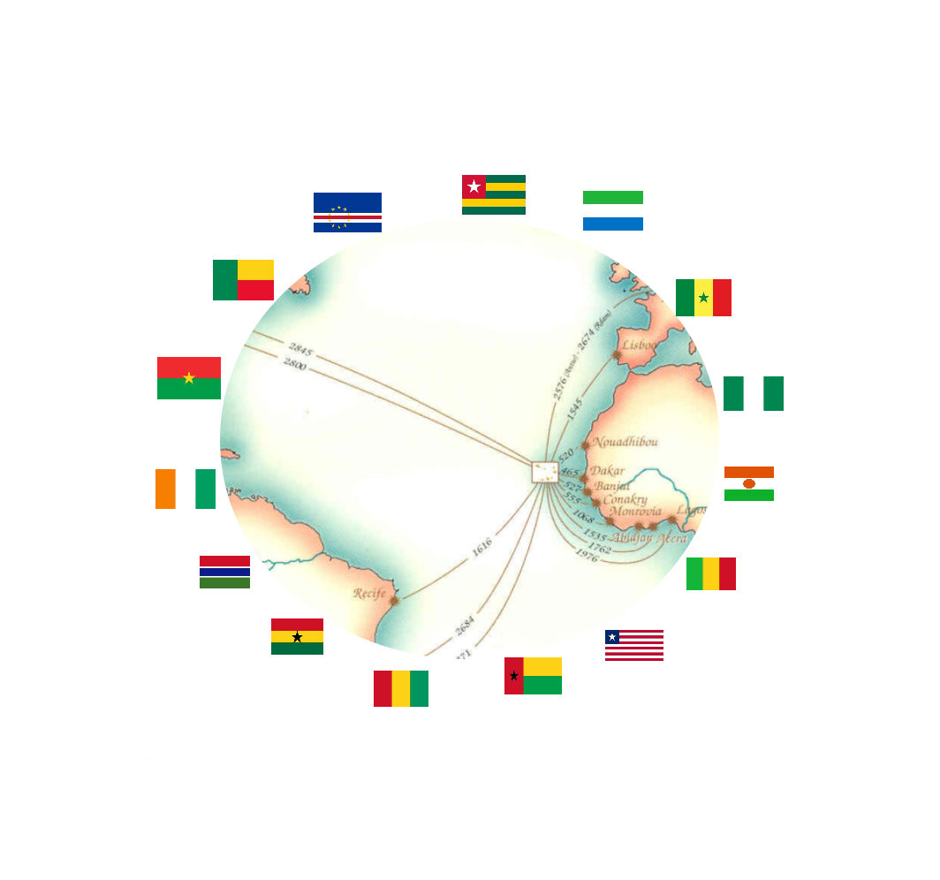
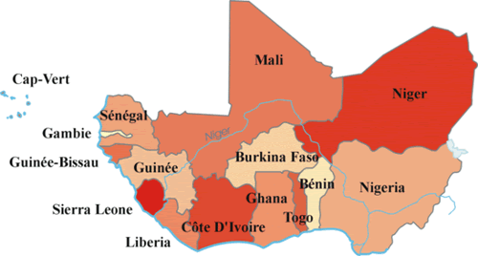

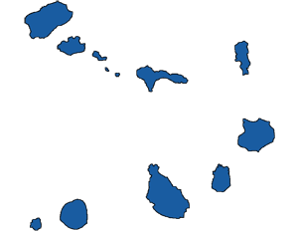
www.atlanticbusinessforum.com
09 -11 JUNE
______■________
2021
PRAIA
SANTIAGO ISLAND
CABO VERDE
BUSINESS opPortuniTIES
AND
BUSINESS PARTNERSHIPS IN ECOWAS SPACE
BUSINESS FORUM
WhatsApp:+351 964 406 800
Skype: setimocontinente
info@atlanticbusinessforum.com
www.atlanticbusinessforum.com

Slide 2
09-11 JUNE
______■________
2021
PRAIA
SANTIAGO ISLAND
CABO VERDE
Index | Pag | Index | Pag
Forum framework | 3-4 | Evolution of the population and internet users | 18
ECOWAS - In Figures | 5 | Programme of the Atlantic Business Forum | 19
Monetary Integration in ECOWAS | 6 | Business Round | 20
ECOWAS - A space of opportunities | 7-8 | Deadlines for expression of Interest and registration | 21
Steps of Regional Integration | 9 | How to participate | 22
Private sector ecosystem development | 10 | Schedule of the Events | 23
Regional Project Opportunities | 11-12 | Sea travel time between Cape Verde and the African continent | 24
Opportunities for each country of the ECOWAS | 13-16 | Contacts | 25
Key indicators of the ECOWAS Agricultural Sector | 17

Slide 3
THE ATLANTIC BUSINESS FORUM
■ Date of the event: 09 - 11 June 2021
■ Duration of the Event: 3 days
■ Place: city of Praia - Santiago Island
■ The final program will be adjusted according to the profile of the registered participants
■ Entities involved: local authorities, Embassies, Investment agencies, Companies, National and International Financial Institutions, Local Chambers of Commerce and industry, Universities, Companies.
■ Participation to the International Conference and to the relevant program, in particular:
  » Business Round on 09 June 2021 from 08:00 to 15:30;
  » Networking Events;
  » Presentation of Business and Partnership opportunities in each ECOWAS Country;
  » Presentation of Business and Partnership opportunities with companies from different countries;
  » Identification of business opportunities in the following sectors: commerce, industry, tourism, agriculture, logistics, agri-food and ICT;
  » Local Chambers of Commerce and Industry.
The Business Forum entitled «ATLANTIC BUSINESS FORUM» is structured in:
■ Five (5) Business Opportunities Presentation Sessions in each ECOWAS member country;
■ An ECONOMIC WORKSHOP with three thematic panels:
» » Panel I: «BRAZIL: The Potential and the Opportunity of Technical and Entrepreneurial Cooperation»
  »Panel II: «PRIVATE SECTOR FINANCING IN ECOWAS»; and
  »Panel III: «THE DEVELOPMENT OF THE DIGITAL ECONOMY IN AFRICA: The Importance of Start-Ups in Market Innovation and Youth Entrepreneurship».
■ Three thematic conferences under the slogan: «CAPE VERDE A LINK WITH MARKETS OF EXCELLENCE»:
  »Conference I: «ACCESS TO THE PREFERENTIAL ECOWAS MARKET»;
  »Conference II: «ACCESS TO THE PREFERENTIAL UNITED STATES MARKET»; and
  »Conference III: «ACCESS TO THE PREFERENTIAL MARKET OF THE EUROPEAN UNION».
■ A Business Round, scheduled in advance, namely the day of June 9, 2021.
■ An Economic Workshop on the theme:«BRAZIL: The Potential and the Opportunity of Technical and Entrepreneurial Cooperation.». In each edition of the Forum, there will be a specially invited country; for the 2021 edition it's Brazil.
After the first interventions of the opening session of the Forum, on June 9, the Economic workshop will take place under the theme:«BRAZIL: The Potential and the Opportunity of Technical and Entrepreneurial Cooperation». The June 10 session will begin with 3 blocks of presentations. Each block will be represented by 5 member countries of ECOWAS and will have a duration of 2 hours, with 24 minutes allocated to each country to present business opportunities and commercial partnerships in the market respective.
A personalized service, managed via a specific web platform, will be permanently available to participants to allow access, regardless of the geographical location of the interested parties, before, during and after the event, whether it is .
The ATLANTIC BUSINESS FORUM documentation includes, in addition to this document, the packages and the conditions of participation, two other documents: a specific document related to the functioning of the BUSINESS ROUND of June 9, 2021, and a presentation of ECOWAS Market (Overview).
Pag 3

Slide 4
Cabo Verde has a privileged geographical location at the confluence of 3 continents: Europe, Africa and America. Cabo Verde is less than one (1) hour of flight from the African continent, less than three (3) hours of flight from flight from the European continent and about four (4) hours of flight from the American continent.
Cabo Verde has legislation that accommodates companies established in free-trade zones, the development of export and re-export activities, as well as special incentives, both in terms of taxation and customs, thus enabling industries and economic activities in general to take advantage of relevant markets in which Cabo Verde is an integral part, such as ECOWAS, with around 400 million consumers, or even benefiting from Special Partnership Agreements with the European Union (GSP+) and with the United States of America (AGOA).
Exporting and re-exporting from Cabo Verde based on the concept of trading hub under the legislation of Cabo Verde is an opportunity that companies and industries of any country can benefit with advantage and security.
Focused on business
Opportunity Centred
PLAN
Actions
Results
Realistic
Strategic
Revaluation
Pag 4

Slide 5
ECOWAS - IN FIGURES
» Member countries
» Francophone countries
» English-speaking countries
» Portuguese speaking countries
» Currency
»Regional market
» Area
» GDP 2018
» Imports
» Exports
» Growth rate
»Integration objective in all areas:
:15;
  : 8;
  : 5;
  : 2;
  : 8;
  : 400 million consumers;
  : 5.114.195 Km2;
  : 629,5 billion dollars 2018;
  : 80,4 billion dollars;
  : 137 billion dollars;
  : 6.1 % in 2014;
  : 4,2% in 2015;
  : 3.1% in 2018;
  : Industry;
  : Agriculture;
  : The environmentt;
  : Infrastructure;
  : Health;
  : Education;
  : Finances;
  : The economy;
  : Currency.
09 - 11 JUNE
________■________
2021
PRAIA
SANTIAGO ISLAND
CABO VERDE
Pag 5

Slide 6
MONETARY INTEGRATION N THE ECOWAS SPACE
The project of the ECOWAS monetary integration has a great deal of fundamental interest in the context of economic and financial globalization.
It is indeed considered by Regional Authorities to be a decisive step towards an effective integration in the world economy.
The challenges are expressed in terms of growth in intra –regional trade and the construction of an attractive and stable macro economic space.
09 - 11 JUNE
________■________
2021
PRAIA
SANTIAGO ISLAND
CABO VERDE
Pag 6

Slide 7
ECOWAS - A SPACE OF OPPORTUNITIES
» Foundation: 28 May 1975;
» Surface: 5,114,210 [km2];
» No. of countries: 15;
» Population: 387,510,869 [ Est. 2019 ];
» Internet users in 2000: 485,800;
» Internet users in 2019: 187,527,756;
» Annual trade: $ 208.1 billion;
» Imports: $ 80.4 billion;
» Exports: $ 137 billion;
» Fuel exports: 75%;
» Export of cocoa and derived foods; 5%;
» Export of Precious Stones: 3%;
» Cotton Exports: 1%;
» Export of Edible Fruits: 1%;
» Rubber Exports: 1%;
» Export of Plastics: 1%;
» Export of Wood and Wood Products: 1%;
» Export of Fish and seafood: 1%;
Main export destinations:
»Europe: 28%;
»European Union: 23%;
»Americas: 40%;
»Asia and Oceania: 16%;
»Near and Middle East: 0.3%;
Main Natural Resources of ECOWAS:
  » Pozzolan;
  » Fish;
  » Titanium;
  » Aluminum;
  » Diamonds;
  » Gold;
  » Wood;
  » Petroleum;
  » Natural gas;
  » Iron ore;
  » Water;
  » Forest;
  » Arable land;
  » Fauna.
ECOWAS Sectors:
»Energy:
»Infrastructure;
»Information and Communications Technologies;
»Commerce;
» Industry
»Water;
»Agriculture and Environment;
»Health;
»Telecommunication
Pag 7

Slide 8
ECOWAS - A SPACE OF OPPORTUNITIES
Top 50 Imported Products in ECOWAS:
  » Petroleum oils and oils obtained from bituminous minerals;
  » Crude petroleum oils, shale oils, crude materials;
  » Motor vehicles for the transport of persons;
  » Rice;
  » Food products and food preparations;
  » Vessels;
  » Telecommunication equipment;
  » Motor vehicles for the transport of goods;
  » Wheat and rye grain;
  » Construction machinery;
  » Medicines (including veterinary medicines);
  » Fresh or frozen fish;
  » Building materials;
  » Sugar, molasses and honeyl;
  » Cotton fabrics;
  » Milk and milk products;
  » Generators;
  » Motorcycles and bicycles;
  » Automobiles;
  » Machines and apparatus for private industries;
  » Hollow tubes and profiles, iron and steel fittings;
  » Rubber Tires & Inner Tubes;
  » Iron and steel bars, angles, profiles and sections;
  » Common metals;
  » Vegetable fats and oils;
  » Paper and cardboard;
  » Electronic machinery and apparatus;
  » Plastic articles;
  » Vehicle parts and accessories;
  » Electricity machines and components;
  » Fertilizers;
  » Iron, steel, aluminum structures and parts;
  » Printed material;
  » Gas pumps and compressors and fans;
  » Internal combustion engines and parts;
  » Circuit board, board, panel;
  » Measurement, analysis and control apparatus;
  » Ethylene polymers in primary forms;
  » Flat rolled iron, unalloyed steel, uncoated;
  » Mechanical tools, others;
  » Insecticides and similar products for retail sale;
  » Heating and cooling equipment and parts thereof;
  » Electricity distribution equipment;
  » Aluminum;
  » Plumbing apparatus, boilers, tanks, vats;
  » Other plastics in primary forms;
  » Miscellaneous products for the chemical industries;
  » Data processing machines;
  » Furniture and parts;
  » Sheets, films, aluminum foil and plastic sheets.
  Source: UNCTADStat.
Pag 8

Slide 9
REGIONAL INTEGRATION STEPS
28/05/1975
ECOWAS Creation
1993
ECOWAS Treaty Review
2006
Effective free movemen
2010
Common external tariff (CET)
2020
Coin Merger
ECOWAS was founded on the 28th of May 1975..
Introduction of articles on political cooperation, peace and regional security.
Effective visa free movement within the region for ECOWAS citizens limited to 90 days
CET negotiations for the ECOWAS space
In 2014: CET comes into force for ECOWAS countries
[ Project adopted ]
Merger of the currencies
[ Provisionally scheduled date ]
1
3
5
7
9
2
4
6
8
1979 e 1990
Foreign Trade Liberalization
2003
Free movement of persons
2007
Vision 2020
2017
Single Currency
Cancellation of customs duties on imports and exports and the abolition of non-tariff barriers between Member States.
Recognition of the right to free movement of persons and work.
The adoption of the constituent principles, which consists of the conversion from ECOWAS of states to ECOWAS of citizens.
Single currency for non-UEMOA ECOWAS countries
[ Project announced ]
In 1979: Agricultural products, handicrafts and crude oil
In 1990: Industrial Products
Pag 9

Slide 10
DEVELOPMENT ECOSYSTEM
OF
PRIVATE SECTOR AND AGRI-BUSINESS IN ECOWAS SPACE
Business Organizations
Financial institutions
ROPPA
http://roppaafrique.org/
EBID
http://www.bidc-ebid.org/
ECOWAS
AFREXIMBANK
www.afreximbank.com
AfDB
https://www.afdb.org/en
AfD
https://www.afd.fr/pt
FEWACCI
https://fewacci.com
BOAD
https://www.boad.org
09 - 11 JUNE
________■________
2021
PRAIA
SANTIAGO ISLAND
CABO VERDE
IFC
https://www.ifc.org/
UEMOA
FAGACE http://www.le-fagace.org/
FOPAO
https://www.fopao.net/
ECOBANK
https://ecobank.com/
AGF http://www.africanguaranteefund.com/
UPADI
https://www.upadi-agri.org/
Pag 10

Slide 11
REGIONAL PROJECTS FOR INFRASTRUCTURE DEVELOPMENT
Power Transmission Corridor in West Africa
Praia-Dakar-Abidjan Multimodal Corridor
Dakar-Niamey Multimodal Corridor
Covering
Covering
Covering
Guinea-Conakry
Guinea-Bissau
The Gambia
Sierra Leone
Liberia
Cote d'Ivoire
Ghana
Cabo Verde
Senegal
Guinea-Conakry
Guinea-Bissau
The Gambia
Sierra Leone
Liberia
Cote d'Ivoire
Senegal
Mali
Burkina Faso
Niger
Coastal Road linking Lagose and Nouakchott
via Dakar
Abidjan–Ouagadougou-Bamaco Corridor
Creation of a Hub involving Ports and Railways
in West Africa
Covering
Covering
Covering
Coastal highway linking Lagos and Nouakchott via Dakar (4,560 km), Dakar-N'Djamena Trans-Sahelian Road (4 460 km), transnational road involving the construction of links along the above-mentioned roads or the rehabilitation of roads linking landlocked countries (Mali, Burkina Faso and Niger) with seaports.
Cote d'Ivoire
Burkina Faso
Mali
Benin
Burkina Faso
Cabo Verde
Cote d'Ivoire
The Gambia
Gana
Guinea-Conakry
Guinea-Bissau
Liberia
Mali
Niger
Nigeria
Senegal
Sierra Leone
Togo
Pag 11

Slide 12
REGIONAL PROJECTS FOR INFRASTRUCTURE DEVELOPMENT
ECOWAS Center for Renewable Energy and Energy Efficiency (ECREEE)
ECOWAS Regional Agricultural Investment Programme (RAIP) / CAADP
West African Common Industrial Policy (WACIP)
Covering
Covering
Covering
Benin
Burkina Faso
Cabo Verde
Cote d'Ivoire
The Gambia
Ghana
Guinea-Conakry
Guinea-Bissau
Liberia
Mali
Niger
Nigeria
Senegal
Sierra Leone
Togo
Benin
Burkina Faso
Cabo Verde
Cote d'Ivoire
The Gambia
Ghana
Guinea-Conakry
Guinea-Bissau
Liberia
Mali
Niger
Nigeria
Senegal
Sierra Leone
Togo
Benin
Burkina Faso
Cabo Verde
Cote d'Ivoire
The Gambia
Ghana
Guinea-Conakri
Guinea-Bissau
Liberia
Mali
Niger
Nigeria
Senegal
Sierra Leone
Togo
Abidjan-Lagos Corridor
Sea Transport Common to Member Countries
Air transport in West Africa
Covering
Covering
Covering
Nigeria
Benin
Togo
Cote d'Ivoire
Ghana
Benin
Burkina Faso
Cabo Verde
Cote d'Ivoire
The Gambia
Ghana
Guinea-Conakry
Guinea-Bissau
Liberia
Mali
Niger
Nigeria
Senegal
Sierra Leone
Togo
Benin
Burkina Faso
Cabo Verde
Cote d'Ivoire
The Gambia
Ghana
Guinea-Conakry
Guinea-Bissau
Liberia
Mali
Niger
Nigeria
Senegal
Sierra Leone
Togo
Pag 12

Slide 13




BENIN
CABO VERDE
Capital: Porto-Novo
Area: 112,622 Km2
Population: 11,801,595 inhabitants
Internet users: 3,801,758
Official Language: French
Currency: West African CFA Franc (XOF)
Industry's input to GDP:
»Secondary sector: 14%;
»Manufacturing industry: 8.3%;
»Mining: 5%;
»Cotton: 15%.
»Industrial capacity utilization rate: 50%;
  Opportunities:
  » Textile industries;
  » Construction Materials;
  » Cement;
  » Agribusiness;
  » Mining industry;
  » Energy;
  » Tourism.
Capital: Praia
  Area: 4,033 Km2
  Population: 560,349 inhabitants
  Internet users: 352,120
  Official Language: Portuguese
  Currency: Cape Verdean Escudo (ECV)
Industry's input to GDP:
»Secondary sector: 18%;
»Manufacturing industry: 12%;
»Mining: 4%;
»Industrial capacity utilization rate: 50%;
Opportunities:
  »Tourism;
  » Renewable energy;
  » Economy of the sea;
  » ICTs;
  » Creative Industry;
  » Public-Private Partnership (PPP).
BURKINA FASO
COTE D’IVOIRE
Capital : Ouagadougou
Area: 274,200 Km2
Population: 20,321,560 inhabitants
Internet users: 3,704,265
Official Language: French
Currency: West African CFA Franc (XOF)
Industry's input to GDP:
» Secondary sector: 18%;
» Manufacturing industry: 9%;
» Mining: 5%;
» Cotton: 15%.
» Indurial capacity utilization rate: 60%
Opportunities:
  » Cotton;
  » Drinks;
  » Agroindustry;
  » Soap;
  » Cigarettes;
  » Textiles;
  » Gold .
Capital : Yamoussoukro
Area: 322,463 Km2
Population: 25,531,083 inhabitants
Internet users: 11,953,653
Official Language: French
Currency: West African CFA Franc (XOF)
Industry's input to GDP:
» Secondary sector: 22%;
» Manufacturing industry: 18%;
» BPT and Mining: 4%;
» Indurial capacity utilization rate: 80%.
Opportunities:
  » Agriculture;
  » Oil industry;
  » Mining industry;
  » Textile industry;
  » Food industry;
  » Construction Materials;
  » Tourism.
ECOWAS
COUNTRY BY COUNTRY OPPORTUNITIES
Pag 13

Slide 14




THE GAMBIA
GUINEA- CONAKRI
Capital: Banjul
  Area: 10,689 Km2
  Population: 2,228,075 inhabitants
  Internet users: 442,050
  Official Language: English
  Currency: Dalasi (GMD)
  Industry's input to GDP:
  » Secondary sector: 9%;
  » Manufacturing industry: 4%;
  » Mining: 2%;
  » Energy and BPT: 2.3%.
  » Industrial capacity utilization rate: 40%;
  Opportunities:
  » Agriculture;
  » Metallurgy;
  » Aerospace Industry;
  » Aeronautical industry;
  » Aquaculture;
  » Mining industry;
  » Energy;
  » Tourism.
Capital: Conakri
Area: 245,836 Km2
Population: 13,398,180 inhabitants
Internet users: 2,411,672
Official Language: French
Currency: Guinea Franc (GNF)
Industry's input to GDP:
  »Secondary sector: 31%;
  » Manufacturing industry: 4%;
  » Mining: 17%;
  » Energy: 1%.
  » BPT: 9%.
  » Industrial capacity utilization rate: 40%;
  Opportunities:
  » Agriculture;
  » Health;
  » Mining industry;
  » Oil industry;
  » Telecommunications;
  » Tourism.
GHANA
GUINEA-BISSAU
Capital: Accra
Area: 238,535 Km2
Population: 30,096,970 inhabitants
Internet users: 11,737,818
Official Language: English
Currency: Ghanaian Cedi (GH₵) (GHS)
Industry's input to GDP:
» Secondary sector: 23.4%;
» Manufacturing industry: 8.3%;
» Mining: 7%;
» Energy: 4.2%.
» BPT: 4%.
» Industrial capacity utilization rate: 90%;
Opportunities:
  » Agriculture;
  » Textile industry;
  » Food industry;
  » Health;
  » Horticulture;
  » Mining industry;
  » Oil industry;
  » Cement;
  » Tourism.
Capital: Bissau
Area: 36,125 Km2
Population: 1,953,723 inhabitants
Internet users: 150,000
Official Language: Portuguese
Currency: West African CFA Franc (XOF)
Industry's input to GDP:
» Secondary sector: 10%;
» Manufacturing industry: 5%;
» Mining: 1.1%;
» Energy: 1.9%.
» BPT: 2%.
» Industrial capacity utilization rate: 30%;
Opportunities:
  » Agriculture;
  » Energy;
  » Industry;
  » Fishing;
  » Public Works;
  » Construction Materials;
  » Tourism.
ECOWAS
COUNTRY BY COUNTRY OPPORTUNITIES
Pag 14

Slide 15




LIBERIA
NIGER
Capital: Monrovia
  Area: 111,369 Km2
  Population: 4,977,720 inhabitants
  Internet users: 4,028,418
  Official Language: English
  Currency: Liberian Dollar (LRD)
  Industry's input to GDP:
  » Secondary sector: 10%;
  » Manufacturing industry: 5%;
  » Mining: 1%;
  » Energy: 1%.
  » BPT: 5%.
  » Industrial capacity utilization rate: 30%.
  Opportunities:
  » Agribusiness;
  » Mining industry;
  » Oil industry;
  »Tourism;
  » Financial services.
Capital: Niamey
Area: 1,267,000 Km2
Population: 23,176,691 inhabitants
Internet users: 2,368,658
Official Language: French
Currency: West African CFA Franc (XOF)
  Industry's input to GDP:
  » Secondary sector: 16%;
  » Manufacturing industry: 5.5%;
  » Mining: 9%;
  » Energy: 1.5%.
  » Industrial capacity utilization rate: 50%.
  Opportunities:
  » Agriculture;
  » Health;
  » Mining industry;
  » Oil industry;
  » Food industry;
  » Tourism.
MALI
NIGERIA
Capital : Bamako
Area: 1,240,192 Km2
Population: 19,689,140 inhabitants
Internet users: 12,480,176
Official Language: French
Currency: West African CFA Franc (XOF)
Industry's input to GDP:
» Secondary sector: 20%;
» Manufacturing industry: 6.5%;
» Mining: 10%;
» Energy: 1.5%.
» BPT: 2%.
» Industrial capacity utilization rate: 60%.
Opportunities:
  » Agro food;
  » Mining industry;
  » Telecommunications;
  » Production of energy;
  » Urbanization;
  » Technical graduation.
Capital : Abuja
Area: 923.768 Km2
Population: 200,962,417 inhabitants
Internet users: 122,292,079
Official Language: English
Motto: Naira
Industry's input to GDP:
» Secondary sector: 40%;
» Manufacturing industry: 6%;
» Mining: 10%;
» Energy: 20%.
» BPT: 4%.
» Industrial capacity utilization rate: 50%.
Opportunities:
  » Agriculture;
  » Oil industry;
  » Agro food;
  » Materials industry;
  » Real estate;
  » Financial service;
  » Infrastructures
ECOWAS
COUNTRY BY COUNTRY OPPORTUNITIES
Pag 15

Slide 16




SENEGAL
TOGO
Capital: Lomé
Area: 56,785 Km2
Population: 8,186,384 inhabitants
Internet users: 1,011,837
Official Language: French
Currency: West African CFA Franc (XOF)
Industry's input to GDP:
» Secondary sector: 17%;
» Manufacturing industry: 8%;
» Mining: 4%;
» Energy: 2.8%;
» BPT: 2.2%;
» Industrial capacity utilization rate: 50%.
Opportunities:
  » Phosphate Mining;
  » Agroindustry;
  » Cement;
  » Crafts;
  » Textiles;
  » Drinks.
Capital: Dakar
  Area: 196,712 Km2
  Population: 16,743,859 inhabitants
  Internet users: 9,749,527
  Official Language: French
  Currency: West African CFA Franc (XOF)
  Industry's input to GDP:
  » Secondary sector: 22%;
  » Manufacturing industry: 15%;
  » Mining: 1%;
  » Energy: 2%;
  » BPT: 4%;
  » Industrial capacity utilization rate: 80%.
  Opportunities:
  » Agribusiness;
  » Mining industry;
  » Oil industry;
  » Tourism;
  » Telecommunications;
  » Construction Materials.
Capital: Lomé
Area: 56,785 Km2
Population: 8,186,384 inhabitants
Internet users: 1,011,837
Official Language: French
Currency: West African CFA Franc (XOF)
Industry's input to GDP:
» Secondary sector: 17%;
» Manufacturing industry: 8%;
» Mining: 4%;
» Energy: 2.8%;
» BPT: 2.2%;
» Industrial capacity utilization rate: 50%.
Opportunities:
  » Phosphate Mining;
  » Agroindustry;
  » Cement;
  » Crafts;
  » Textiles;
  » Drinks.
Capital: Dakar
  Area: 196,712 Km2
  Population: 16,743,859 inhabitants
  Internet users: 9,749,527
  Official Language: French
  Currency: West African CFA Franc (XOF)
  » Secondary sector: 22%;
  » Manufacturing industry: 15%;
  » Mining: 1%;
  » Energy: 2%;
  » BPT: 4%;
  » Industrial capacity utilization rate: 80%.
  » Agribusiness;
  » Mining industry;
  » Oil industry;
  » Tourism;
  » Telecommunications;
  » Construction Materials.
SIERRA LEONE
REGIONAL PROJECTS
Capital : Freetown
Area: 71,740 Km2
Population: 7,883,123 inhabitants
Internet users: 1,043,725
Official Language: English
Currency: Leone (SLL)
Industry's input to GDP:
» Secondary sector: 9.6%;
» Manufacturing industry: 5.2%;
» Mining: 2.2%;
» Energy: 0.2%;
» BPT: 2%;
» Industrial capacity utilization rate: 30%.
Opportunities:
  » Agriculture;
  » Mining industry;
  » Oil industry;
  » Textile industry;
  » Energy;
  » Financial services.
Opportunities:
  » Food industry;
  » Agro-chemical industry;
  » Agricultural machinery;
  » Building materials industry;
  » Communications industry;
  » Electronics;
  » Pharmaceutical industry.;
  » Steel industry;
  » Car building industry;
  » Car accessories industry.
ECOWAS
COUNTRY BY COUNTRY OPPORTUNITIES
Pag 16

Slide 17
KEY INDICATORS OF THE ECOWAS AGRICULTURAL SECTOR
COUNTRY | Area | Value Added Agriculture | Cereal yield | fertilizer per ha | Food in total imports | Agricultural production per capita | Rural population
 | [ km2 ] | (%) |  | Kg | (%) | Kg | [%]
Benin | 114 763 | 33,7 | 1157 | 4,3 | 25,1 | 148 | 59,9
Burkina Faso | 274 200 | 33,8 | 1006 | 9,9 | 17,4 | 241 | 81,6
Cabo Verde | 4 033 | 9,6 | 329 |  | 29,6 | 21 | 42,7
Cote d'Ivoire | 322 463 | 24,1 | 1757 | 23,6 | 19,3 | 76 | 53,2
The Gambia | 10 689 | 25,7 | 1434 | 7,8 | 35,7 | 145 | 46,3
Ghana | 238 535 | 35,0 | 1489 | 9,8 | 15,5 | 95 | 52,2
Guinea-Conakry | 245 836 | 21,8 | 1342 | 1 | 20,2 | 254 | 66,9
Guinea-Bissau | 36 125 | 55,0 | 1180 | 12,9 | 50,8 | 139 | 70,3
Liberia | 111 369 |  | 1140 | 0,4 |  | 56 | 42
Mali | 1 240 192 | 37,4 | 415 | 6 | 15,1 | 283 | 69,4
Niger | 1 267 000 | 39,3 | 1383 | 7 | 29,8 | 275 | 83,6
Nigeria | 923 768 | 37,2 | 981 |  | 16,3 | 171 | 53,8
Senegal | 196 712 | 16,6 | 1193 | 5,6 | 25,7 | 115 | 58,3
Sierra Leone | 71 740 | 49,4 | 1141 | 7,8 | 27,6 | 129 | 63,1
Togo | 56 785 | 38,6 | 1247 | 11,4 | 18 | 161 | 60,1
ECOWAS | 5 114 210 | 35,3 | 1 247,0 | 7,8 | 17,7 | 169,0 | 58,4
Sub-Saharan Africa |  | 15,8 | 1 203,0 | 11,4 | 11,7 | 138,0 | 65,0
South Asia |  | 19,9 | 2 548,0 | 133,3 | 7,3 | 218,0 | 71,3
World |  | 3,1 | 3 307,0 | 117 | 7,1 | 347,0 | 51,4
Source: World Development Indicators (WDI), 2011.
Pag 17

Slide 18
EVOLUTION OF POPULATION AND INTERNET USERS IN ECOWAS
COUNTRY | Surface | Population | Internet users |  | Internet penetration | Internet | GNI
 |  |  |  |  |  | Growth rate (%) | [ per capita ]
 | [ km2 ] | [ 2019 ] | 31/Dec/00 | 30/Jun/19 | [ % of population ] | 2000 - 2019 | 30/Jun/17
Benin | 114 763 | 11 801 595 | 15 000 | 3 801 758 | 32,2% | 25245% | $2 260
Burkina Faso | 274 200 | 20 321 560 | 10 000 | 3 704 265 | 18,2% | 36943% | $1 810
Cabo Verde | 4 033 | 560 349 | 8 000 | 352 120 | 62,8% | 4302% | $6 570
Cote d'Ivoire | 322 463 | 25 531 083 | 40 000 | 11 953 653 | 46,8% | 29784% | $3 820
The Gambia | 10 689 | 2 228 075 | 4 000 | 442 050 | 19,8% | 10951% | $483
Ghana | 238 535 | 30 096 970 | 30 000 | 11 737 818 | 39,0% | 39026% | $1 641
Guinea-Conakry | 245 836 | 13 398 180 | 8 000 | 2 411 672 | 18,0% | 30046% | $825
Guinea-Bissau | 36 125 | 1 953 723 | 1 500 | 150 000 | 7,7% | 9900% | $723
Liberia | 111 369 | 4 977 720 | 500 | 4 028 418 | 80,9% | 805584% | $456
Mali | 1 240 192 | 19 689 140 | 18 800 | 12 480 176 | 63,4% | 66284% | $2 160
Niger | 1 267 000 | 23 176 691 | 5 000 | 2 368 658 | 10,2% | 47273% | $378
Nigeria | 923 768 | 200 962 417 | 200 000 | 122 292 079 | 60,9% | 61046% | $2 100
Senegal | 196 712 | 16 743 859 | 40 000 | 9 749 527 | 58,2% | 24274% | $2 620
Serra Leone | 71 740 | 7 883 123 | 5 000 | 1 043 725 | 13,2% | 20775% | $1 480
Togo | 56 785 | 8 186 384 | 100 000 | 1 011 837 | 12,4% | 912% | $1 620
TOTAL ECOWAS | 5 114 210 | 387 510 869 | 485 800 | 187 527 756 | 48,4% | 38502% | Valor médio
TOTAL AFRICA | 30 370 000 | 1 320 038 716 | 4 514 400 | 521 614 944 | 39,5% | 8,503.1 % | $1 930
Pag 18

Slide 19
PROGRAMME
3rd DAY - 11 JUNE
2021
11 June
Panel II
ECONOMIC AND FINANCIAL WORKSHOP
Panel II
«PRIVATE SECTOR FINANCING IN ECOWAS»
1st DAY - 9 JUNE
2nd DAY - 10 JUNE
BUSINESS ROUND
PRESENTATIONS
■ Cabo Verde
■ Senegal
■ The Gambia
■ Cote d’Ivoire
■ Benin
PRESENTATIONS
■ Nigeria
■ Mali
■ Burkina Faso
■ Niger
■ Sierra Leone
Moderator: Cabo Verde
Speaker:
■ ECOWAS Investment and Development Bank
■ African Guarantee and Economic Cooperation Fund
■ African Development Bank - AfDB
■ International Finance Corporation - IFC
Accreditation - 08:00 – 08:15
8:00 – 10:00
Business Round
Coffee-Break
08:15 – 10:15
10:00 – 10:30
2021
11 June
Conference II
Coffee-Break
Conference II
«ACCESS TO THE PREFERENTIAL UNITED STATES MARKET»
10:15 – 10:45
Coffee-Break
Business Round
2021
10 June
Business Opportunities
2021
10 June
Business Opportunities
Moderator: Cabo Verde
Speaker: USA / AGOA
16:30 – 17:00
10:45 – 12:30
10:30 – 12:30
Lunch
Coffee-Break
Lunch
12:30 – 14:00
10:30 – 11:00
08:30 – 10:30
14:30 – 16:30
13:00 – 14:30
ECONOMIC AND FINANCIAL WORKSHOP
Panel III - «THE DEVELOPMENT OF THE DIGITAL ECONOMY IN AFRICA: The Importance of Start-Ups in Market Innovation and Youth Entrepreneurship»
Business Round
2021
11 June
Panel II
14:00 – 15:30
2021
10 June
Business Opportunities
Free time
2021
10 June
Market
Opportunity
Moderator: Cabo Verde
Speaker:
■ ECOWAS Commission
■ ANPROTEC - Brazil
■ French Development Agency - AF
> 18:30
Lunch
14:30 – 16:30
2021
9 June
Opening Session
of Business Forum
13:00 – 14:30
Coffee-Break
11:00 -13:00
17:00 -18:30
16:30 – 17:00
2021
11 June
Conference III
Conference III
«ACCESS TO THE PREFERENTIAL EUROPEAN UNION MARKET»
PRESENTATIONS
■ Gana
■ Togo
■ Guinea
■ Guinea-Bissau
■ Liberia
Conference I
«ACCESS TO THE ECOWAS PREFERENTIAL MARKET»
15:30 – 16:00
Moderator: Cabo Verde
Speaker: UE / SPG +
ECONOMIC WORKSHOP
Moderator: Cabo Verde
Speaker: CEDEAO
17:00 – 19:00
Panel I:
«BRAZIL: The Potential and the Opportunity of Technical and Entrepreneurial Cooperation»
2021
11 June
Opening Session
2021
11 June
GALA DINNER
16:00 – 18:00
Remark: Some of the names indicated are still being confirmed.
Pag 19
19:00 – 19:30
20:30 – 23:00

Slide 20


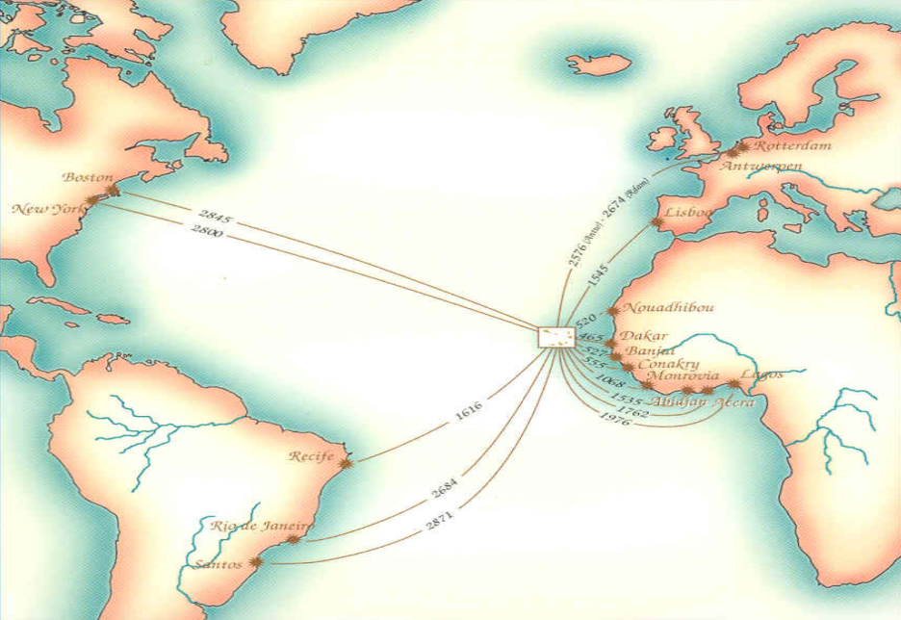

BUSINESS
ROUND
BRIDGE TO MARKETS
PRODUCTS AND SERVICES
SUSTAINABILITY
AND RESILIENCE
09 JUNE
________■________
2021
PRAIA
SANTIAGO ISLAND
CABO VERDE
WARRANTY AND
OPPORTUNITY
IMPORT
AND
EXPORT
FROM
CAPE VERDE
TO THE WORLD
PARTNERSHIPS
AND
COMMITMENTS
PROMOTE
AND
DISSEMINATE
Stability
Consolidation
Warranty
Transparency
Trust
INNOVATE
IN PRODUCTS
HOSPITALITY
AND ADDED VALUE
Competence
Efficiency
Excellence
INNOVATE
IN PROCESSES
DIGITAL
ECONOMY
Cabo Verde, the place where departure and destination converge.
Mobilize
Undertake
Expand
Growth
NETWORK
ECOWAS
Share
15 country
Synergy
Sustainability
Opportunity
Simplicity
A market with strong potential
Resilience
Pag 20

Slide 21
DEADLINES FOR EXPRESSION OF INTEREST AND REGISTRATION
Deadline for the expression of interest in participating in the business network
Deadline for registration to participate in the business round
2021
10 June
PRESENTATION OF OPPORTUNITIES IN ECOWAS
2020
01
August
2021
31
January
2021
30
April
2021
09
June
2021
10 AND 11
June
2021
11 June
ACCESS TO PREFERENTIAL MARKETS
Registration opens for expressions of interest and participation in the Forum
BUSINESS FORUM
BUSINESS ROUND
Pag 21

Slide 22
HOW TO PARTICIPATE
All interested parties are invited to participate to the Business Forum on the theme: «Business Opportunities and Business Partnerships in the ECOWAS Space».
To participate in the Forum you need to register in advance, which can be done in one of the following ways
  1. Online registration through the platform www.atlanticbusinessforum.com; or
  2. Submission of a duly completed registration form that can be downloaded from the said platform.
For registration purposes, all instructions included in both the Event Regulations and the registration form should be strictly followed.
09 - 11 JUNE
________■________
2021
PRAIA
SANTIAGO ISLAND
CABO VERDE
Pag 22

Slide 23

EVENTS AGENDA
INTERNATIONAL CONFERENCE |  |  |  |  |  | INTERNATIONAL CONFERENCE |  |  |  |  | ATLANTIC BUSINESS FORUM
07 to 09 JUNE 2021 |  |  |  |  |  | 09 JUNE 2021 |  |  |  |  | 09 - 11 JUNE 2021
Application of Basalt Powder in Agriculture and Basalt Fiber in Industry |  |  |  |  |  | Application of Basalt Powder in Agriculture and Basalt Fiber in Industry |  |  |  |  | 08:00 | - | 08:15 | ACCREDITATION OF BUSINESS ROUND
 |  |  |  |  |  |  |  |  |  |  | 08:15 | - | 12:30 | BUSINESS ROUND
07 June 2021 |  |  |  |  |  | 09 June 2021 |  |  |  |  | 12:30 | - | 14:00 | LUNCH
ACCREDITATION::From 7:00 |  |  |  |  |  | ACCREDITATION::From 7:00 |  |  |  |  | 14:00 | - | 15:30 | BUSINESS ROUND
08:00 | - |  | 08:30 | Opening Ceremony |  | 08:30 | - | 10:15 | Conference VI |  | 15:30 | - | 18:00 | Panel I: «BRAZIL: The Potential and the Opportunity of Technical and Entrepreneurial Cooperation»
08:30 | - |  | 10:15 | Conference I: |  | 10:15 | - | 10:45 | Coffee Break |  | 10 JUNE 2021
10:15 | - |  | 10:45 | Coffee Break |  | 10:45 | - | 12:30 | Conference VII |  | ACCREDITATION::From 7:00
10:45 | - |  | 12:30 | Conference II: |  | 12:30 | - | 14:00 | Lunch |  | 08:00 | - | 08:30 | Opening Ceremony
12:30 | - |  | 14:00 | Lunch |  | 14:00 | - | 16:00 | Panel IV |  | 08:30 | - | 10:30 | Presentation of Opportunities in ECOWAS
14:00 | - |  | 15:45 | Conference III: |  |  |  |  |  |  | 10:30 | - | 11:00 | Coffee Break
15:45 | - |  | 16:15 | Coffee Break |  |  |  |  |  |  | 11:00 | - | 13:00 | Presentation of Opportunities in ECOWAS
16:15 | - |  | 18:00 | Conference IV: |  |  |  |  |  |  | 13:00 | - | 14:30 | Lunch
 |  |  |  |  |  |  |  |  |  |  | 14:30 | - | 16:30 | Presentation of Opportunities in ECOWAS
20:00 | - |  | 22:30 | Welcome Reception |  | 16:00 | - | 16:30 | Closing Session |  | 16:30 | - | 17:00 | Coffee Break
 |  |  |  |  |  |  |  |  |  |  | 17:00 | - | 18:30 | Conference I - ACCESS TO THE ECOWAS PREFERENTIAL MARKET
08 June 2021 |  |  |  |  |  | 20:30 | - | 23:00 | Welcome Dinner «THE FLAVORS OF ECOWAS» |  | >18:30 | - | Free time
ACCREDITATION: from 7:00 |  |  |  |  |  |  |  |  |  |  | 11 JUNE 2021
08:30 |  | - | 10:15 | Panel I: |  |  |  |  |  |  | ACCRÉDITATION: à partir de 7:00
10:15 |  | - | 10:45 | Coffee Break |  |  |  |  |  |  | 08:00 | - | 10:00 | Panel II - PRIVATE SECTOR FINANCING IN ECOWAS
10:45 |  | - | 12:30 | Panel II: |  |  |  |  |  |  | 10:00 | - | 10:30 | Coffee Break
12:30 |  | - | 14:00 | Lunch |  |  |  |  |  |  | 10:30 | - | 12:30 | Panel III - THE DEVELOPMENT OF THE DIGITAL ECONOMY IN AFRICA
14:00 |  | - | 15:45 | Panel III: |  |  |  |  |  |  | 12:30 | - | 14:00 | Lunch
15:45 |  | - | 16:15 | Coffee Break |  |  |  |  |  |  | 14:00 | - | 16:00 | Conference II - ACCESS TO THE PREFERENTIAL UNITED STATES MARKET
16:15 |  | - | 18:00 | Conference V: |  |  |  |  |  |  | 16:00 | - | 16:30 | Coffee Break
 |  |  |  |  |  |  |  |  |  |  | 16:30 | - | 18:30 | Conference III -ACCESS TO THE PREFERENTIAL EUROPEAN UNION MARKET
 |  |  |  |  |  |  |  |  |  |  | 18:30 | - | 19:00 | Closing Session of the Business Forum
>18:30 |  | - | Temps libre |  |  |  |  |  |  |  | 20:30 | - | 23:00 | GALA DINNER
Pag 23

Slide 24
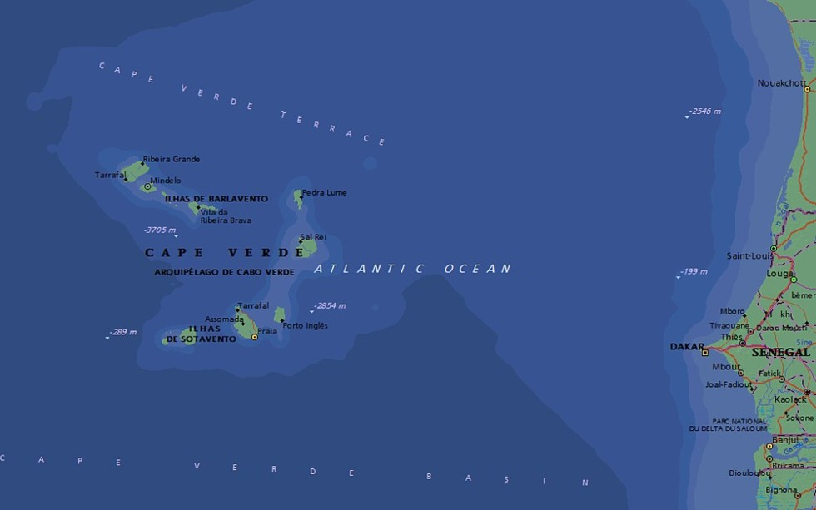
09-11 JUNE
________■________
2021
PRAIA
SANTIAGO ISLAND
CABO VERDE
36 hours by sea
40 hours by sea
SEA TRAVEL TIME
BETWEEN CAPE VERDE
AND
THE AFRICAN CONTINENT
Pag 24

Slide 25
09-11 JUNE
________■________
2021
PRAIA
SANTIAGO ISLAND
CABO VERDE
CONTACTS
BUSINESS FORUM
WhatsApp:+351 964 406 800
Viber:+351 964 406 800
Skype: setimocontinente
info@atlanticbusinessforum.com
www.atlanticbusinessforum.com
Pag 25

